Slide 1


FAST TRACK FACTORY
Using the Engineering Design Process to Improve Efficiency in Mass Production

Slide 2
Objectives:
Students will be able to:
Analyze and simulate a mass production system to identify inefficiencies related to cost and time, using hands-on activities that reflect real-world manufacturing challenges.
Apply the engineering design process by planning, designing, testing, and refining modifications to improve assembly line performance, supported by data and performance comparisons.
Demonstrate collaboration, problem-solving, and communication skills by working in teams to develop a final presentation that outlines their design decisions, test results, and a recommended implementation plan.

Slide 3
Phase 1 Research
(Research - Ask - Imagine)
Analyze a mass production system to identify inefficiencies related to cost and time, using hands-on activities that reflect real-world manufacturing challenges.

Slide 4

"Fast Track Factory: Using the Engineering Design Process to Improve Mass Production Efficiency"
The auto industry is booming, but our manufacturing company
has hit a speed bump. Our cars are selling fast, but behind the scenes,
it’s costing too much time and money to keep up.
That’s where you come in!
As elite “efficiency experts”, you've been contracted to solve a real-world challenge: take three popular vehicle models and rework the mass production system to make it faster, leaner, and more profitable — all while following strict safety and efficiency laws.

Slide 5

When making cars using craft production, each engineer designs and builds a product individually.
But our company strives to make hundreds, thousands, or even millions of cars, so we don’t have one person build an entire car from scratch. Instead, we follow a mass production approach using an assembly line.
One person might be responsible for installing the engine, another for the doors, and another for the tires.
By working together in a system, cars can be
made faster, more efficiently, and at a lower cost.

Slide 6

Pay close attention because this behind-the-scenes look also provides details about
how the engineering design process
drives the world of manufacturing.

Slide 7
Common Engineering Roles in Manufacturing
There are many engineers in manufacturing, but here are a few to think about:
A design engineer designs and often makes plans to improve systems and products based on available materials and requirements.
A sourcing engineer is responsible for finding and purchasing product components and making sure they will meet the needs of the product.
A manufacturing engineer is often responsible for building the process of constructing the product and making sure it goes as efficiently as possible.
A quality engineer is responsible for making sure the product is designed and built to meet all requirements.

Slide 8
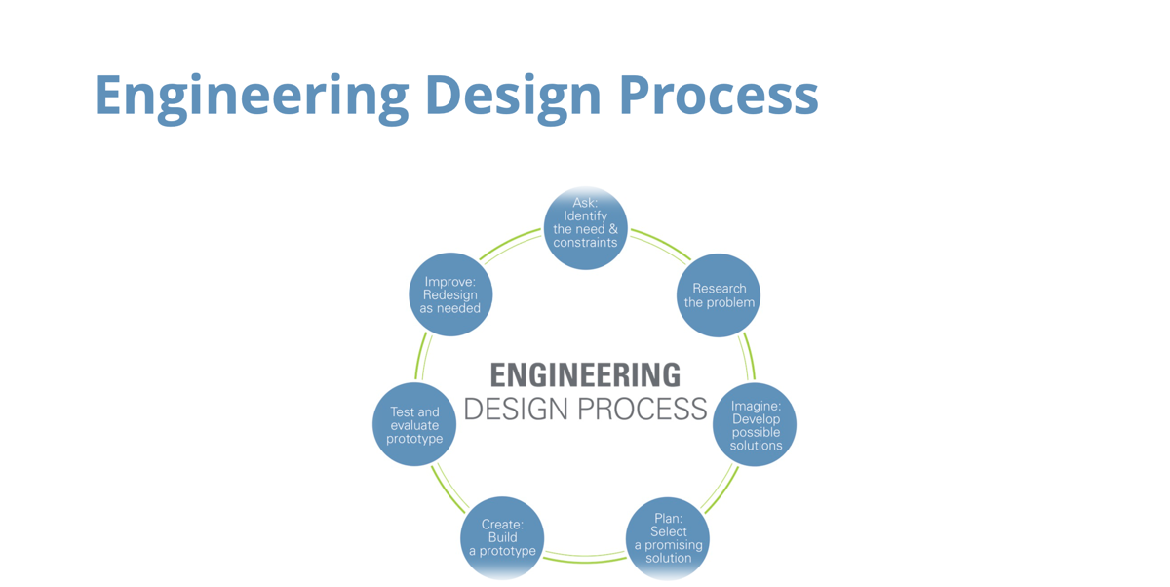

Slide 9

Experience Our Design
You are a team of efficiency experts, and your fresh perspective is just what our company needs!
We hired you for your reputation as excellent problem-solvers for a variety of companies, and we’ve heard from your previous clients that you had the most success when you were able to dive into the current system first.
Let's take a moment to walk you through our three vehicle designs, the coupe, sedan, and van.

Slide 10
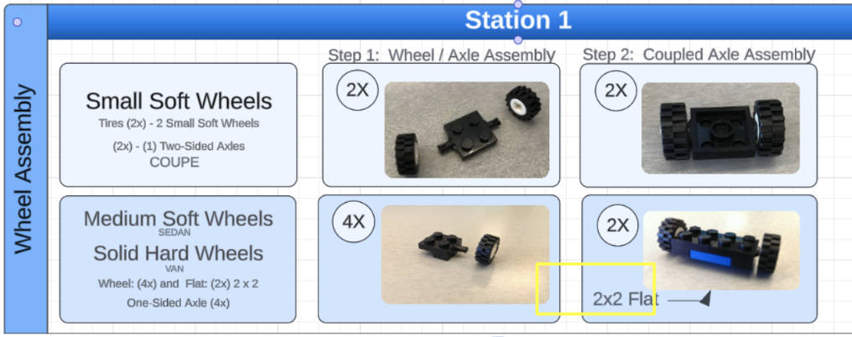
Experience our Design Graphic Assembly Guide
Your team now has access to the Fast Track Factory: Graphic Assembly Guide.
Use it to take a close look at how each of our three vehicles—coupe, sedan, and van—are currently being built. This guide will give you the inside scoop on the steps, parts, and time involved in producing each model.

Slide 11

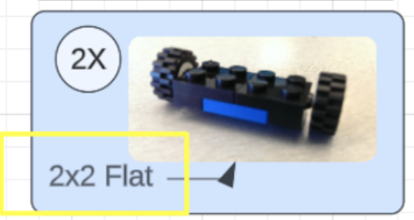
Practice construction for the coupe, sedan and van
Using plastic building bricks & the assembly guide, please build each of the three vehicle models—coupe, sedan, and van.
Ask questions.
Take notes.
How are parts fitting together?
What works well?
What could be better?

Slide 12
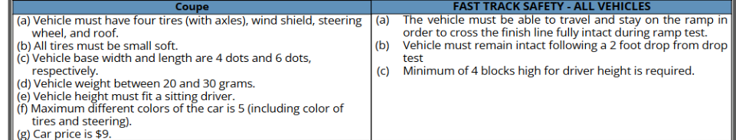

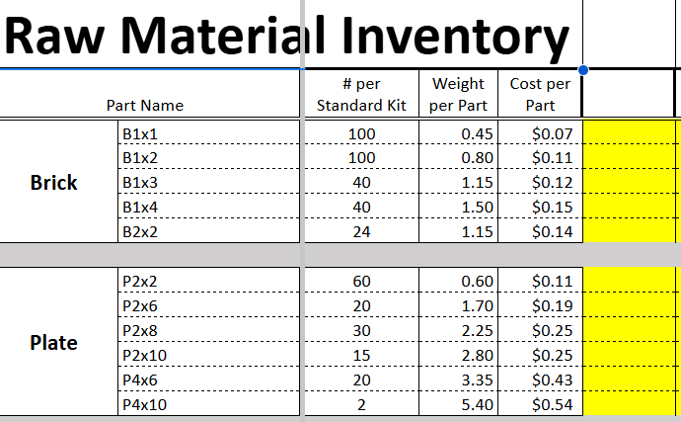
Our Coupe, Sedan & Van
Use this as a guide for specific details
What suggestions do you have for design changes we should make to each model?
Revised models must meet safety and efficiency standards required by law.
The raw material parts must also cost less than the sales price. Our marketing team has provided us with the highest prices customers are willing to pay.
Weight & Cost Sheet
Notes:
Safety and Efficiency Guidelines and Spreadsheet. (Tip: If students have added up correctly, totals should match slide 33)

Slide 13
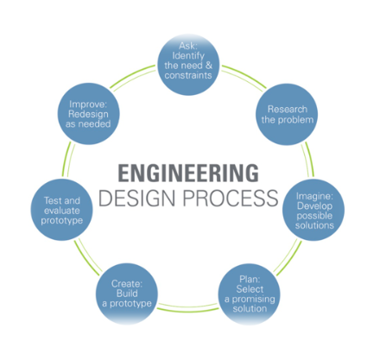
Time for Your Expert Opinions!
Discuss with your fellow experts changes that you believe should be made using the resources provided.
Please open a blank document and record your proposed revisions to our current vehicle models using the two resources provided for greater efficiency and cost effectiveness.
Please include pictures with your documentation throughout the activities.
Which steps of the engineering design process are being used most effectively during today’s activity, and reflect how the steps of the EDP help to guide your team to improve your team’s final vehicle designs?

Slide 14
Phase 2
Physical Simulations
(Plan - Create - Test - Improve)
Apply the engineering design process by proposing, testing, and refining modifications to improve assembly line performance, supported by data and performance comparisons.

Slide 15

Thank you so much for the expertise you’ve offered
for our vehicle design process!
Now we would like to show you how we bring our vehicle designs to life through our assembly line process using the engineering design process.
As you get hands-on experience with our system, please keep in mind we want you to make suggestions for improvement, so don’t hesitate to speak up. It’s why we brought you on board!
Notes:
The teacher may give a copy of the Engineering Design Process Handout to each team. A poster is also available through TeachEngineering.

Slide 16



Designate Engineering Roles for Your Team
Please designate within your group who will take on each of the roles that are currently required to make our assembly line work.
Sourcing Engineer(s) (Suppliers) - Gathers the parts required for each assembly station, makes sure each station remains fully stocked, and puts recycled building materials back into the supply area.
Manufacturing Engineers (Builders) - Constructs each portion of the car, according to the graphic assembly guide instructions.
Quality Engineer(s) (Testers) - Verifies that each vehicle is built correctly, according to the provided specifications and passes the ramp and drop tests.

Slide 17
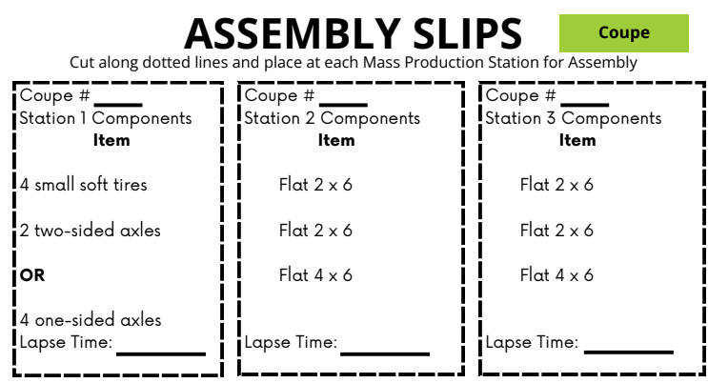
Round 1: Setting the Stage for the “Initial” Simulation
Your team will use Pages 1–3 of the Assembly Specification Slips.
Cut along the dotted lines and use the slips to load the correct parts into the supply bins at each station. Be sure to prepare enough materials to build at least two cars. Place slips at your station.
The Quality Testing Slips can be found at the bottom of Pages 1–3. Place at the Quality Station.
Time to Help Set up The Line!
All Hands On Deck!
Notes:
Allow time to gather parts. They should have roles assigned and know exactly what supplies they will need from the Assembly Slips and Station #.

Slide 18
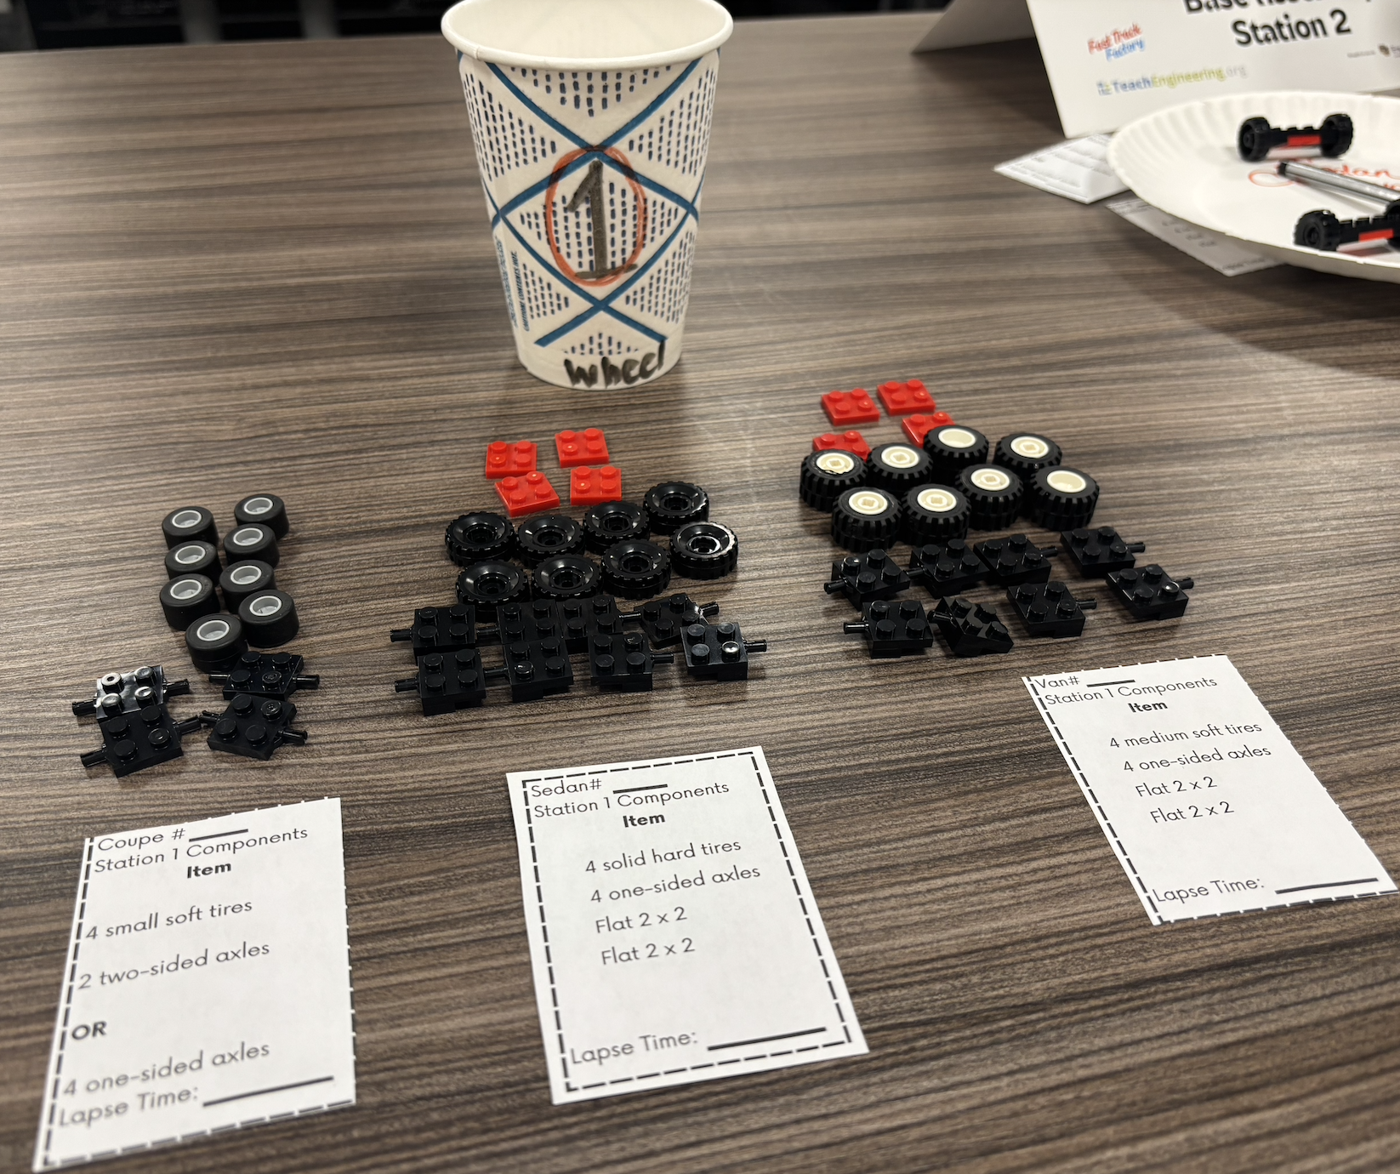

Round 1: Setting the Stage for the “Initial” Simulation
Each engineer will take the assembly slips for their station and gather enough parts for TWO of each model.
Label cup with station number.
Pick up a stopwatch.
Add the Station Activity Place Card (if applicable) at the correct station.
Example of the
Wheel Assembly
or
Station 1

Slide 19
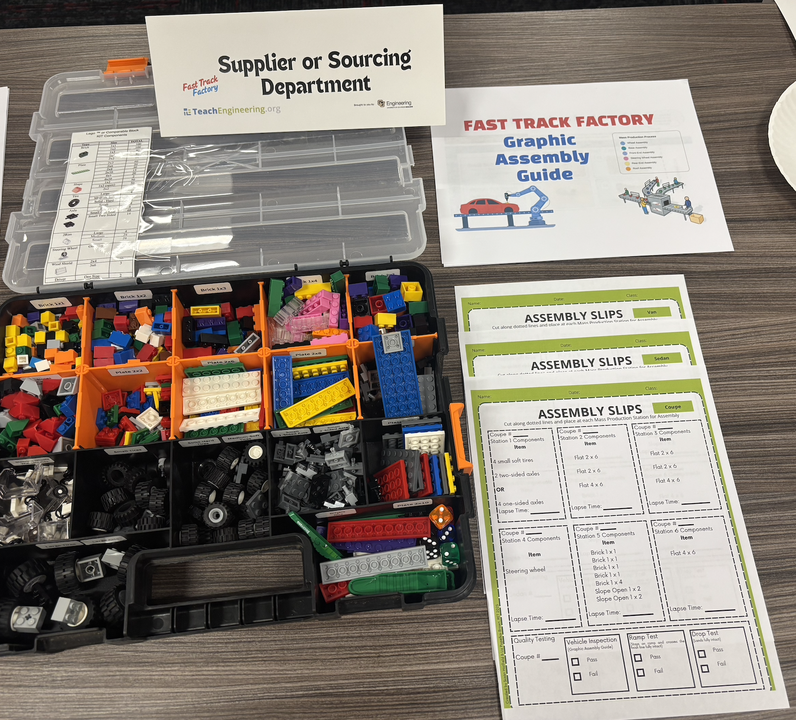
Round 1: Setting the Stage for the “Initial” Simulation
Sourcing Engineer(s)
Verify your station has the plastic brick supply kit.
Have a copy of the Graphic Assembly Guide.
Have a full copy of the Assembly Specification Slips for each car model (coupe, sedan & van) (1 full set of Pages 1-3).

Slide 20
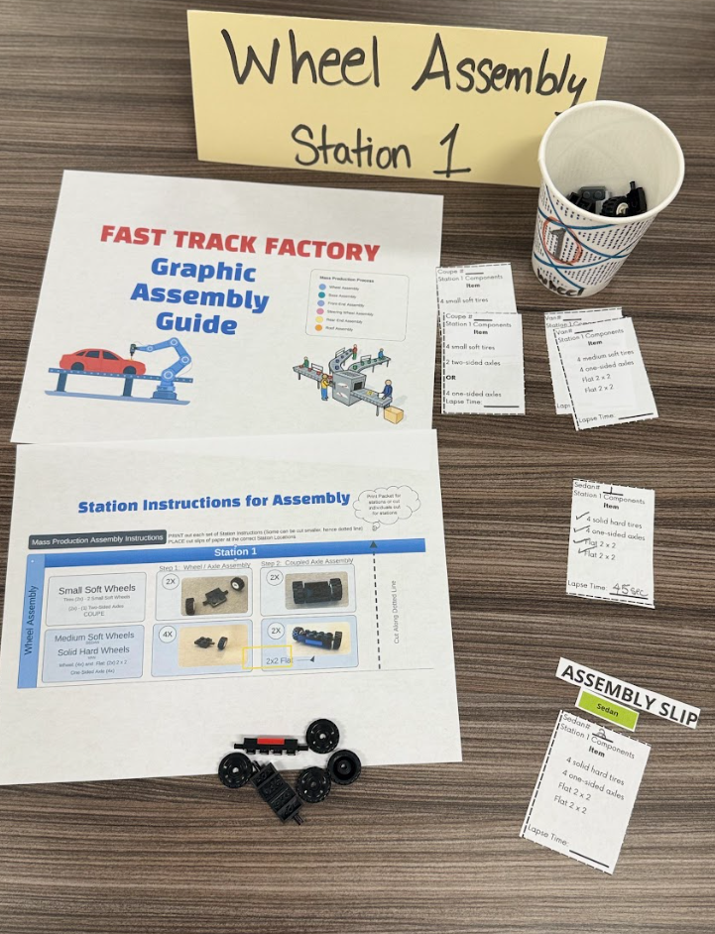
Round 1: Setting the Stage for the “Initial” Simulation
Builders/Manufacturing Engineers
Verify your stations have the necessary parts of the Graphic Assembly Guide.
Have a stack of Assembly Slips for your stations.
Have the correct supply bins loaded with the correct materials for each car model.

Slide 21
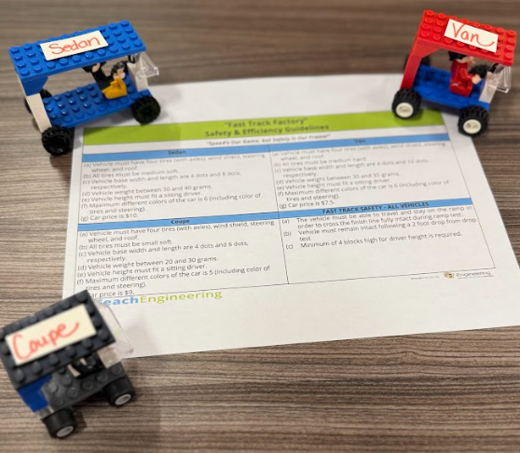
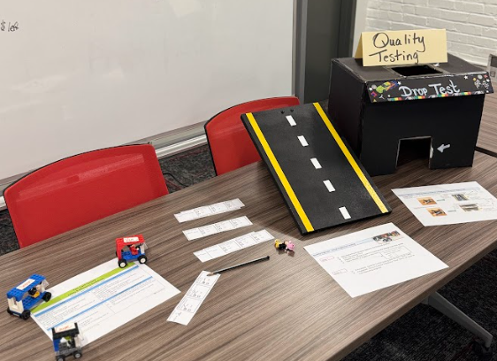
Round 1: Setting the Stage for the “Initial” Simulation
Quality Engineer
Verify you have a copy of the Graphic Assembly Guide for your station.
Use the Team’s Safety & Efficiency Guidelines with prototypes to check off initial inspection.
Set up ramp and drop testing equipment.
Have a stack of Quality Testing Slips (located at the bottom of Pages 1-3 from the Assembly Slips).

Slide 22

The assembly line starts with a manufacturing engineer
The manufacturing engineer/builder 1 will:
Confirm with the line that they will build 2 coupes, followed by 2 sedans, 2 vans, 2 coupes, and so forth…
Start a stopwatch.
Announce the start of production.
Move to building station 1 (could also already be at station 1).

Slide 23
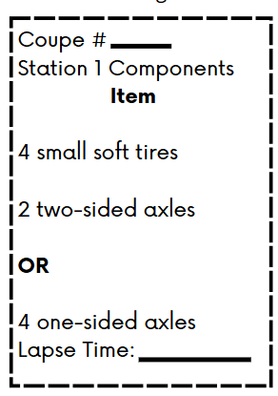
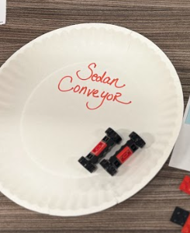
Building Stations
Each manufacturing engineer (builder) will:
Start a stopwatch.
Fill in the vehicle number on the Assembly Specification Slip.
Build their part of the car.
Pass on the partially constructed vehicle to the next station (on a paper plate tray or “conveyor”).
Stop the stopwatch and fill in the lapse time on the Assembly Specification Slip.
Flip over completed Assembly Specification slip, revealing a blank copy to repeat the process.
Reset stopwatch or hit “lap,” and begin again for the next car.
Paper Plate = Conveyor

Slide 24
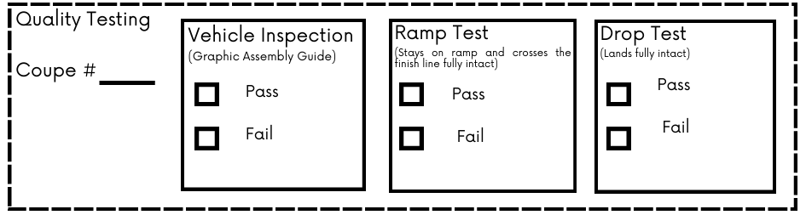
Quality Engineer/Tester Instructions
Pay attention to the testing forms. Coupe - Sedan or Van. Make sure you match up correctly.
When the last builder finishes, they will hand the completed vehicle to the quality engineer (tester).
The quality engineer will use the Safety & Efficiency Guideline Sheet & Graphic Assembly Guide (If necessary) to do the first initial test to check to make sure model is accurately built.
Compare the vehicle to the prototype for the correct model.
  If it does not match, mark “Fail” on the order form and return it to the builder.
  If it does match, mark “Pass” on the order form and continue testing.
Run two tests: (check pass or fail)
  Ramp Test: Does the car roll from top to bottom in one piece?
  Drop Test: Can the car survive a gentle drop without breaking?
Record all results. Flip over the Assembly Specification Slip and repeat process with next car.

Slide 25
Sourcing Engineer Again
A sourcing engineer will pick up the tested vehicle, take it apart, and return all the components to the supply area.
The manufacturing engineers (builders) need to make sure they’re stocked with building materials. When they realize they are in need of more, they should call out to the sourcing engineer or supplier and ask for the parts they require.
The sourcing engineer should use the previously completed Assembly Specification Slips as a quick reference to retrieve the required materials from the supply area.

Slide 26
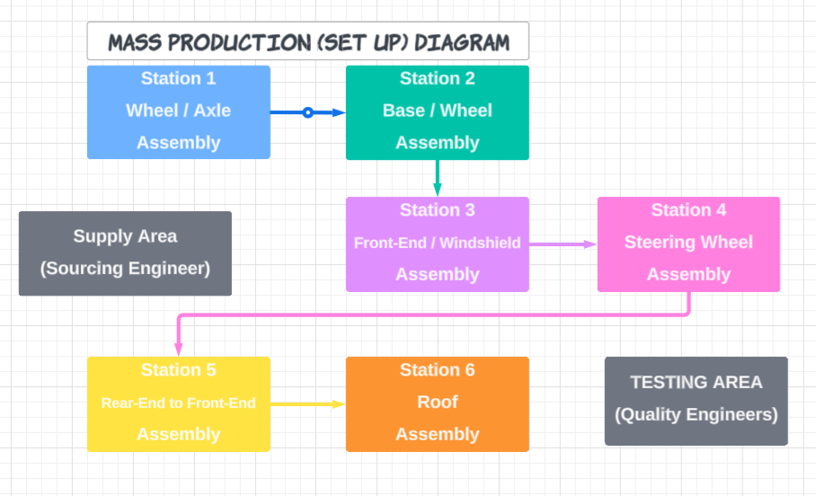

Let’s Get to Work! Round 1 Simulation!
Please take some time to experience our current design by doing a test run of our assembly line.
Remember, we brought you here for your feedback, and every detail you provide matters, so observe closely and share your insights!
Make notes:
What works well?
What could be better?

Slide 27
Time for Your Expert Opinions - Efficiency and Profit
Thank you for giving us your initial thoughts!
To enhance your analysis with hard data, we’ve provided you with a copy of the Mass Production Efficiency Data Spreadsheet we use to calculate the production times and profit of our existing system.

Slide 28
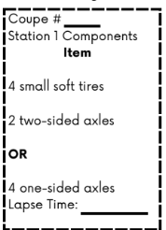
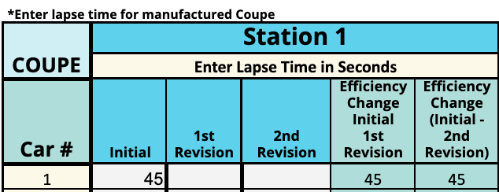
Time for Your Expert Opinions - Efficiency and Profit
Please use the times you have recorded in each assembly slip …
…to fill in the building time required at each station.
1
45
goes here
this
Notes:
Teacher Tip: Use a copy as a Google Sheet so students can simultaneously work as a team entering data into the software. Teacher Tip #2: The video at https://www.youtube.com/watch?si=0SRVJ2rBnB97eC7W&v=6Tgzf0j6fuY&feature=youtu.be shows where to enter data, as well.

Slide 29
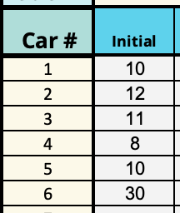
Time for Your Expert Opinions - Efficiency and Profit
Since this is the first testing round, you should only have data in the column under Initial for each station.

Slide 30
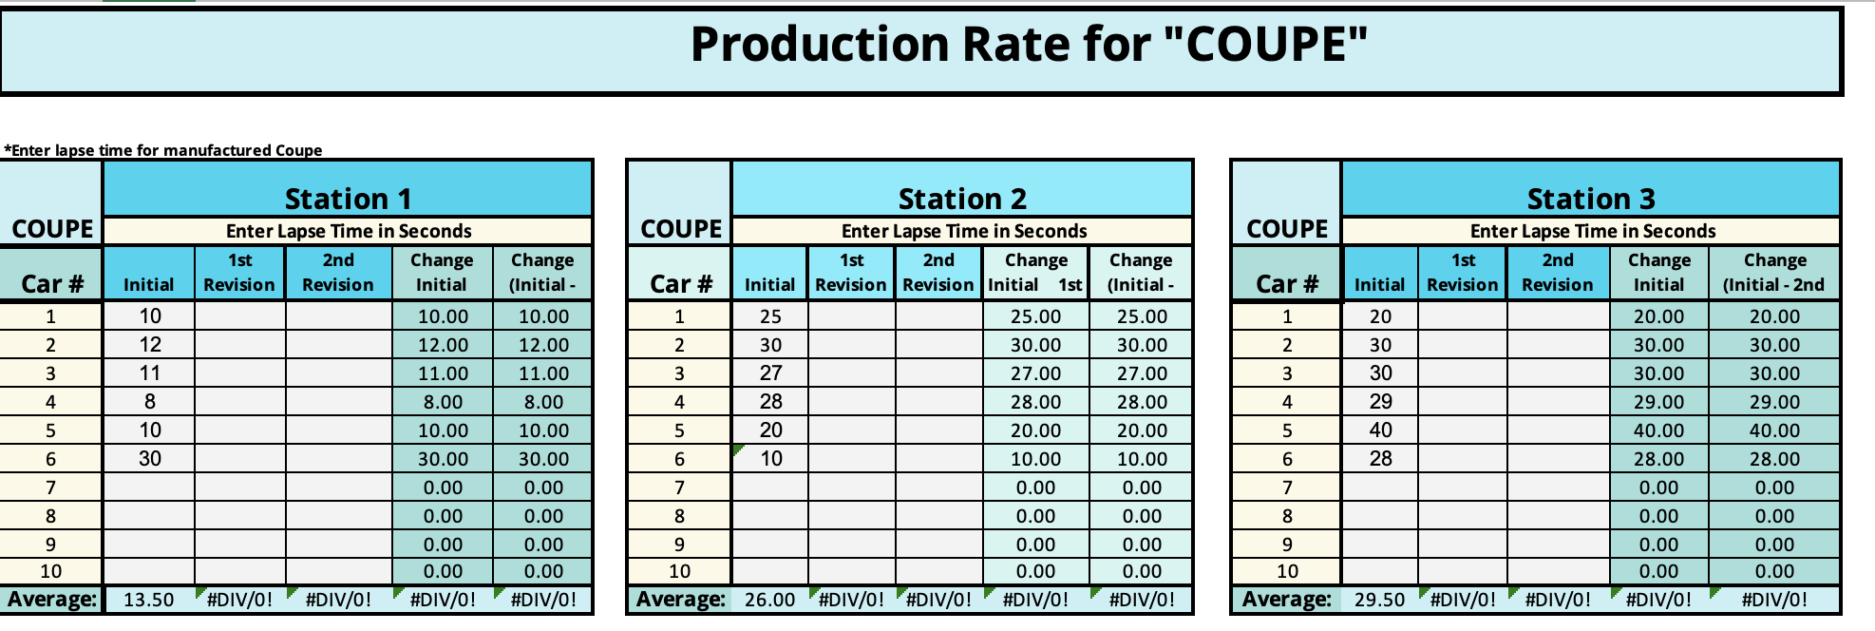
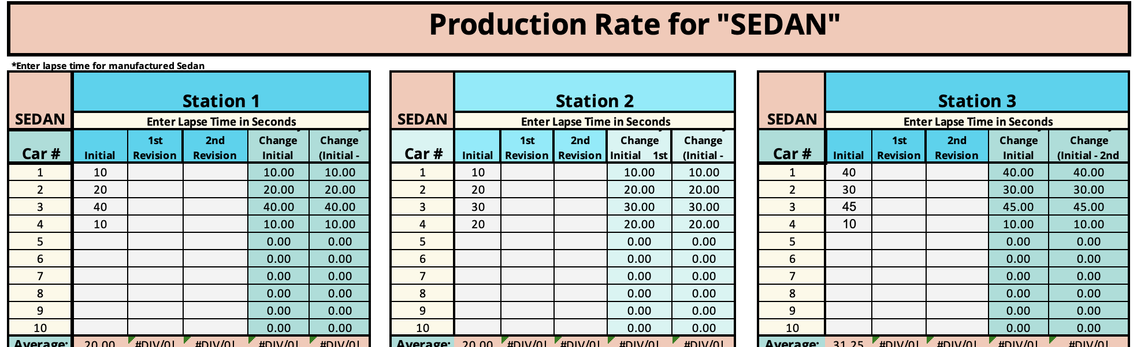
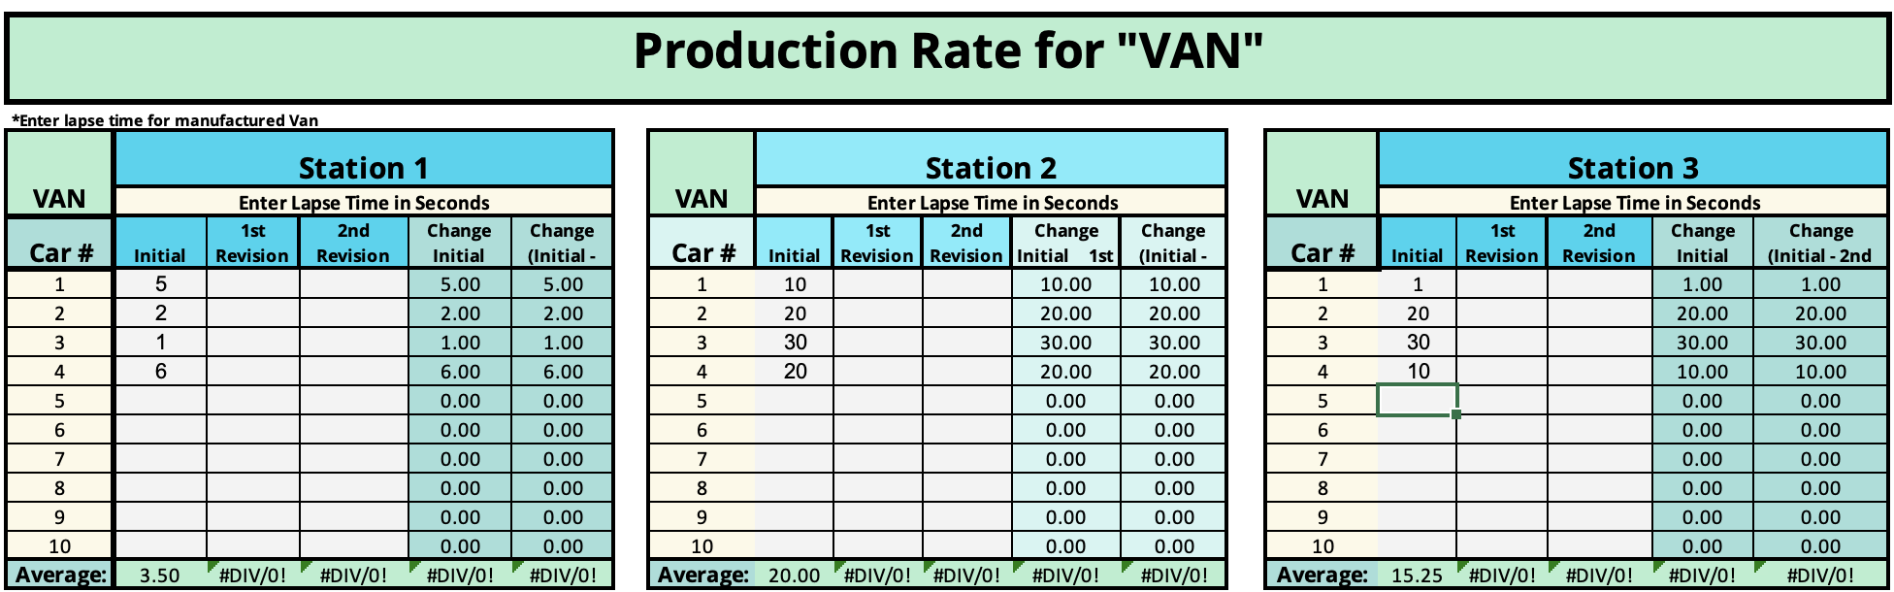
Time for Your Expert Opinions - Efficiency and Profit
Fill in the time at each building station for the initial test run for each car model, the coupe, sedan, and van.
Each is on a separate tab of the spreadsheet.
There are cells in each column for 10 cars, but you will likely not use them all.
Enter data in gray areas only.

Slide 31
Time for Your Expert Opinions - Efficiency and Profit
Only enter data in the gray cells.
The other colored cells contain important formulas that will help with the analysis that you don’t want to change.

Slide 32

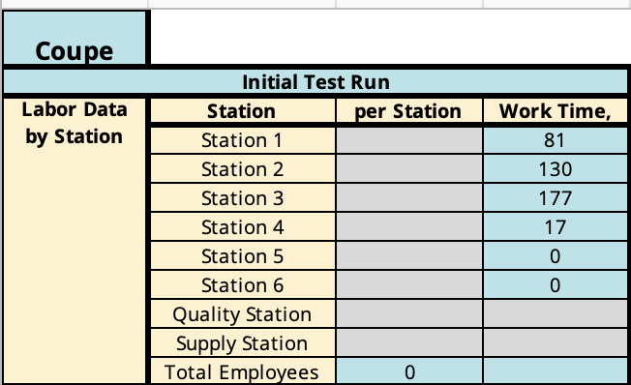
Time for Your Expert Opinions - Efficiency and Profit
Also, please fill in the number of employees working at each station on the
tab of the
spreadsheet.
The quality and supply station
employee work times should be
the entire length of the test run,
in seconds.

Slide 33
Enter Costs and Sale Price for Each Model
Raw Material Cost per Car (bricks)
Coupe (tires with 2 2-sided axles): $4.08
Coupe (tires with 4 1-sided axles): $4.50
Sedan: $5.40
Van: $6.29
Sales Price:
Coupe: $9.00
Sedan: $10.00
Van: $7.50
Notes:
Raw Material Cost for Current Manufacturing System

Slide 34
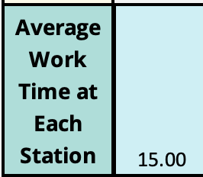
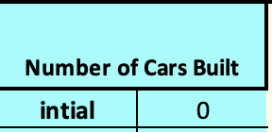


Data You Could Consider:
What was the average building time at each station?
How many total cars were built?
What was the total cost per car? Total Profit per Car Model?

Slide 35
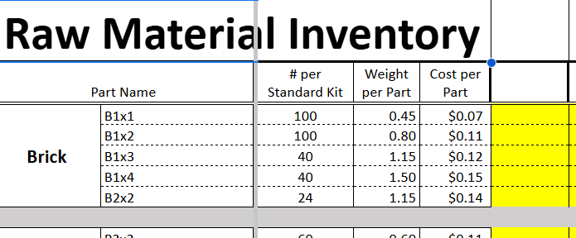
Time for Your Expert Opinions!
What do you like about the assembly line?
What changes might you suggest we try
(examples: layout, personnel locations, order
of the vehicle types, etc.) ?
Please open your previous document and record your
thoughts and proposals. Don’t forget pictures/diagrams!
Now that you’ve implemented the assembly line, you MIGHT see a need to revise the car design. If you do, please use our editable Mass Production Weight / Cost Spreadsheet to assure your weight falls into the required safety guidelines and to obtain the total cost of parts for your redesigned vehicle.
Notes:
See Teacher Notes in Instructional Lesson Plan for more specific (detailed) guiding questions.

Slide 36

Round 2 (1st Revision): Redesign for Speed and Profit
Now that you've experienced the original production run, it's time to improve the system!
Your Mission:
Run the Fast Track Factory simulation again, but this time:
Your team will REVISE the manufacturing process to make it more efficient and profitable.

Slide 37
Simulation Round 2 Instructions
Use the engineering design process to make informed, strategic changes.
Review the Data
Look at your build times, test results, and material use from Round 1 (current system). Where did time or materials get wasted?
Revise the Process
As a team, make strategic changes. You can:
Simplify vehicle designs while staying within the original constraints.
Reduce cost.
Reassign roles or tweak your build order for speed.

Slide 38
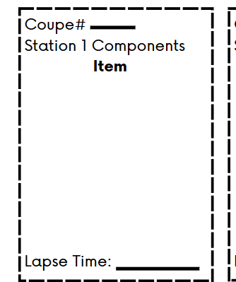

Simulation Round 2 Instructions
Use the engineering design process to make informed, strategic changes.
Open a blank document and create your own revised copy of the Graphic Assembly guide, with pictures.
Update Assembly Specification Slips (Pages 4-6 provide blank or editable templates for your team).
Reflect your changes clearly so your team can follow the new process during the next simulation.
Notes:
More details to add to Slide 37 with explanation to use the blank assembly slips. Allow 15 minutes+ to work on their revisions.

Slide 39

Round 2: 1st Revision of the Assembly Line
(Your Station Setup & Simulation)
Time to test out your “efficiency” in the production process your team created.
Be ready to make some important notes.

Slide 40
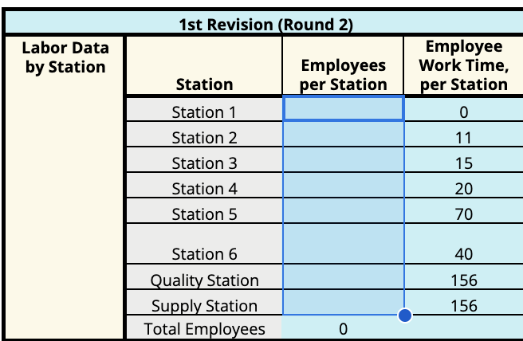
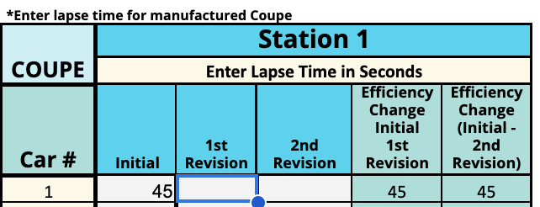
End of 1st Revision Testing - Recording Results
Please open the Mass Production Efficiency spreadsheet
we use used earlier and record the data from your
slips/this testing round.
here
here
Notes:
Remind students how to enter the new 1st revision data to the spreadsheet.

Slide 41

Post Mass Simulation Reflections
Did your new process improve build time? By how much?
How did your material usage change in Round 2? (Did you use fewer plastic bricks? Did the new design require less?)
Was your final product still successful in the quality tests?
What trade-offs did you encounter?

Slide 42
Post Mass Simulation Reflections
How did your team's collaboration and communication change between rounds?
Did your revised plan result in higher profit or efficiency overall? Explain.
If you had one more round, what would you change next? Why?
How does this process reflect the real-world engineering design process?
What lesson from this simulation can apply to real manufacturing or engineering careers?
Notes:
Allow students time to document revisions and enter data as well as reflect.

Slide 43

Round 3: 2nd Revision of the Assembly Line
(Your Station Setup & Simulation)
Now it’s time to level up!
Take everything you’ve learned and revise your Fast Track Factory system one more time to make it even faster, leaner, and more efficient—can your team outdo your last run?
Let’s find out!
Notes:
Another revision opportunity.

Slide 44
Phase 3
(Evaluate - Improve)
Demonstrate collaboration, problem-solving, and communication skills by working in teams to develop a final report that outlines design decisions, test results, and a potential implementation plan.

Slide 45

Get Ready for the “Fast Track Huddle”
Time to put your thinking caps (hard hats) on!
Use your data sheets to spot traffic jams in our production, shift gears with smart solutions, and steer the company toward success using the engineering design process.
You will need to:
Spot those bottlenecks.
Brainstorm brilliant fixes.
Compare and contrast your data from the 1st simulation to the final revision simulation(s).
Time to impress the company executives!
You've got this, “Efficiency Experts!”
Our Company Meeting with Executives
"Where efficiency meets innovation!"
Notes:
Transition to the Analysis Presentation Phase of the Lesson.

Slide 46
Open Your Mass Production Efficiency Data Spreadsheet
Analyze your data
What specific problems or bottlenecks did you encounter during initial production?
How could simplifying the vehicle design improve production efficiency?
How might rearranging the assembly line layout increase productivity?
What changes in personnel roles or tasks could lead to faster and more accurate assembly?
How might your proposed revisions impact overall profitability?
Notes:
Helping to propose to students specific reflection questions that address their simulation experience.

Slide 47
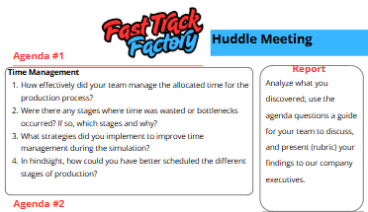
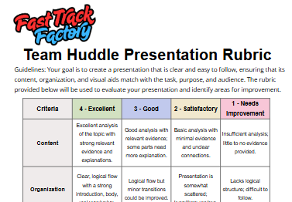
Let’s Analyze Our Performance!
Use the Fast Track Huddle Meeting Handout to guide your team on
Notes:
Provide copies of the Fast Track Huddle Meeting Handout and Presentation Rubric to instruct them they will prepare a presentation to outline their improvements. Final recommendations to the company’s executives.

Slide 48
Thank You “Efficiency Experts!”
Ready for Presentations!
Thank you! Our company executives are ready to listen to your findings. You will have 7 minutes to present to our team.

