Slide 1
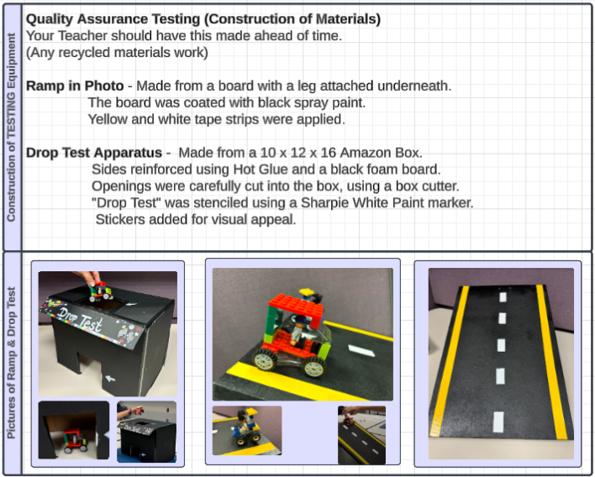
Teacher Slide Only
(Slide is hidden)
Teacher’s Quality Testing Equipment
Notes:
Instructions on how the RET teachers developed the Quality Testing Equipment.
Any questions, contact: Susan Hatfield, Susan.hatfield@hardin.kyschools.us and Liz Popelka-Brown Elizabeth.popelka@jefferson.kyschools.us.

