Slide 1
Exploring States of Matter - Sorting Simulations – Answer Key

Slide 2
Answers to simulations

Slide 3
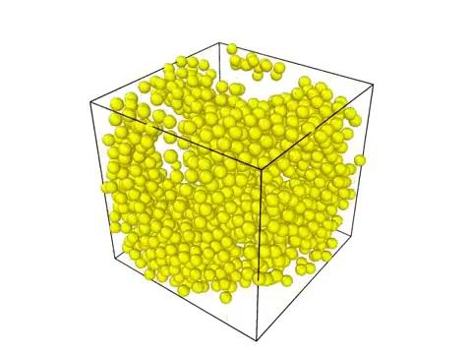
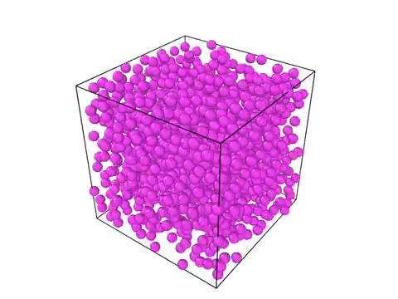
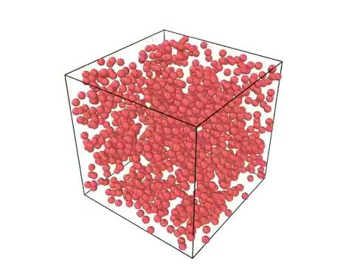
Computer simulations matching state of matter.
Solid
Liquid
Gas

Slide 4
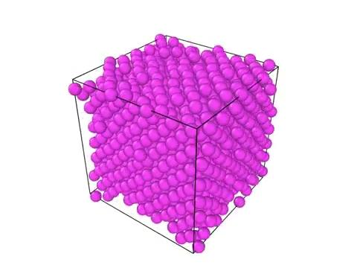
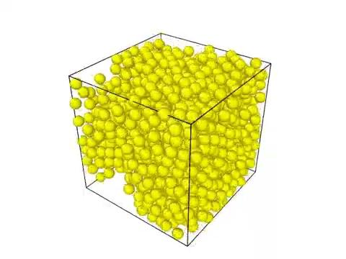
Computer simulations matching state of matter.
Solid
Liquid
Gas

Slide 5
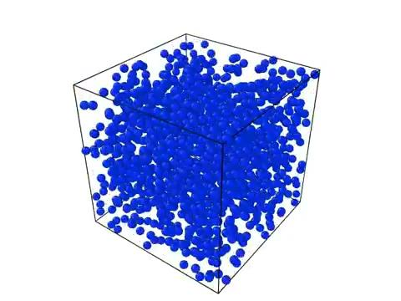
Computer simulations matching state of matter.
Solid
Liquid
Gas

Slide 6
All the Simulations

Slide 7
