Slide 1
Exploring States of Matter - Sorting Simulations

Slide 2
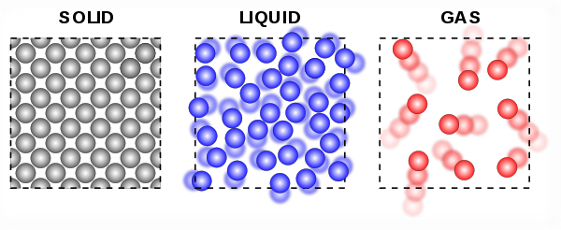
Sorting Simulations!

Slide 3
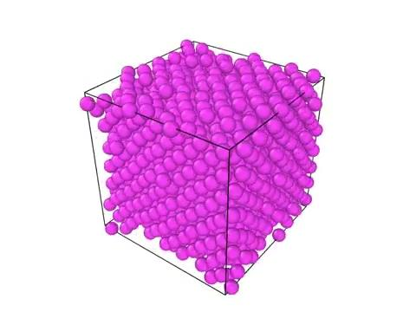
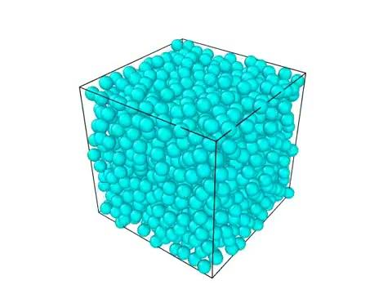
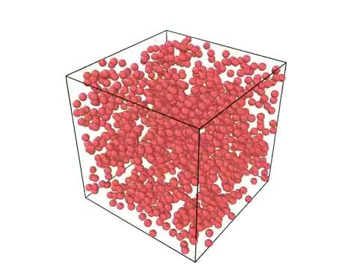
Identify which state of matter this is by the movement of the particles.
Here are some examples:
Solid
Liquid
Gas

Slide 4
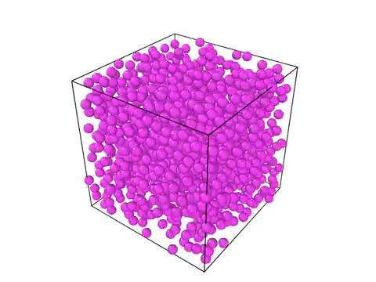
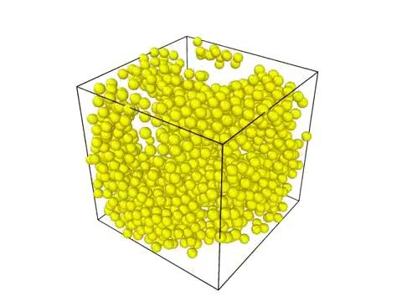
Move the computer simulations to the proper state of matter.
Solid
Liquid
Gas

Slide 5
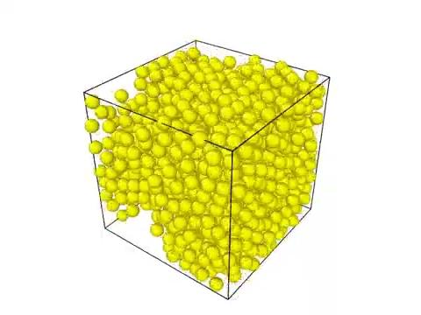
Move the computer simulations to the proper state of matter.
Solid
Liquid
Gas

Slide 6
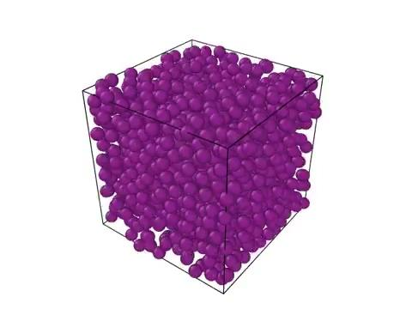
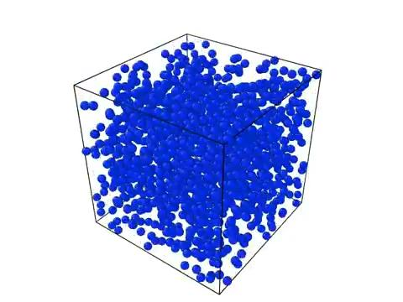
Move the computer simulations to the proper state of matter.
Solid
Liquid
Gas

Slide 7
Answers to simulations

Slide 8
Computer simulations matching state of matter.
Solid
Liquid
Gas

Slide 9
Computer simulations matching state of matter.
Solid
Liquid
Gas

Slide 10
Computer simulations matching state of matter.
Solid
Liquid
Gas

Slide 11
All the Simulations

Slide 12
