Slide 1
Gel Engineering Journey

Slide 2
Gel Engineering Journal Table of Contents
What is Engineering? | Slide 3
Ask | Slide 6
Research | Slide 8
Imagine | Slide 9
Plan | Slide 10
Create | Slide 13
Test | Slide 16
Improve | Slide 19
#6091ba
#9fcc3b

Slide 3
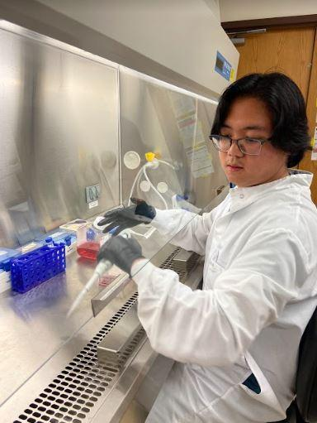
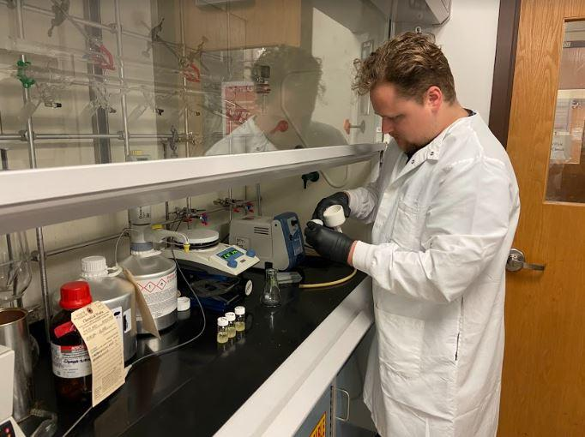
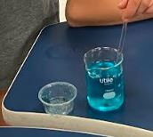
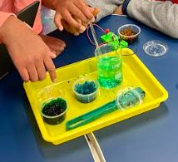
What is Engineering? Engineers design and improve bridges, roads, vehicles, computers; they design and improve food products, materials, medical devices…anything that is needed to make the world a better place.

Slide 4
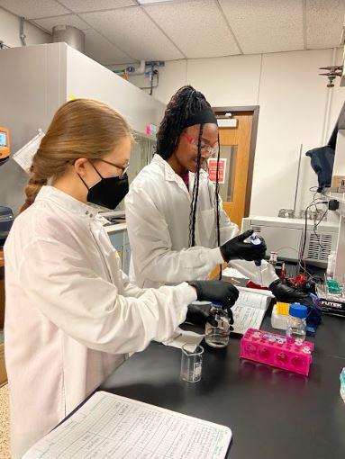
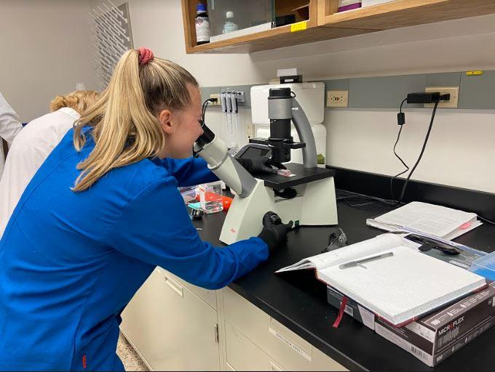
Who Becomes an Engineer?
Anyone who likes to solve problems and explore! These are chemical engineering graduate students at UT Austin. They are designing and testing gels for biomedical research.

Slide 5
How Does Engineering Happen?
1. Ask
2. Research
7. Improve
The Engineering Process
#9fcc3b
3. Imagine
6. Test
5. Create
4. Plan

Slide 6
Ask
What physical properties do these gels have in common?

Slide 7
Ask
Are these gels mixtures or solutions?
Why do you think so?
Do these gels fit the criteria for one of the three states of matter?
Why or why not?
What is your definition of a gel?

Slide 8
Research
What are gels used for in real life?
1.
2.
3.
4.
5.

Slide 9
Imagine
What else could a gel possibly be made to do?
Brainstorm your answers here, and remember: any idea is welcome, no matter how wild!

Slide 10
Plan for Gel #1
Gel color:
Physical property for gel to exhibit:
Materials needed:
Design procedure:

Slide 11
Plan for Gel #2
Gel color:
Physical property for gel to exhibit:
Materials needed:
Design procedure:

Slide 12
Plan for Gel #3
Gel color:
Physical property for gel to exhibit:
Materials needed:
Design procedure:

Slide 13
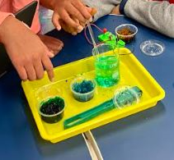
Create Gel #1
Observations of the process
I observed…

Slide 14
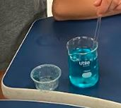
Create Gel #1
Observations of the process
I observed…

Slide 15
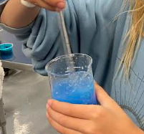
Create Gel #2
Observations of the process
I observed…

Slide 16
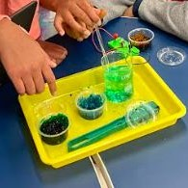
Create Gel #2
Observations of the process
I observed…

Slide 17
Test Gel #1
Observations of the test results
I observed…
I think we achieved that result because…

Slide 18
Test Gel #2
Observations of the test results
I observed…
I think we achieved that result because…

Slide 19
Test Gel #3
Observations of the test results
I observed…
I think we achieved that result because…

Slide 20
Improve Part 1
Which gel has the most potential for a real-life application? Why?

Slide 21
Improve Part 2
How can we improve this gel to make it able to fulfill a real-life application?

