Slide 1



Mines to Mobiles: Aqueous Solutions and Environmental Chemistry
Day 1

Slide 2
DAY 1 (45 MINS)
Today students will:
- Identify the problem with mining.
- Gain essential background knowledge.
- Have their current knowledge on aqueous solutions assessed (pre-test).
- Clearly define the problem and what they will be doing as engineers in class.
- Ask questions and construct criteria and constraints for how to be successful in this engineering endeavor.
Materials needed before class starts:
- Team Handout - Mines to Mobiles Warm-Up Questions (1 page per group of 4/table group)
- Student Handout – Pepper Extraction Model (1 per person)
- Student Handout – Pre-Test (1 per person)
- Periodic tables for each student or one to reference on the board/wall (you will need to print your own copies of this).
Notes:
Teacher reference slide

Slide 3
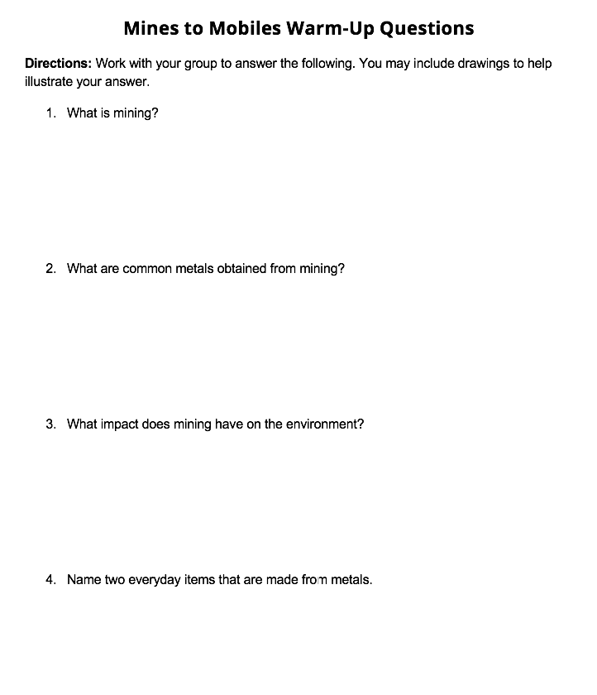
DO NOW
Complete the “Mines to Mobiles” Warm-Up Questions with your group
DO NOW
Notes:
INTRODUCE PHENOMENA
- Optional: Pass out the Mines to Mobiles Warm-Up Questions Team Handout for each group.
- Have students take turns reading the questions out to their team and gathering team answers to record in an abbreviated form.
- Allow 3-5 minutes for students to complete this in groups of 2-3. The goal of this page is to draw on students’ prior knowledge of the activity content and get them communicating in their student groups.
- Optional: You can have them turn it in to you as a pre-assessment, or you can use it as a guide to call on students throughout the Lesson 1 discussion. If students are struggling to fill this out, try to have them think about where they have heard these terms before.
*Note* - If you fear you are running low on time, cut this portion out. It is just to help the students have a reference point to come back to during the discussion.

Slide 4

DAY 1 (45 MINS)
Teach Engineering
Notes:
Teacher reference slide

Slide 5
WHAT ARE PHONES MADE OF?
What metals do they use?
Where do we get these metals from?
Notes:
ASK
This is the introduction slide to the activity phenomena. Say, “Who has a phone or computer with them or at home? Have you ever looked inside to see what’s there? What are phones made of? What metals do they use? Where do we get these metals from?” Wait for responses and list some on the board. Allow about 3 minutes for this.

Slide 6
PHONES ARE MADE OF MANY METALS
We particularly care about lanthanides (rare earth elements) for displays.
Sc
Y
La
Ce
Pr
Nd
Pm
Sm
Eu
Gd
Tb
Dy
Ho
Er
Dr
Tm
Yb
Lu
Notes:
ASK
We are continuing the phenomena conversation here. Say, “Phones are often made of many metals, but we particularly care about lanthanides (rare earth elements) for displays.”
-Reference the periodic tables and ask students, “Can you locate these elements on the periodic table?” Allow about 2 minutes for students to look for these element symbols on their own periodic tables.

Slide 7
PHONES ARE MADE OF MANY METALS
We particularly care about lanthanides (rare earth elements) for displays.
Sc
Y
La
Ce
Pr
Nd
Pm
Sm
Eu
Gd
Tb
Dy
Ho
Er
Dr
Tm
Yb
Lu
Notes:
ASK
Continuing talk about phenomena on this slide. Say, “One of the more common rare earth elements (REEs) in screen displays is terbium, which will be the REE we will be focused on in this lesson.” Allow students about 1 minute to find this on their periodic tables.

Slide 8
METALS COME FROM THE EARTH’S CRUST
Mining involves two main steps:
Step 1: Extraction
Miners dig into the earth to take metals from rock.
Step 2: Purification
Often, metals do not come clean and ready to use. We need to separate them from other metals and clean them for manufacturing.
Separate the desired metals from undesired metals
Wash metals in lots of acid
Mining Process
Notes:
ASK
Say, “Metals come from the Earth’s crust, and we get them through mining. Mining involves two main steps: digging up the metals and then purifying them. Phones and computers mostly use special metals called rare earth elements (REEs). Even though they are called "rare," they aren’t actually all that rare; rather, they are hard to find in a pure form. They are often mixed with other metals such as iron and calcium. What are some other metals we mine?”
Have students do a partner share, then have 2-3 people share answers with whole class.
Say, “When miners dig up these metals, they get a mixture of REEs, calcium, and iron. They need to separate them, which is tricky. Usually, they use acid to wash away the unwanted metals, but this can harm the environment and be dangerous for workers.”

Slide 9
MINING POLLUTION
If acid leaks from mines…how could this affect the local ecosystem?
LAND
WATER
AIR
Mining Pollution
Notes:
ASK
Say, “The acid can leak into nearby water, hurting plants, animals, and people. Mining also uses a lot of energy, which causes air pollution. That’s why we need better, safer ways to separate these metals..
Have you ever seen pollution before? How did it affect the surrounding ecosystem? Talk to a neighbor.”
Allow about 3 minutes.

Slide 10
ENVIRONMENTAL ENGINEERS
Design new mining techniques to make purifying metals safer for workers and the surrounding environment.
Mining Water Pollution
Notes:
ASK
Say, “That’s why we need better, safer ways to separate these metals. Environmental engineers are working on new methods that are safer and more eco-friendly. They start with small models in the lab and then scale up their solutions for real-world use. They do a lot of planning, testing, and improving to find the best ways to mine and purify metals.”

Slide 11
CAN YOU FIND THESE ELEMENTS?
Using the Periodic Table of Elements, can you find iron (Fe), terbium (Tb), and calcium (Ca)?
Fe
Ca
Tb
Notes:
ASK
Have students explore their specific metals.
Say, “Can you find calcium (Ca), terbium (Tb), and iron (Fe) on the periodic table? (If you can, put a periodic table on the projector and ask one student to come up and point to calcium, terbium and iron). “
Allow 2 minutes for this.

Slide 12
THE METALS WE WILL BE “MINING”
Fe
Ca
Tb
Transition Metal
Alkaline Earth Metal
Rare Earth Metal
Notes:
ASK
After students locate these metals, say, “Calcium is an alkaline earth metal. Iron is a transition metal. Terbium is a Rare Earth Metal (REE). We want to mine terbium for screen displays. But it does not come ready to use. It is often “dirty,” and covered in layers of iron and calcium we need to wash off with acid.”

Slide 13
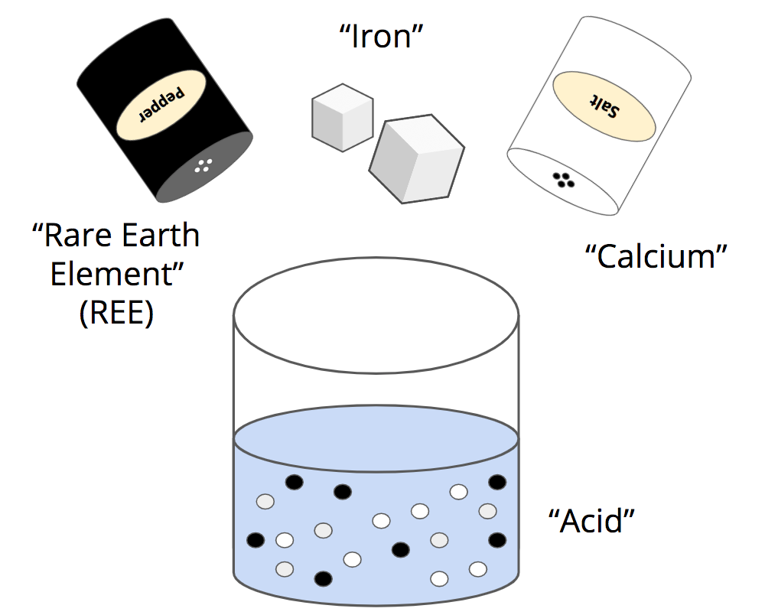
USING SAFE ALTERNATIVES
In class, we will not be putting calcium, terbium, or iron in acid.
Instead, we will be using their safer (but chemically similar) counterparts.
Terbium
Initial Pepper Extraction Model
Notes:
ASK
Now we are introducing the way we will run our experiment in the lab. You may want to print or draw the Pepper Extraction Model Image somewhere in the room to reference throughout the activity.
Say, “In class, we will use a safe experiment to understand this process. We’ll use water, salt, sugar, and pepper. The water will act like the acid, the pepper will be the REEs (in our case, terbium), the salt will be calcium, and the sugar will be iron.”

Slide 14
WHAT DO YOU ALREADY KNOW ABOUT SALT, SUGAR, WATER, AND PEPPER?
Talk to a shoulder partner.
Be ready to share your ideas.
Initial Pepper Extraction Model
Notes:
ASK
Say, “Now, let’s brainstorm. What do you already know about salt, sugar, pepper, and water? What happens when we mix them together?”
Have students do a partner share, then have 2-3 people share answers with whole class.
Record answers on chart paper/whiteboard.

Slide 15
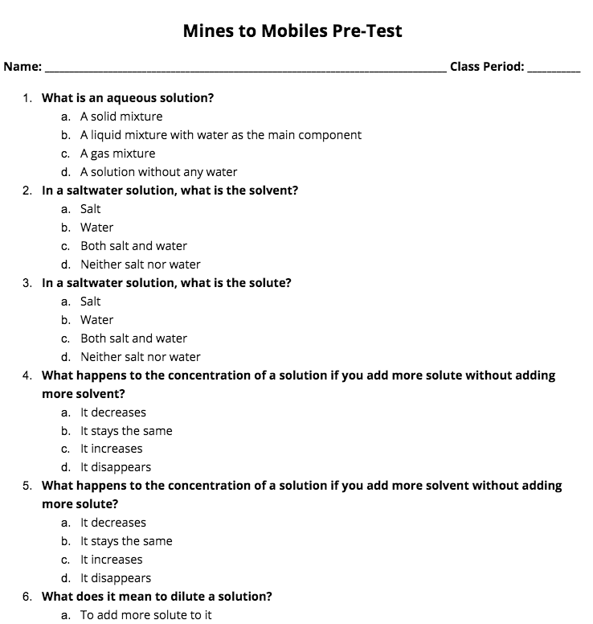
Pre-Test
PRE-TEST
PRE-TEST
Complete on your own.
Try your best, and take your best guess!
Mines to Mobiles Pre-Test
Notes:
ASK
Allow 10 minutes for students to complete the pre-test. If students finish early, you may suggest having them brainstorm how to best dissolve salt into water or how to dissolve sugar into water in their notebooks.

Slide 16
CLEARLY DEFINE THE PROBLEM
Your goal is to separate the “REE” from the “other metals” by dissolving the “calcium” and “iron.”
Based on the model we will use in class, what does this mean your group is actually doing?
Initial Pepper Extraction Model
Notes:
CLEARLY DEFINE THE PROBLEM
- Pass out the Student Handout - Pepper Extraction Model to each student. Have students work in their groups to answer the questions with each other. Walk around the room to help them answer these questions and clarify any confusion. This should take about 5 minutes.
Remember, the goal is to separate the pepper from the other two spices after they all have been dumped in water. With the correct methodology, the salt and sugar should dissolve, leaving behind only the pepper. This simulates the purification process of mining. The goal is to do so in an efficient way with minimal mess to decrease harm to the environment. The “product” groups are designing is actually a step-wise set of instructions to dissolve the sugar and water, and then filter the pepper using their knowledge of chemistry that they will learn in the next few days.
Students should use their “Pepper Extraction Model” pages to help guide their thinking throughout the activity.

Slide 17
CRITERIA AND CONSTRAINTS
Criteria
Requirements we use to determine whether our solution is successful
How will we know we were successful in extracting the most pepper from our solution?
Constraints
Limits to our solutions, otherwise known as things we cannot do
We have to pretend the water is incredibly strong acid, so what does this mean we cannot do?
Notes:
CRITERIA AND CONSTRAINTS
Try having students brainstorm ideal criteria and constraints. This may be hard, but the more they come up with as a class the better. Spend about 3 minutes brainstorming as a whole class. Be sure to clearly define what criteria and constraints are.

Slide 18
CRITERIA AND CONSTRAINTS
Criteria
Must extract as much black pepper as possible
Must not extract any salt or sugar
Must be eco-friendly and make the least amount of mess
Constraints
Cannot use hands to extract pepper
Filtration system required
Limited time and resources to extract the black pepper
Notes:
CRITERIA AND CONSTRAINTS
Final ideas should be posted in the classroom (chart paper/whiteboard) where students can reference them all lesson long.
*Note* - Even if the students do not come up with these exact criteria and constraints, be sure to add these noted on this slide to their working list to ensure the activity runs smoothly.

Slide 19
END OF DAY 1

Slide 20
Citations
Ademski, E. (2025). Initial Pepper Extraction Model [Diagram]. TeachEngineering.
Ademski, E. (2025). Mines to Mobiles Pre-Test [Image]. Teach Engineering.
Ademski, E. (2025). Mining Pollution [Diagram]. Teach Engineering.
Ademski, E. (2025). Mining Process [Diagram]. Teach Engineering.
Ademski, E. (2025). Mining Water Pollution [Diagram]. Teach Engineering.
Teach Engineering. NGSS Engineering Design Process [Diagram].
TeachEngineering.Org, https://www.teachengineering.org/populartopics/designprocess. Accessed 24 June 2025.

