Slide 1



Mines to Mobiles: Aqueous Solutions and Environmental Chemistry
Day 2

Slide 2
DAY 2 (45 MINS)
Today students will:
- Conduct laboratory research on aqueous solutions in a jigsaw format.
- Confirm findings with jigsaw partners.
- Have a class consensus of key aqueous solutions patterns.
Materials needed before class starts:
- Wet Lab Research Stations Prepped with all supplies (cups, beakers, salt, sugar, etc.)
→ See “Teacher Resource – Research Station Preparation”
- Team Handout – Research Table Directions – 1 or 2 copies per research station
- Student Handout – Stations Research Data Sheet – 9-10 copies at each research station per class period
→ Station 1 should only have Station 1 data sheets, Station 2 should only have Station 2 data sheets, etc.
- Student Handout – JIGSAW Key Patterns – 1 per student
- Student Handout – Solubility Graph – 1 per student
Notes:
Teacher reference slide

Slide 3

DAY 2 (45 MINS)
Teach Engineering
Notes:
Teacher reference slide

Slide 4
JIGSAW LABORATORY RESEARCH
Goal: Learn how salt, sugar, and pepper dissolve in water.
Assignment: Each table group person gets a different station.
Time: 20 minutes for data collection.
Collaboration: Work with others at your lab station.
Reporting: Share findings with your original table group.
Person 1:
Concentration
Person 2:
Surface Area
Person 3:
Temperature
Person 4:
Agitation
JIGSAW Research Roles
Notes:
RESEARCH OVERVIEW
Students will be at tables in groups of 4. If your classroom does not already have tables of 4, you can rearrange the desks or simply put students in groups of 4. If there are too many or too few students, do not make a group of 3. It is better to make a group of 5 and have two students partner up. Students will number themselves 1, 2, 3 or 4. You can either let them choose, or you can go in order of oldest to youngest, favorite color, etc. They group will split up to go to their lab stations. Each person will need to grab their Stations Research Data Sheet (should be waiting for them at their lab table).
You will also need to have copies of Research Station Instructions printed (and probably also in sheet protectors) at each lab station. Students will then work with others to collect and discuss data. After 15 minutes, data collection should be done and students can assist with cleanup and then head back to their original groups of 4 to report their findings and record patterns of aqueous solutions together.
If you only have one set of students, all non-reusable materials can go in the trash or down the sink. If you have another period of students coming in, have students reset the lab station to how they found it.

Slide 5
4 TOTAL RESEARCH STATIONS
Investigation 1: Increasing Amount of Salt, Sugar, and Pepper
Investigation 2: Changing Size of Sugar, Salt, and Pepper
Investigation 3: Increasing Temperature of the Water
Investigation 4: Increasing Time of Agitation (Amount of Stirring)
30s
60s
30s
60s
30s
60s
Research Stations
Notes:
RESEARCH OVERVIEW
Before they go back to lab, preview what they will be doing. Person 1 goes to Station 1, person 2 goes to Station 2, etc. As students go to stations, there should be anywhere from 3-8 people per station (class sizes vary). Each station tests 3 trials for salt, sugar, and pepper. The more hands there are, the better. Divide up roles at the lab. There should be at least one person per spice, and no more than 3 people per spice. If this is a very large class, it is always good to assign a “lab manager” role to ensure everyone is following along.
Assign lab roles. One person should read the Table Directions aloud to the group while the other people are doing the lab. One person needs to be conducting the research on the salt samples at the table, while the next person conducts the research on the sugar sample, and the last person conducts the research on the pepper sample. The remaining students will record the data and be sure to share out findings to the table. All students partake in cleanup. A good rule of thumb would be to demonstrate each station first so students can visualize directions.
A way to make the lab go faster is to have the spices weighed out before students get there. This is more work on your end, but saves time in lab in case things are taking too long. You can have a scale for each table to help weigh the spices if supplies allow. This can be seen in the research preparation instructions.

Slide 6
LAB SAFETY
Investigation 1: safety goggles, hair back, sleeves up
Investigation 2: safety goggles, hair back, sleeves up
Investigation 3: safety goggles, hair back, sleeves up, heat-protection gloves, teacher supervision
Investigation 4: safety goggles, hair back, sleeves up
30s
60s
30s
60s
30s
60s
Stations Lab Safety
Notes:
RESEARCH OVERVIEW
Students will be around spices that will likely spill or get splashed. Please make sure students are wearing the safety equipment as listed above. Different stations have different safety requirements and personal protective equipment.
If these spices or solutions get into their eye, they will need to use the eyewash station or go see the nurse if one is not available. Students working with hot water need to practice caution. Hot water can lead to burns, and therefore any distractions like long hair, dangling jewelry, or long sleeves must be out of the way.
It is advised that only you should have access to the bulk hot water (kettle), and you should be the one pouring the hot water into the cups. Students can stir cups after the hot water has cooled down enough for them to stir it gently. If a student does get burned, they need to run the affected area under cool water for an extended period of and/or go see the nurse immediately.

Slide 7
AQUEOUS SOLUTIONS RESEARCH
Put the safety glasses on and tie your hair back.
Grab a Data Sheet and read it front to back aloud with your group.
Assign 1 person the “Lab Manager” role. They will read the instructions for each step of the lab.
Assign the other people to work on salt, sugar, and pepper. Try to make even groups.
    2 people will work on salt research.
    1 will work on sugar research.
    1 will work on pepper research.
The salt research should be conducted first. While that person is conducting and listening to the Lab Manager, the other students will observe what is happening to the salt. In the Observations box, record how well the salt dissolves each step of the way. Be as detailed as possible.
After the salt research is complete, record a summary of what you just learned about salt and Concentration in the “Explain” box.
Repeat Steps 6-7 for both sugar and pepper.
Verbally share your results with the people at your table, and make sure everyone has the information on their data sheets. Call your teacher over to confirm if your data is correct.
Clean the lab before returning to your original group of 4.
Notes:
CONDUCTING RESEARCH
Leave these directions up during the research time so students can guide themselves. This total research should take no more than 15 minutes.
The most important thing to do before a group starts to clean up is to discuss what is happening when trying to dissolve the salt, sugar, and pepper at their station. Did the solute dissolve at all?

Slide 8
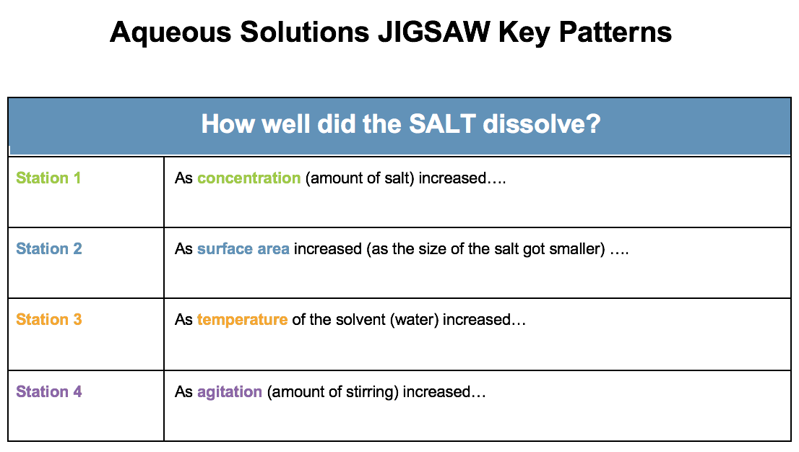
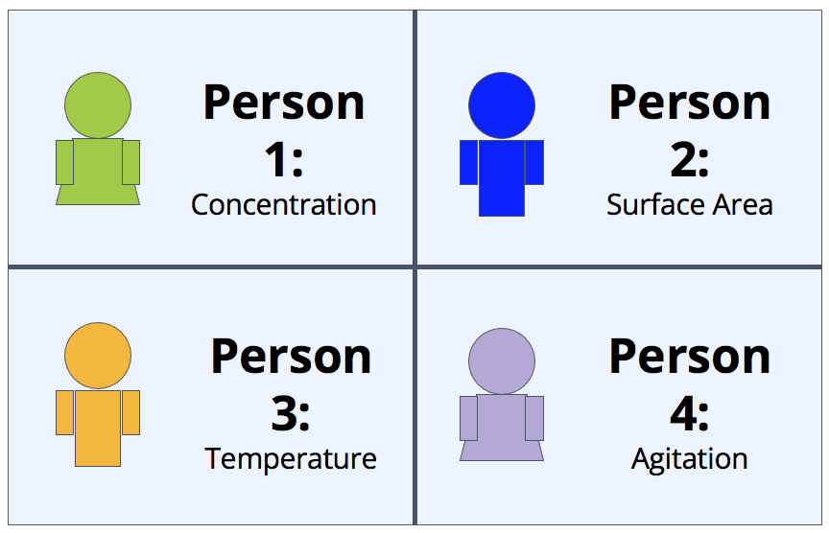
SHARING YOUR FINDINGS
In numerical order, take turns verbally sharing your findings with your jigsaw group of 4.
How did your station help (or not help) dissolving the following solutes:
Salt
Sugar
Pepper
JIGSAW Research Roles
Notes:
SHARING RESEARCH
Once the lab is clean, have students come back to their original teams. They will need the JIGSAW Key Patterns page. Station 1 person will start sharing the patterns they noticed for salt, sugar, and pepper. The other 3 students will need to write this down on their handouts. After person 1 has shared, person 2 will share. All students will take turns sharing until all their handout is complete.
Walk around and make sure students are talking about specific patterns. The more detail students can give on their station, the better. Pay close attention to how they are sharing about the patterns they observed in lab. If they are having a hard time understanding what happened in lab, try to guide them.

Slide 9
RESEARCH CLASS DISCUSSION
Your group be assigned one of these questions. You have 5 minutes to prepare an answer. Be prepared to share your answers with the whole class.
What helps sugar dissolve the best?
What helps salt dissolve the best?
What patterns did you notice about pepper in the lab?
How does this relate to rare earth elements?/mining?
Why is the problem with mining hard to solve?
Why did we choose salt, water, sugar, and pepper instead of acid and REEs?
How will we use this information?
Notes:
SHARING RESEARCH
Rather than you leading the discussion, give the students these questions to discuss. If you have fewer than 7 groups, you can start the discussion by answering the first one or two questions.

Slide 10
Solubility - The ability of a substance (solute) to form a solution with another substance (solvent)
KEY VOCABULARY
Solute
Solvent
Solution
Aqueous Solution - Solvent is water
Dissolution Process
Notes:
RESEARCH
Students will need to take notes on solute, solvent, and solution. You can draw this on the board while they copy this in their notes. Students will add notes to their Initial Models.
It would also be critical to note here that to “dissolve” something completely, you can no longer visually see the solute. It appears as though it disappeared, but in reality it has mixed so well into the solvent that you can no longer see it with the naked eye.

Slide 11
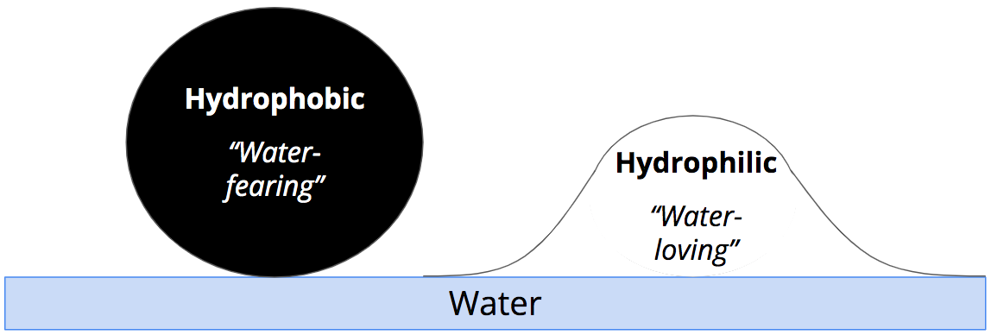
KEY VOCABULARY
‘Water Fearing”
These objects do not like water and do not mix with water.
‘Water Loving”
These objects like water and like to mix with water.
Hydrophobic and Hydrophilic
Notes:
RESEARCH
Question the class whether the pepper is hydrophobic or hydrophilic. Why is this important information? Students will add notes to their Initial Models.

Slide 12
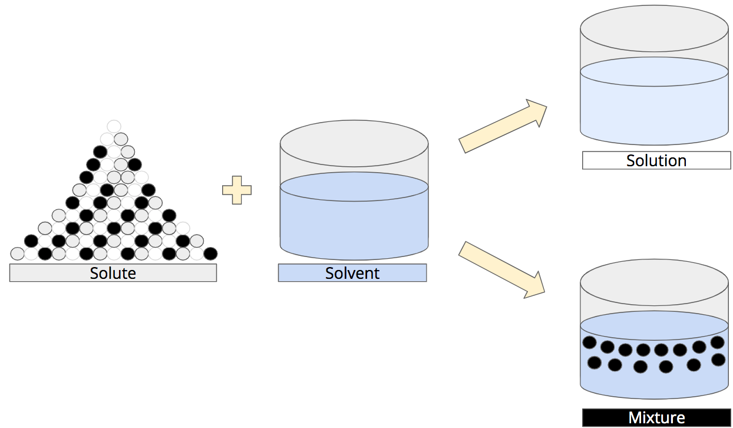
KEY VOCABULARY
When hydrophilic salt and sugar completely mix with water, you can no longer see the particles. This means they went into solution.
Hydrophobic pepper won’t mix with water. It can still be seen despite agitation. This makes it a mixture.
Salt and Sugar Dissolve; Pepper Does Not
Notes:
RESEARCH
Ideally, all of these diagrams would be drawn on the board so students can reference them all week. Students will add notes to their Initial Models.

Slide 13
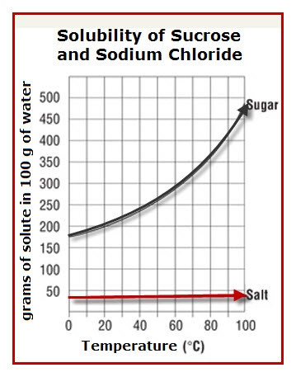
SOLUBILITY GRAPH
On your personal copy of this graph, annotate:
What I see…
What it means…
American Chemical Society. (2023, August 25)
Notes:
RESEARCH
Use the I-squared strategy:
Identify patterns by adding arrows/color coding the graph.
Write under those arrows what the pattern means.
Caption what the graph means (summarize).

Slide 14
SOLUBILITY CONSENSUS
Temperature:
  The more sugar and salt you add, the less gets dissolved by the water
  Pepper never got dissolved no matter how much there was
Concentration:
  The
  more surface area there was, the more sugar and salt dissolved
  Pepper never dissolved
Agitation:
  The hotter the water, the more sugar would dissolve
  Pepper never dissolved
  Salt only dissolves a little no matter what temperature
Surface Area of Solute:
  Increased agitation causes more sugar and salt to dissolve
  Black pepper does not dissolve under any circumstances
American Chemical Society. (2023, August 25)
Notes:
RESEARCH
Record student consensus between laboratory data, key vocabulary, and the solubility graph data. The graph shows heat helps more with sugar, whereas salt reaches a maximum point of solubility with every 100 mL of solvent. Either a decreased concentration of salt or more than 100 mL of solvent is needed to get more than 50 grams of salt to dissolve completely.

Slide 15
SOLUBILITY CONSENSUS
Concentration:
  The more sugar and salt you add, the less gets __________________ by the water.
  ___________________never got dissolved no matter how much there was.
Surface Area:
  The more surface ________________there was, the more sugar and salt dissolved (smaller particles dissolved faster).
  __________________never dissolved.
Temperature:
  The ____________ the water, the more sugar would dissolve.
  Pepper never dissolved.
  Salt only dissolves a little no matter what _____________._
Agitation:
  Increased ____________ causes more sugar and salt to dissolve.
  Black pepper does not dissolve under any circumstances.
American Chemical Society. (2023, August 25)
Notes:
Printable notes for all/absent/students with modifications

Slide 16
SOLUBILITY CONSENSUS
Concentration:
  The more sugar and salt you add, the less gets dissolved by the water.
  Pepper never got dissolved no matter how much there was.
Surface Area:
  The more surface area there was, the more sugar and salt dissolved (smaller particles dissolved faster).
  Pepper never dissolved.
Temperature:
  The hotter the water, the more sugar would dissolve.
  Pepper never dissolved.
  Salt only dissolved a little no matter what temperature.
Agitation:
  Increased agitation causes more sugar and salt to dissolve.
  Black pepper does not dissolve under any circumstances.
American Chemical Society. (2023, August 25)
Notes:
Printable notes for all/absent/students with modifications
Graph Citation: American Chemical Society. (2023, August 25). Lesson 5.6: Does Temperature Affect Dissolving? American Chemical Society; American Chemical Society. https://www.acs.org/middleschoolchemistry/lessonplans/chapter5/lesson6.html
‌

Slide 17
END OF DAY 2

Slide 18
Citations
Ademski, E. (2025). Dissolution Process [Diagram]. Teach Engineering.
Ademski, E. (2025). Hydrophobic and Hydrophilic [Diagram]. Teach Engineering.
Ademski, E. (2025). JIGSAW Research Roles [Diagram]. Teach Engineering.
Ademski, E. (2025). Research Stations [Diagram]. Teach Engineering.
Ademski, E. (2025). Salt and Sugar Dissolve; Pepper Does Not [Diagram]. Teach Engineering.
Ademski, E. (2025). Stations Lab Safety [Diagram]. Teach Engineering.
American Chemical Society. (2023, August 25). Lesson 5.6: Does Temperature Affect Dissolving? American Chemical Society; American Chemical Society. https://www.acs.org/middleschoolchemistry/lessonplans/chapter5/lesson6.html
Teach Engineering. NGSS Engineering Design Process [Diagram].
TeachEngineering.Org, https://www.teachengineering.org/populartopics/designprocess. Accessed 24 June 2025.

