Slide 1



Mines to Mobiles: Aqueous Solutions and Environmental Chemistry
Day 3

Slide 2
DAY 3 (45 MINS)
Today students will:
- Use the patterns they saw last class to interpret a graph of salt and sugar solubility.
- Practice writing purification recipes with imaginary scenarios with their groups, clarifying any misunderstandings in a group discussion.
- Get a metals shipment assigned to them (A or B) and plan an “acid wash” procedure specifically for their assigned shipment.
- Go test their procedure in lab and let their extracted pepper dry overnight.
Materials needed before class starts:
- Student Handout – Imagine Ideal Scenarios – 1 per student
- Team Handout – Pepper Purification Plan – 1 per group
- Wet Lab Prepped with all supplies (cups, beakers, spoons, straws, hot water, cold water, graduated cylinders etc.)
→ See “Teacher Resource – AB Shipment Materials Prep”
Notes:
Teacher reference slide

Slide 3

DAY 3 (45 MINS)
Teach Engineering
Notes:
Teacher reference slide

Slide 4
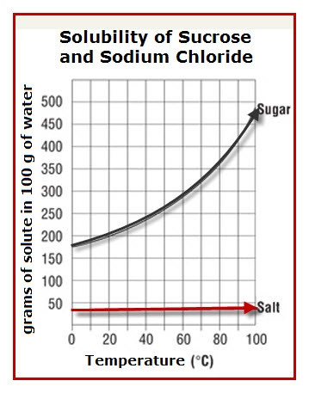
LET’S RECAP
DO NOW: Talk with your neighbors about the research we did last class.
What are some key trends we saw yesterday in lab?
What was the biggest difference between sugar and salt when dissolving?
American Chemical Society. (2023, August 25)
Notes:
PLAN
Give students 5 minutes to look back at their notes from yesterday. They should especially be referencing the JIGSAW Share-out Page. Be sure to spend time here discussing the graph. Say, “Why does the sugar line go up, but the salt line doesn’t? Is this like what we saw in class yesterday? What does this graph tell us?”
This graph demonstrates that in a container of 100 grams of water (equivalent to 100 mL of water), salt will only dissolve if the amount is less than 45 mg. You can heat it and agitate it, but it will not fully dissolve if there is too much. Sugar, on the other hand, will dissolve easily with added heat (and presumably added agitation based on the research the students conducted in lab the previous class period). This is critical information to know moving forward in the lesson, so take time to really interpret the graph with the students.

Slide 5
IMAGINE IDEAL SCENARIOS
Scenario 1: You receive a shipment of 20 grams of salt and 30 grams of pepper in 100 mL of water. What is the simplest way to extract the pepper?
You must use the coffee filter to separate the pepper from the water.
You must write the method like a recipe (ex: Step 1: ________, Step 2: __________, etc.).
American Chemical Society. (2023, August 25)
Notes:
PLAN
Students need to practice understanding and interpreting this graph to move forward with the engineering process. Give students 5 minutes to design this method in their Imagine Ideal Scenarios Handout. Walk around the room and make sure students are sharing ideas and contributing. You can even have them take 2-3 minutes to think on their own first, so they have ideas to discuss with their groups. Fastest way: add more water
It is important to go over the answers with the students, so they know they are doing things correctly. This should be done as a class discussion. Call out and ask students to share their attempted recipe and then cross-reference that with the Teacher Answer Key. Write the correct answer in the space provided on the slide and then give them a minute to correct their own papers if necessary. The move on to the next scenario.

Slide 6
IMAGINE IDEAL SCENARIOS
Scenario 2: You receive a shipment of 300 grams of sugar and 30 grams of pepper in 100 mL of water. What is the simplest way to extract the pepper?
You must use the coffee filter to separate the pepper from the water.
You must write the method like a recipe (ex: Step 1: ________, Step 2: __________, etc.).
American Chemical Society. (2023, August 25)
Notes:
PLAN
Students need to practice understanding and interpreting this graph to move forward with the engineering process. Give students 5 minutes to design this method in their Imagine Ideal Scenarios Handout. Walk around the room and make sure students are sharing ideas and contributing. You can even have them take 1-2 minutes to think on their own first, so they have ideas to discuss with their groups. Fastest way: add more water and heat
It is important to go over the answers with the students, so they know they are doing things correctly. This should be done as a class discussion. Call out and ask students to share their attempted recipe and then cross-reference that with the Teacher Answer Key. Write the correct answer in the space provided on the slide and then give them a minute to correct their own papers if necessary. The move on to the next scenario.

Slide 7
IMAGINE IDEAL SCENARIOS
Scenario 3: You receive a shipment of 50 grams of salt and 30 grams of pepper in 100 mL water. What is the simplest way to extract the pepper?
You must use the coffee filter to separate the pepper from the water.
You must write the method like a recipe (ex: Step 1: ________, Step 2: __________, etc.).
American Chemical Society. (2023, August 25)
Notes:
PLAN
Students need to practice understanding and interpreting this graph to move forward with the engineering process. Give students 5 minutes to design this method in their Imagine Ideal Scenarios Handout. Walk around the room and make sure students are sharing ideas and contributing. You can even have them take 1-2 minutes to think on their own first, so they have ideas to discuss with their groups. Fastest way: agitation
It is important to go over the answers with the students, so they know they are doing things correctly. This should be done as a class discussion. Call out and ask students to share their attempted recipe and then cross-reference that with the Teacher Answer Key. Write the correct answer in the space provided on the slide and then give them a minute to correct their own papers if necessary. The move on to the next scenario.

Slide 8
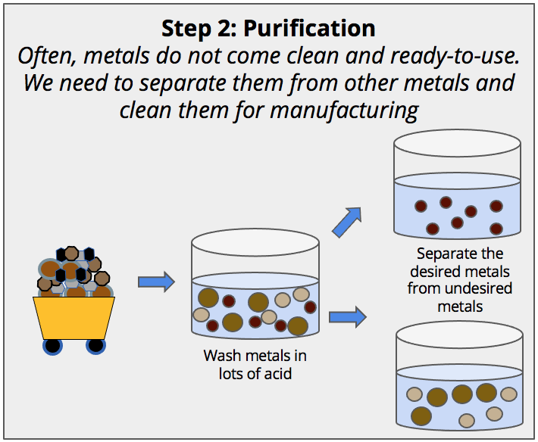
WHICH SHIPMENT WILL YOU GET?
Shipment A | Shipment B
10 Grams Total Solutes | 10 Grams Total Solutes
All metals mixed evenly | All metals mixed evenly
60% Sugar | 60% Salt
10% Salt | 10% Sugar
30% Pepper | 30% Pepper
Mining Purification Process
Notes:
PLAN
Students will either be assigned to design a Purification Solution for Shipment A or Shipment B. You may assign these groups however you see fit, but ideally about half the class should be testing Shipment A, and the other half of the class should be testing Shipment B. They will then use the Pepper Extraction Plan handout to plan an ideal pepper purification specifically for their assigned shipment of “metals.”

Slide 9
PLANNING YOUR WASH
Your Scenario: You receive a shipment of 10 grams of total metals. Think about the following questions as you and your group fill out the Pepper Extraction Plan.
Do we have more sugar or more salt?
Which method will help that dissolve the fastest:
  Agitation
  Changing the surface area
  Heat
  Changing the concentration of the solution
How much water will we need to add to our cup of metals to help it dissolve?
Will we need any tools to help our metals dissolve?
  Spoons
  Straws
  Remember, you cannot touch it with your hands!
American Chemical Society. (2023, August 25)
Notes:
PLAN
Be sure to give the students about 10 minutes to plan their method. They can use the 3 practice scenarios we just worked through as a starting point to guide their answers. Be sure to check that they wrote the correct percentages for each type of metal, so they do their calculations correctly!
Students will get your approval on their method and then go and grab a shipment of metals and head to lab do try it out! Students will need to write their names with a marker on a coffee filter (or a sticky note and stick that to their coffee filter) so they can allow their filtered pepper to try overnight. All students should be aiming to extract 3 grams of total pepper no matter their shipment.

Slide 10
TEST YOUR PLAN
Put on proper safety equipment, and
get your shipment from your teacher.
Add your water and dissolve your salt and sugar so only pepper remains.
Rest the coffee filter on top of another beaker/cup and pour your solution through it to filter out the pepper.
Purifying Your Pepper
Notes:
CREATE
Students should have about 10-15 minutes to test their plan in lab. They will need to let their filtered pepper dry overnight, so be sure to set aside a space in the room for them to lay their pepper out to allow water evaporation. Make sure students are using proper protections when working with hot water (maybe only you handle the hot water). Be sure all students are wearing goggles/safety glasses.
It is advised that the students filter their solutions into a small disposable cup or glass beaker. The glass beaker is easy to clean, and the cup can be thrown away easily. Be sure to post your cleanup instructions for your classroom in the room so students follow those procedures accordingly.

Slide 11
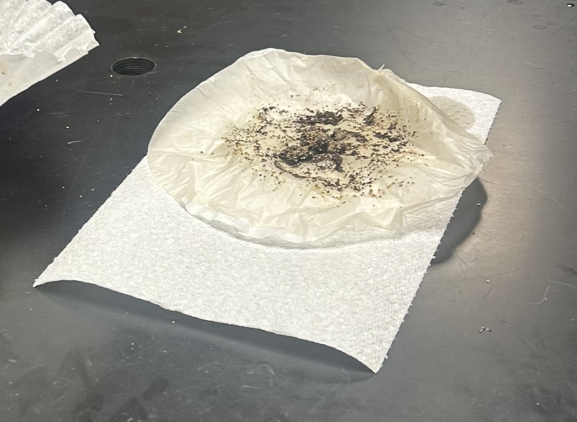
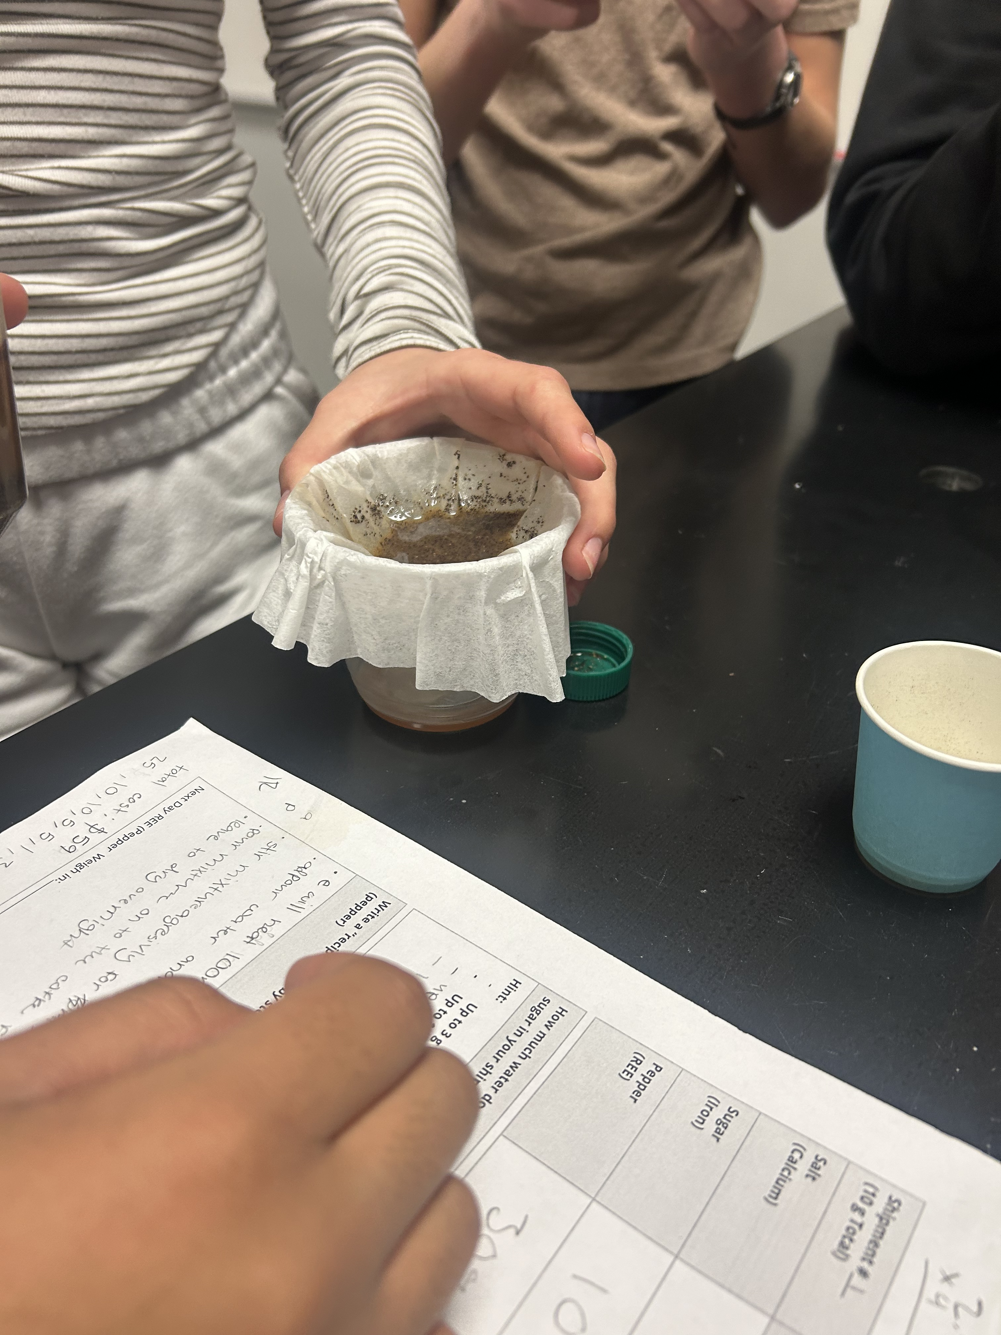
TEST YOUR PLAN
Drying The Pepper
Filtration in Action
Notes:
CREATE
Students should have about 10-15 minutes to test their plan in lab. They will need to let their filtered pepper dry overnight, so be sure to set aside a space in the room for them to lay their pepper out to allow water evaporation. Make sure students are using proper protections when working with hot water (maybe only you handle the hot water). Be sure all students are wearing goggles/safety glasses.
It is advised that the students filter their solutions into a small disposable cup or glass beaker. The glass beaker is easy to clean, and the cup can be thrown away easily. Be sure to post your cleanup instructions for your classroom in the room so students follow those procedures accordingly.

Slide 12
DRY THE PEPPER OVERNIGHT
Make sure the pepper is spread out as much as possible to allow all the water to evaporate.
On your “Pepper Extraction Plan” page, answer Question 7 with your group. Be sure to clean your lab station.
Dried Pepper in Coffee Filter
Notes:
CREATE
Make sure students spread the pepper out so all the water evaporates overnight. Have students clean up and then fill out Question 7 on the Pepper Extraction Plan. Students will essentially do a quick “plus/delta” consensus. What went well/what would you keep the same? What needs to change? Be sure students hold onto all handouts for reference later in the lesson activity.

Slide 13
END OF DAY 3

Slide 14
Citations
American Chemical Society. (2023, August 25). Lesson 5.6: Does Temperature Affect Dissolving? American Chemical Society; American Chemical Society. https://www.acs.org/middleschoolchemistry/lessonplans/chapter5/lesson6.html
Ademski, E. (2025). Dried Pepper in Coffee Filter [Diagram]. Teach Engineering.
Ademski, E. (2025). Drying the Pepper [Image]. Teach Engineering.
Ademski, E. (2025). Filtration in Action [Image]. Teach Engineering.
Ademski, E. (2025). Mining Purification Process [Diagram]. Teach Engineering.
Ademski, E. (2025). Purifying Your Pepper [Diagram]. Teach Engineering.
Teach Engineering. NGSS Engineering Design Process [Diagram].
TeachEngineering.Org, https://www.teachengineering.org/populartopics/designprocess. Accessed 24 June 2025.

