Slide 1



Mines to Mobiles: Aqueous Solutions and Environmental Chemistry
Day 5

Slide 2
DAY 5 (45 MINS)
Today students will:
- Weigh the pepper they extracted the previous class and record on their Budget Form (if they turned this in to you, you will need to return it to them).
- Compare how well their methods worked two separate times:
a. First, they will compare with groups who had the same shipment.
b. Second, they will compare with groups who had the opposite shipment.
- Reflect on their methods to cut costs and time by filling editing their “Budget Form.” This can be used as a formative assessment for the group, and students will turn this in to you before leaving. You can have them do this in a different color pen.
- Take a post-test to assess their learning of solutions, solutes, and solvents.
Materials needed before class:
-Team Handout – Budget Form - 1 per group
-Wet Lab Prepped with all supplies (cups, beakers, spoons, straws, hot water, cold water, graduated cylinders etc.)
→ See “Teacher Resource – AB Shipment Materials Prep”
Notes:
Teacher reference slide

Slide 3

DAY 5 (45 MINS)
Teach Engineering
Notes:
Teacher reference slide

Slide 4
DO NOW
Go and weigh your pepper from yesterday!
DO NOW
Be sure to tare the scale with a fresh coffee filter before weighing your filtered pepper.
The most pepper you should get is 3 grams. If you have more than 3 grams, you have water in your sample that did not fully evaporate.
Pepper Weigh In
Notes:
Allow about 5 minutes depending on supplies. If students have more than 3 grams, they did not spread their pepper out enough and their data is not valid. They will need to try to separate the pepper more next round.

Slide 5
HOW WELL DID YOUR METHOD WORK?
On your “Budget Form,” record the amount of pepper you purified.
Check that there are no salt or sugar solutes in your pepper that were not dissolved.
Dried Pepper in Coffee Filter
You should have gotten 3 grams of pepper (terbium).
Notes:
Be sure they record their mass on the Budget Form. Allow 3 minutes here.

Slide 6
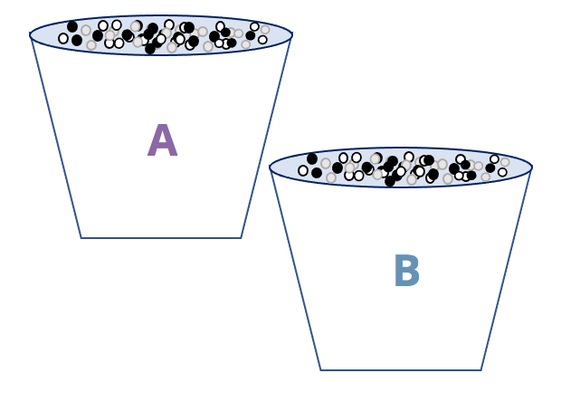
COMPARE DATA
Find a group with the same shipment as you and compare procedures:
  Star: What is one thing that worked very well?
  Wishes: What are two things that you would change if you could do this method again today?
  What did you learn about solutions?
AB Shipments
Notes:
In the reflection process, it is important to share a star (what went well for your group) and Wishes (what you wish you could change if you had more time). Walk around and listen to see if they found similar success and similar challenges given that they had the same “shipment challenge.” Ideally, they would have a conversation about what methods would best dissolve sugar/salt in any scenario. Allow 5 minutes here.

Slide 7
COMPARE DATA
Find a group with the opposite shipment as you and compare procedures:
  Star: What is one thing that worked very well?
  Wishes: What are two things that you would change if you could do this method again today?
  What did you learn about solutions?
AB Shipments
Notes:
In the reflection process, it is important to share a star (what went well for your group) and Wishes (what you wish you could change if you had more time). Walk around and listen to see if they found similar success and similar challenges given that they had opposite “shipment challenges.” Ideally, they would have a conversation about what methods would best dissolve sugar/salt in any scenario. Allow 5 minutes here.

Slide 8
PEPPER REFLECTIONS
Look back at the front of your Budget Form with your group where you wrote your “Acid Wash” procedure.
If you were to repeat this experiment today, mark any changes on your paper that would either expedite the process or help you extract more pepper solute at the cheapest cost.
Notes:
Students will have a clearer picture now if their methods were successful. If they need to make any changes, now is the time to do so in a different color on the Budget Form. You may take this up as a final option for a formal assessment. Allow 5 minutes here.

Slide 9
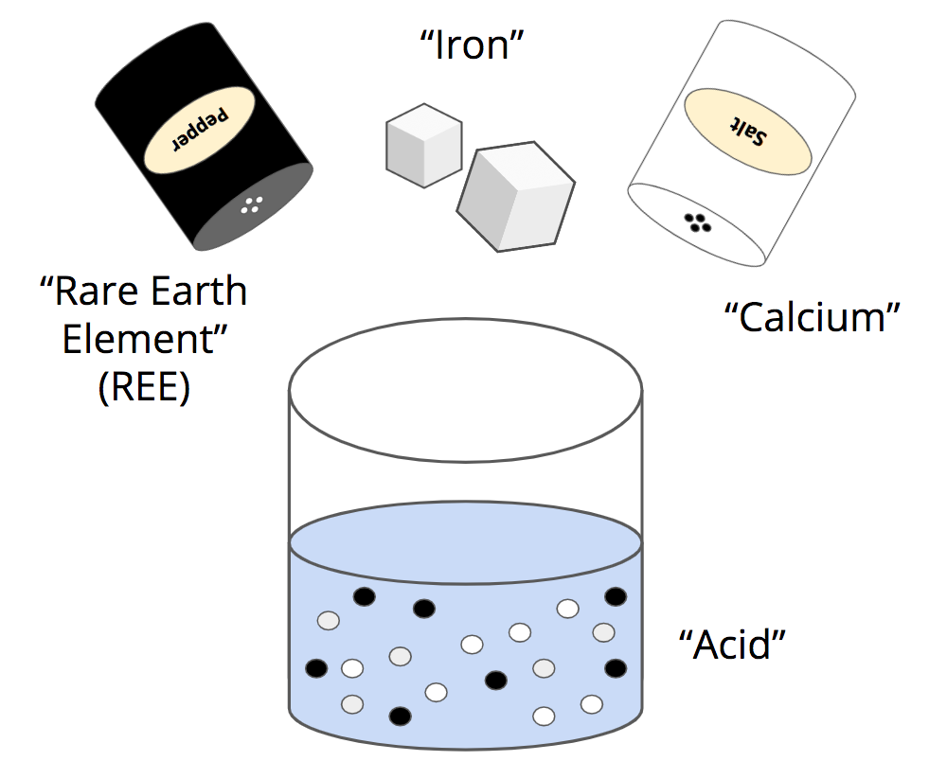
REVISITING OUR MODEL
Talk to a shoulder partner about the following:
1. What have you learned about dissolving solutes through this process?
2. Which is easier to dissolve, salt or sugar? Why?
3. Why is water such a good solvent?
4. What did this competition teach you about mining?
Spices = Solutes
Hydrophilic
Hydrophilic
Hydrophobic
Water = Solvent
Salt & Sugar Dissolved in Water = Aqueous Solution
Final Pepper Extraction Model
Notes:
Ideally, students can talk from much more personal experience about how to properly dissolve salt and sugar solutes. You should allow 5 minutes for students to mark up their models and make corrections or write their notes. They can answer these questions wherever they have room on their models. Be sure to emphasize the vocabulary words: solute, solvent, aqueous solution, hydrophobic, and hydrophilic. Be sure to call on different students to share out their ideas for questions 1-4. This should take about 10 minutes total.

Slide 10
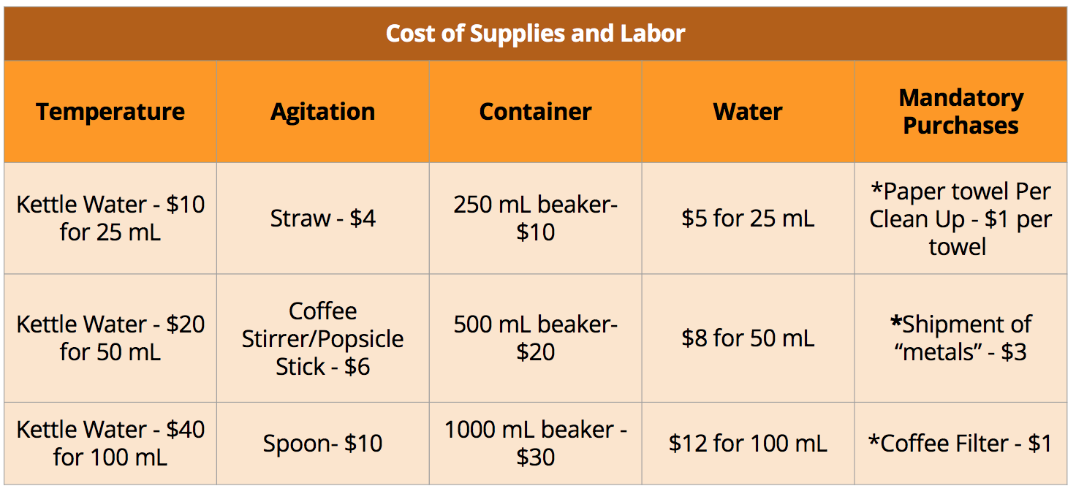

WHO GOT 3 GRAMS OF PEPPER THE CHEAPEST?
Final Pepper Mass
Cost of Supplies and Labor Orange
Notes:
Allow all groups to share their final gram amounts and total cost for extraction (it may be good to have a table/chart/space in the classroom for them to walk up and write this in for all to see). Talk with the teams and decide who won the design challenge. Congratulate the winning team and ask them to share how they were so successful. This should take 5-7 minutes.

Slide 11
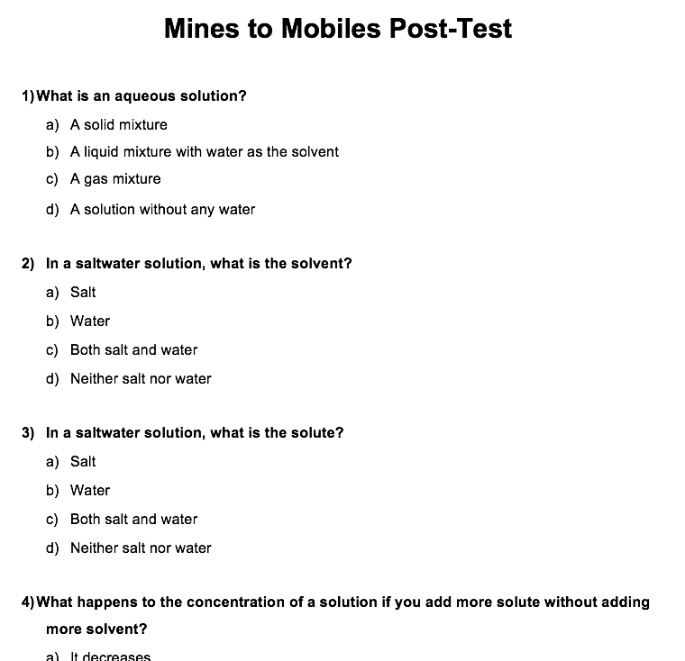
Pre-Test
POST-TEST
POST-TEST
Complete on your own.
Try your best, and use your knowledge from the last 5 classes!
Mines to Mobiles Post-Test
Notes:
Allow the remainder of class for students to complete their post-test. It is up to you if you decide to allow the students to use their notes or not. If short on time, the most important question is question 8 (the last question).

Slide 12
END OF ACTIVITY

Slide 13
Citations
Ademski, E. (2025). Ab Shipments [Diagram]. Teach Engineering.
Ademski, E. (2025). Cost of Supplies and Labor Orange [Diagram]. Teach Engineering.
Ademski, E. (2025). Dried Pepper in Coffee Filter [Diagram]. Teach Engineering.
Ademski, E. (2025). Final Pepper Extraction Model [Diagram]. Teach Engineering.
Ademski, E. (2025). Final Pepper Mass Model [Diagram]. Teach Engineering.
Ademski, E. (2025). Mines to Mobiles Post-Test [Diagram]. Teach Engineering.
Ademski, E. (2025). Pepper Weigh In [Diagram]. Teach Engineering.
Teach Engineering. NGSS Engineering Design Process [Diagram].
TeachEngineering.Org, https://www.teachengineering.org/populartopics/designprocess. Accessed 24 June 2025.

