Slide 1


Cell Membranes and Osmosis and Gummy Bears, Oh My!
What? How?

Slide 2
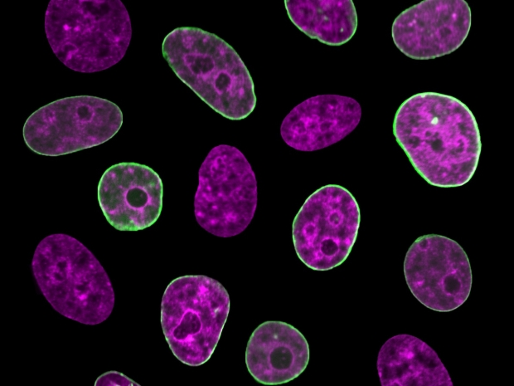
What?
Photos should preferably be a square - although horizontal or vertical are accepted
Notes:
Human cell nuclei with fluorescently labeled chromatin (purple) and nuclear envelope (green). Credit: Fang-Yi Chu and Alexandra Zidovska, Department of Physics, New York University.

Slide 3
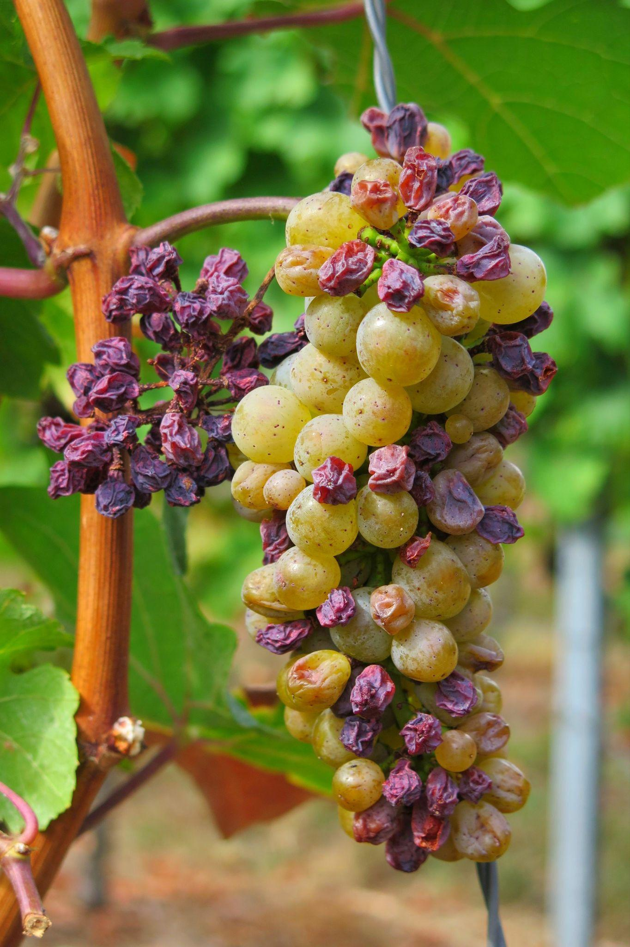
How?
Notes:
https://pixabay.com/photos/grape-dryness-raisin-fall-fruit-3666726/

Slide 4
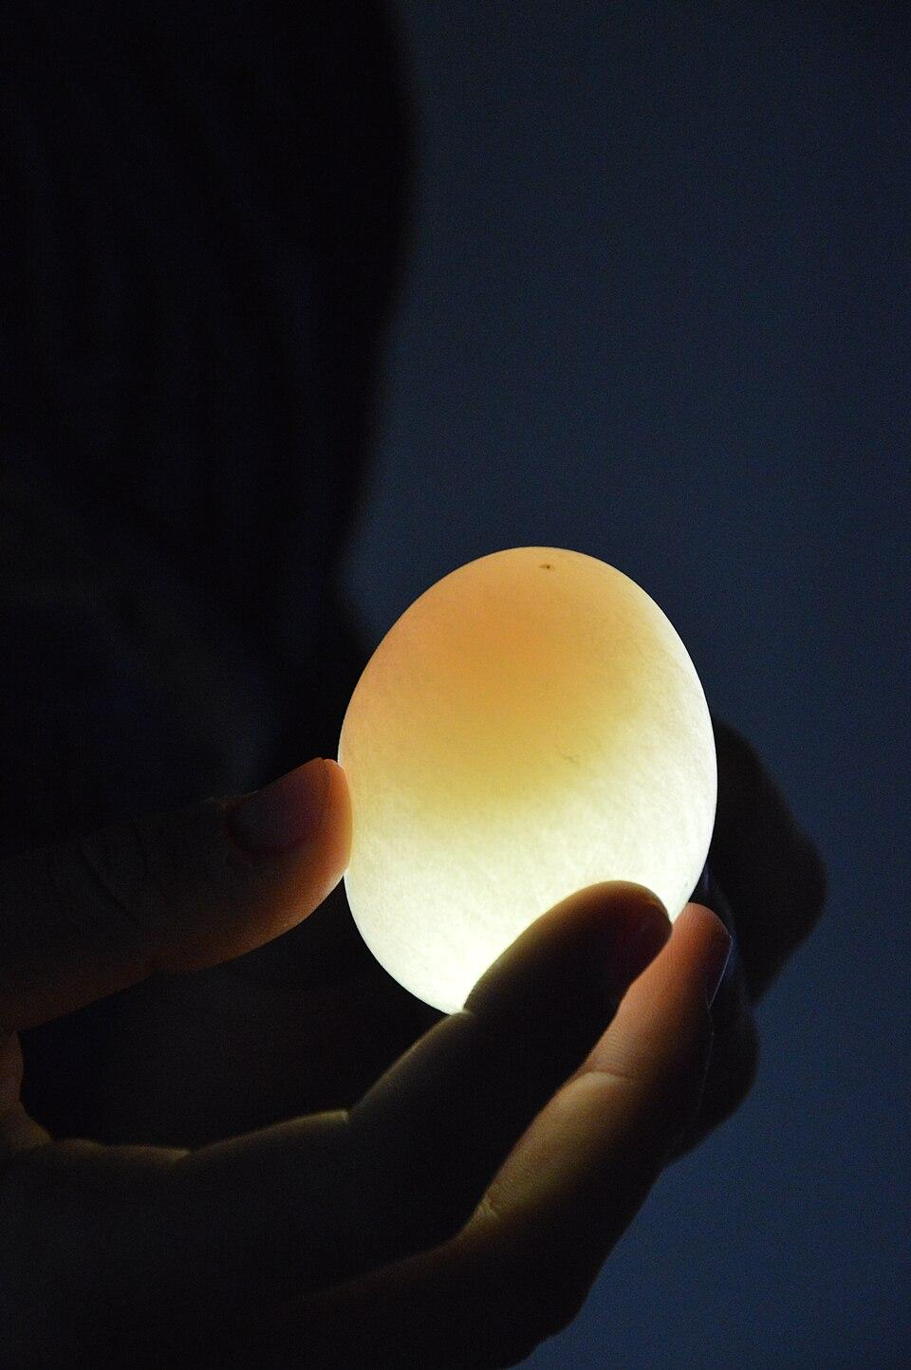
How?
Notes:
https://commons.m.wikimedia.org/wiki/File:Egg_in_vinegar.jpg

Slide 5
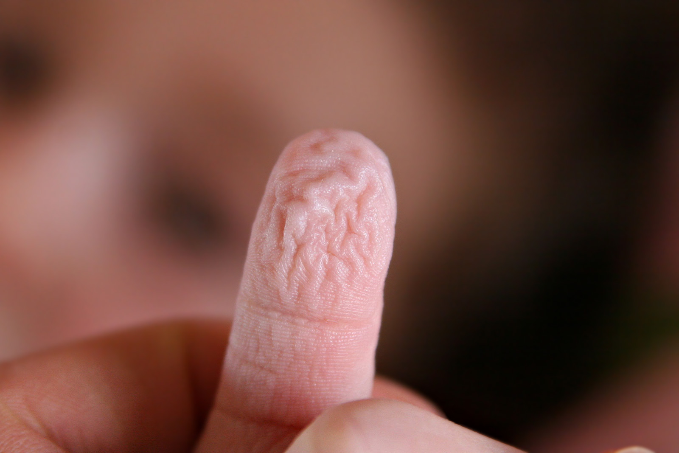
How?
Notes:
https://en.m.wikipedia.org/wiki/File:Wrinkly_fingers.jpg

Slide 6
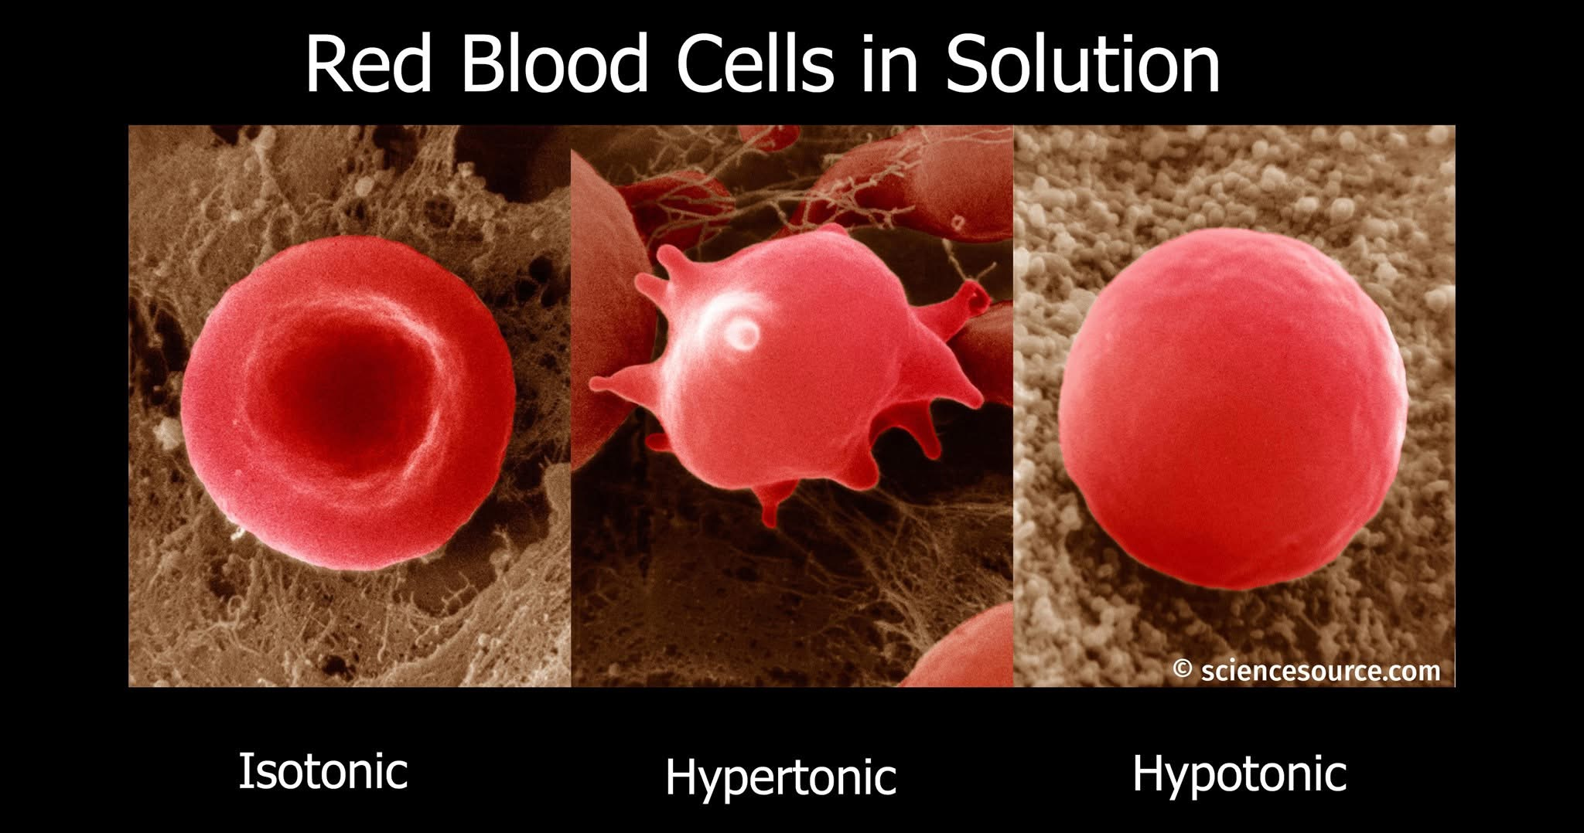
How?
Notes:
ScienceSource.com image ID#'s: SS2148601, SS2148604, and SS2148607 © David M. Phillips / Science Source

Slide 7
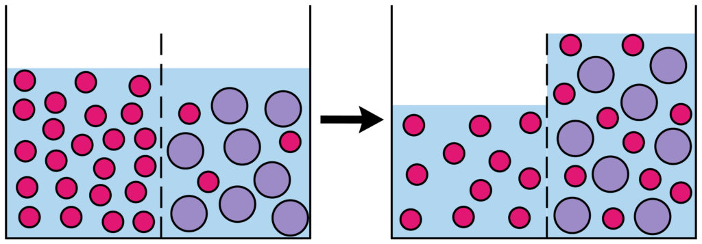
How?
Notes:
Copyright © 2025 Science Sparks - Wild Sparks Enterprises Ltd

