Slide 1


Unbeweavably Strong

Slide 2
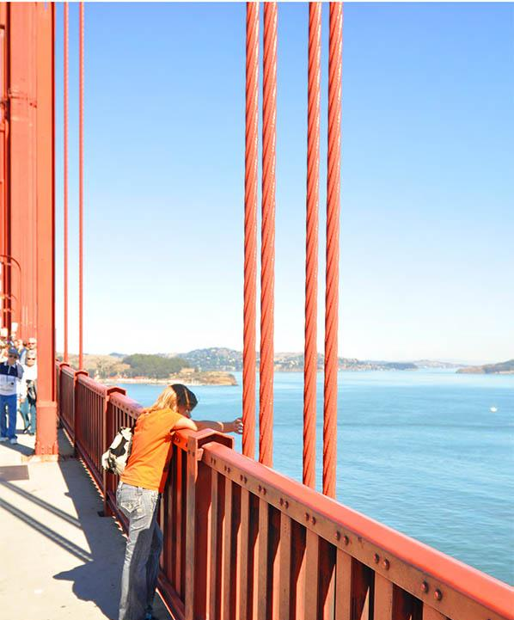
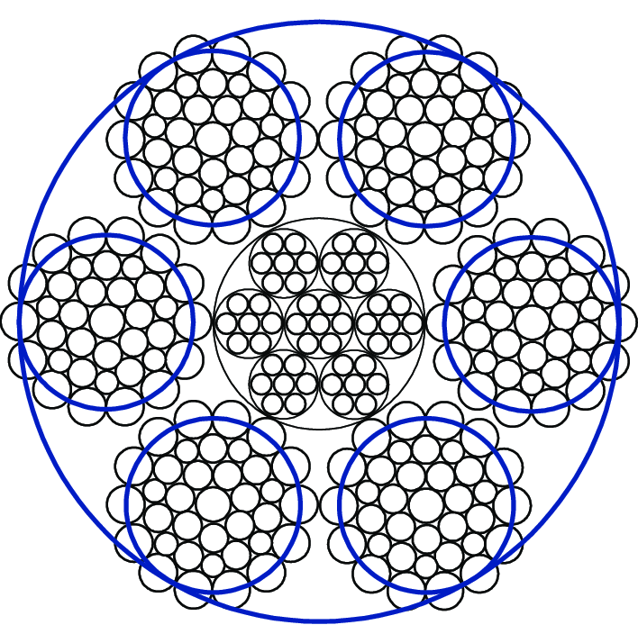
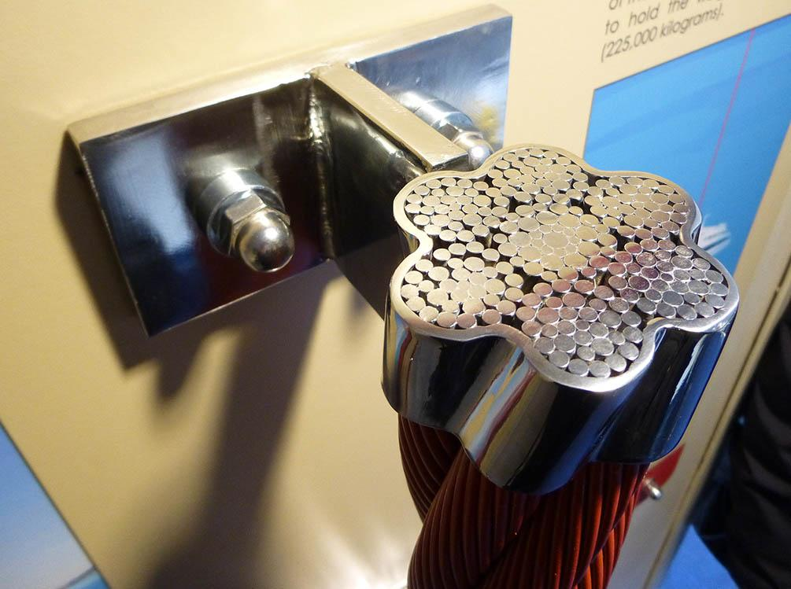
Everyday Phenomenon
What do you notice?
#9fcc3b
Figure 2: Cross-section of a steel cable (drawing)
Figure 1: Cross-section of a steel suspender rope from the Golden Gate Bridge (photograph)
Figure 3: Steel suspender rope on the Golden Gate Bridge
(photograph)
Notes:
Figure 1
Golden Gate Bridge, Highway and Transportation District. (n.d.). What suspends a suspension bridge? Original rope. Retrieved June 28, 2025, from https://www.goldengate.org/assets/1/6/what-suspends-a-suspension-bridge-original-rope.jpg
ADA: This photograph shows a close-up view of the original rope used in building the Golden Gate Bridge. The image highlights the thick steel cables made up of many tightly wound wire strands. These strands are bundled and twisted together to create a strong and flexible cable that supports the massive weight of the bridge. The detailed texture of the metal wires and their organized pattern demonstrate the careful engineering and durable materials that contribute to the bridge’s ability to hold heavy loads and withstand strong winds and other forces. This rope is a key component of the bridge’s suspension system, which helps keep the structure stable and safe.
Figure 2
ResearchGate. (n.d.). Cross-section of wire rope structure [Image]. Retrieved from https://www.researchgate.net/figure/Cross-section-of-wire-rope-structure_fig1_334069136
ADA description: Cross-section of a steel cable, showing how many thin strands are twisted together to form a much stronger structure. This design distributes weight and tension evenly, increasing both strength and flexibility—similar to how paper can be strengthened through twisting, braiding, or folding.
Figure 3
Golden Gate Bridge, Highway and Transportation District. (n.d.). What suspends a suspension bridge? Suspender ropes. Retrieved June 28, 2025, from https://www.goldengate.org/assets/1/6/what-suspends-a-suspension-bridge-suspender-ropes.jpg
ADA Description: This photograph captures a close-up view of the steel suspender ropes of the Golden Gate Bridge. These vertical ropes, spaced 50 feet apart, connect the bridge's main cables to the roadway deck. Each rope is capable of supporting up to 500,000 pounds, demonstrating the immense strength required to hold the weight of the bridge and its traffic. The image showcases the intricate design and robust materials that contribute to the bridge's structural integrity

Slide 3
Picture Word Inductive Activity:
What do you see? (Nouns)
What actions do you notice? (Verbs)
What can we infer or predict about what we see?
Photos should preferably be a square - although horizontal or vertical are accepted
Captions should be shown like this...
Figure 3: Steel suspender rope on the Golden Gate Bridge
(photograph)

