Slide 1
Electromagnetic Waves Are Everywhere!

Slide 2
What do a cellphone, a radio, and an x-ray machine have in common?
They all use electromagnetic radiation
Brainstorm:
What do you know about electromagnetic radiation?
What are some of the things in our world that use electromagnetic radiation?

Slide 3
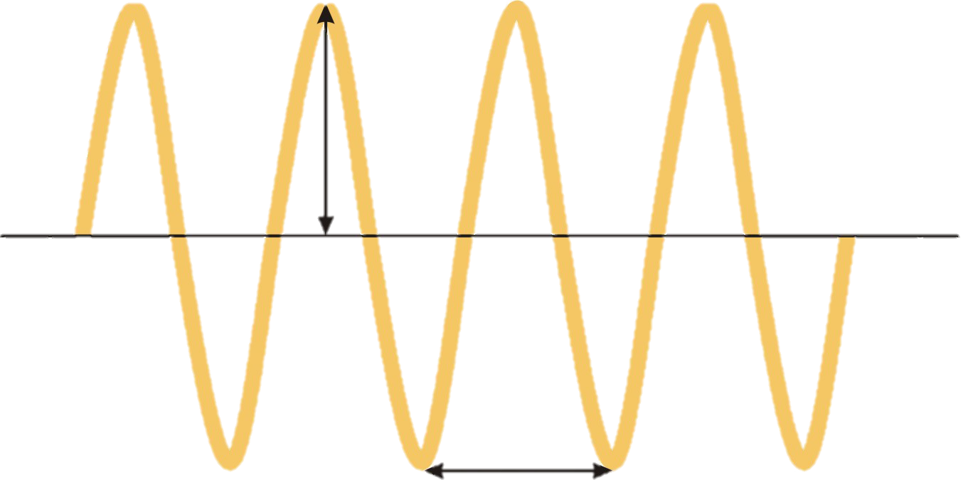
Electromagnetic Radiation
Electromagnetic radiation exists in waves
https://youtu.be/CVsdXKO9xlk (Wave Motion | Waves | Physics)
Wavelength is the distance between waves.
Amplitude is the height of the waves.
Frequency is the number of waves in a section.
Period is the amount of time it takes a wave to occur.
Amplitude
Wavelength

Slide 4
Activity: On the Same Wavelength
Purpose: to familiarize yourselves with some of the characteristics of the electromagnetic spectrum.
Put your name at the top of your paper.
Solve problems one at a time.
Once you solve a problem come find the slip of paper that has the answer to the problem on it.
Glue this piece of paper in the correct spot.
Once you have all your pieces glued in, find your classmates that are in the same group.

Slide 5
Activity: Electromagnetic Exploration
Purpose: To practice researching and inquiry skills and start thinking about how the electromagnetic spectrum works in your lives.
Put your name and group name at the top of your paper.
Work with your group to research the different devices.
Rank them from lowest frequency waves to highest frequency waves.
Write 1-2 sentences, based on your research, that might describe how electromagnetic waves work in each device.
At the end, reflect on what you’ve learned. Write 2-4 facts that surprised or interested you.

Slide 6
Activity: Device Jigsaw
Purpose: to learn more about how devices use electromagnetic radiation to function.
As a group, choose one of the devices from the electromagnetic exploration chart.
You will receive one piece of poster-board and art supplies.
Draw the device and write its name.
Write what category the device fits under.
Write two interesting facts about the device.
At the end, each group will share their posters with the class.

Slide 7
Final Thoughts
Share your interesting facts, aha! moments, and questions for further exploration.

