Slide 1
Indoor Environments and Living Walls

Slide 2
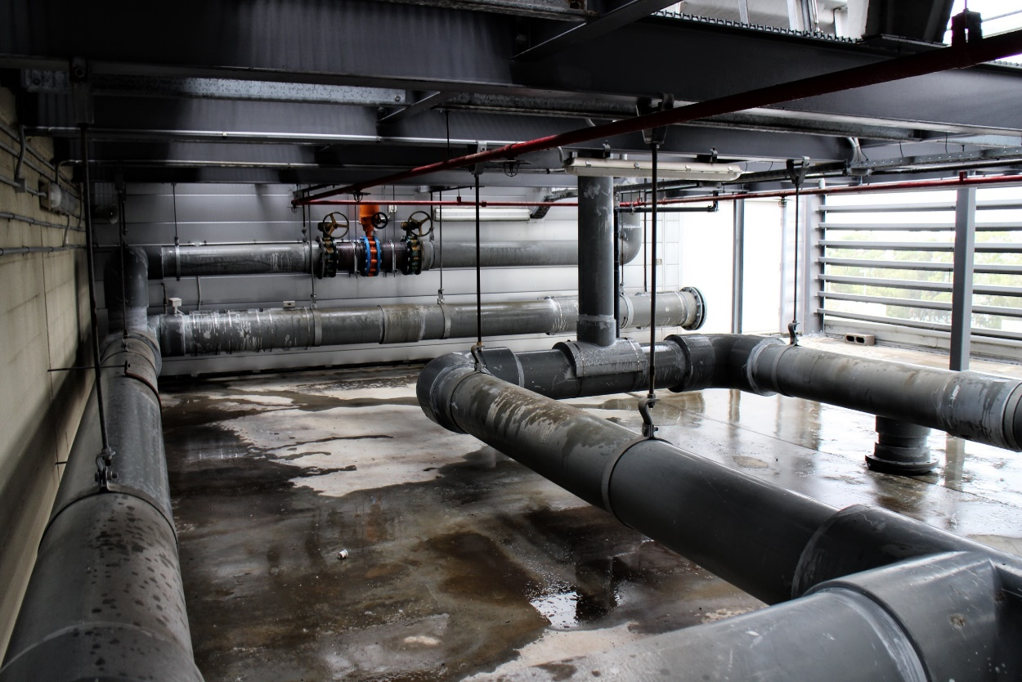
Heating and cooling
Notes:
How are our buildings currently cooled and heated?
This is what the HVAC system looks like, have you seen these on buildings? What is their purpose? To heat and cool the building as necessary.

Slide 3
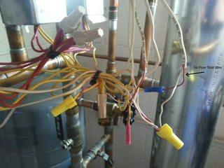
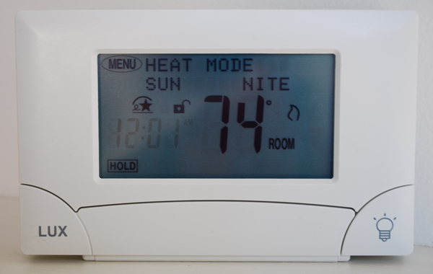
Human comfort
Notes:
What are these? Wires and thermostats. What do they to? These control the different types of systems of heating and cooling in a building.

Slide 4
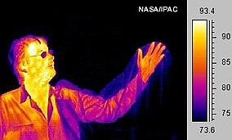
Body heat increases overall room temperature
Notes:
In a room all alone it may feel cool but add 50 people to the same room and how does it feel? Why? Body heat may affect a room.

Slide 5
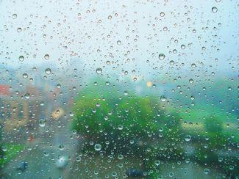
Temperature, humidity and carbon dioxide
Notes:
Other factors that affect a rooms.

Slide 6
Examples of living walls
https://livewall.com/
https://www.ypsbotanicals.com/gallery/living-wall-projects/
Notes:
What is a living wall? It is just an area of plant growth in a building. These can be moveable or stationary as the ones pictured are

Slide 7
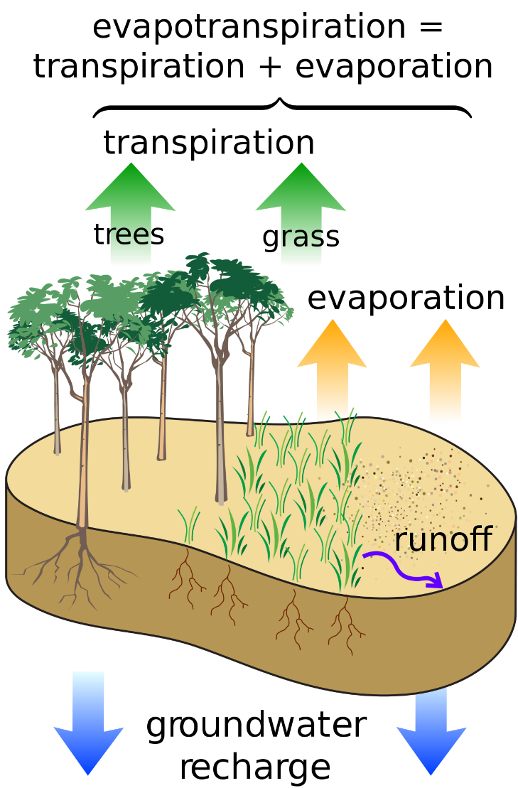
Photosynthesis & evapotranspiration
Notes:
Quickly walk through photosynthesis. What is evaoptraspiration? Transpiration= The release of water from plant leaves Evaporation=vaporization that occurs on the surface of a liquid as it changes into the gas phase

Slide 8
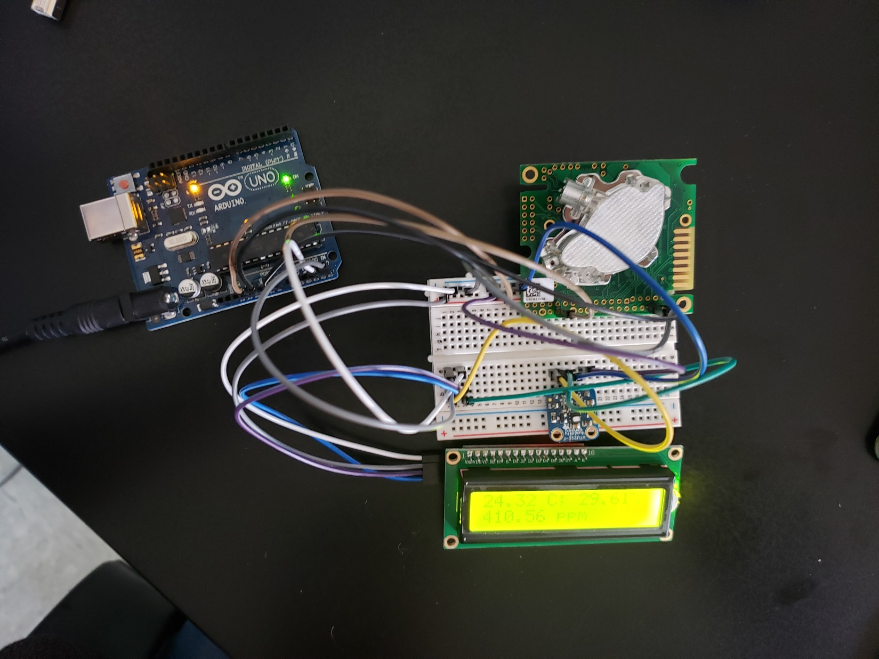
Monitoring with sensors
Humidity and
temperature
monitor
CO2 monitor
Notes:
How to monitor our environment.

Slide 9
Fritzing diagram

Slide 10
Living Wall Day 2

Slide 11
Brainstorming
Where would be a good location for a living wall?
Remember: we want it somewhere it could be helpful, for example:
Improving the ambient humidity or CO2 levels
Improving aesthetics or as a beautification project
What are some other ways a living wall can help an environment?

Slide 12
Observations
List a few ideal spaces for the living wall, and consider the following questions:
What type of light does this area receive?
How large of an area is it?
Who would get to see it?
What do you know about this area in terms of usage?
Are there devices that would increase the amount of CO2 or humidity in this area?
Now, write a proposal based of this data.

Slide 13
Data gathering
Using the Arduino that you built to monitor you will need to collect a varied amount of data. You will need at least 30 points of data.
Calculate the average of temperature, relative humidity, and CO2. **If you complete this you can calculate the standard deviation of your data.

Slide 14
Average Chart
Location
Average Temp
Average RH
Average CO2

Slide 15
Living Wall Day 3

Slide 16
Data analysis
What trends do you see with the chart?
What is it about that location that is the same or different?
Could we graph this data to show the information more clearly?

Slide 17
How to find the right spot?
This website is great for showing where the optimal zone is for relative humidity temperature AND air flow.
Things to know:
Operative temperature—What is the temperature?
Air speed—Is there a breeze?
Humidity—How much water is in the air?
https://comfort.cbe.berkeley.edu/
Notes:
Give students 5 minutes to explore this website.

Slide 18
Example: Regulations Data Table for CO2

Slide 19
Recommendations
WHY?
Industry standards recommend that a level of 1000 ppm carbon dioxide not be exceeded in classrooms.
Higher levels of CO2 have been found to positively correlate with increased student sickness and absenteeism.
High CO2 levels are indicative of poor air circulation that also results in high levels of dust, dander, germs, microbes and other particles.
High levels of CO2 in an enclosed area reduces the amount of oxygen to the brain resulting in drowsiness and poor student performance.
Sources: https://www.uft.org/your-rights/safety-health/environmental-health-and-safety/building-hazards/carbon-dioxide
https://www.trane.com/commercial/Uploads/PDF/520/ISS-APG001-EN.pdf
https://www.co2meter.com/blogs/news/7334762-indoor-air-quality-ihe-classroom

Slide 20
Where should the living wall go?
Location
Average Temp
Average RH
Average CO₂
*Your assignment* is now to use the data the entire class used and write an argument where you think this wall should go!
Please type your response. It should be clearly stated what location your choice is. You will need to support your choice using the data collected. Explain in detail how/why you have come to your decision. You may also choose to do more research and add that into your response for evidence. Cite your sources.

