Slide 1
Intro Activity
Lab Research to Engineer a Phosphorescent Bioplastic
Notes:
Intro Activity Presentation, Lab Research to Engineer a Phosphorescent Bioplastic activity, TeachEngineering.org

Slide 2
Qualitative Observations of the Beads
Notes:
Expect students to report that the beads changed from white to a color after being exposed to sunlight.

Slide 3
Electromagnetic Spectrum
Notes:
In the above graph, the first bar is a key to the electromagnetic radiation that either, do or do not penetrate the earth's atmosphere. Y is for yes and N is for no. Although some radiation are marked as no in the diagram, some waves do in fact penetrate the atmosphere, although extremely minimally compared to the other radiation.
Next the wavelengths are expressed in terms of meters, using scientific notation. Notice the spectrum goes from the longer radio waves, at 10³ meters, all the way to the shorter gamma rays, at 10⁻¹² meters.
Next the various wavelengths are compared to sizes found in everyday life.
///
Graphic source:
2007 NASA, Wikimedia Commons CC BY-SA 3.0 https://commons.wikimedia.org/wiki/File:EM_Spectrum_Properties_reflected.svg
reversed image: 2013 by inductiveload, Wikimedia Commons CC BY-SA 3.0 https://commons.wikimedia.org/wiki/File:EM_Spectrum_Properties_edit.svg

Slide 4
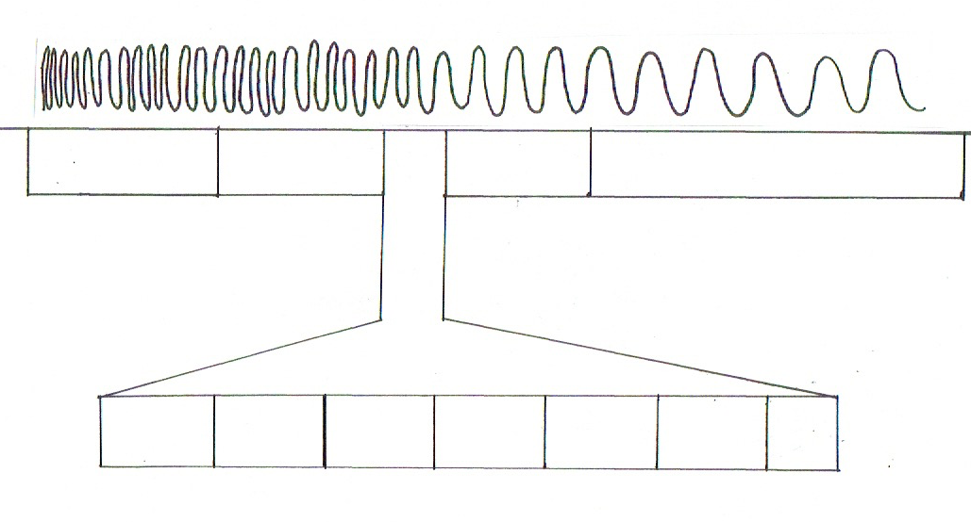
Electromagnetic Spectrum

Slide 5
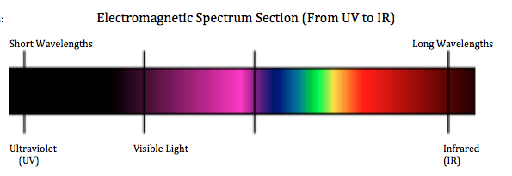
What caused the beads to change colors?

Slide 6
What caused the powder to change colors?
Notes:
Image source: ____?

Slide 7
Definitions
Fluorescent
When hit with UV radiation, it absorbs the UV radiation and emits visible light
BUT the emission stops as soon as the UV radiation stops
Phosphorescent
When hit by a short wavelength, it absorbs the waves and emits visible light (of a longer wavelength)
The emission may continue after the waves have stopped

Slide 8
Is the powder…
Fluorescent?
Phosphorescent?

Slide 9
Research/Design Problem
Today, your challenge is to create a phosphorescent bioplastic using the following reaction scheme:
corn starch + water + vinegar + glycerin + phosphorescent ➔ phosphorescent
powder bioplastic
…so that the bioplastic is structurally sound and gives off a high phosphorescent.
What reactant will you be manipulating?
~ problem step ~

Slide 10
Research Your Reactant
Ideas to research:
What is your reactant?
How is it commonly used?
Is it commonly used in baking? If so, why?
What does structural integrity mean to you?
List your prior knowledge about the reactant.

Slide 11
Hypothesis
What is the independent variable?
What are the dependent variables?
Write a hypothesis that includes the variable and describes how the variables will change.
~ hypothesis step ~

