Slide 1
Lab Procedure for Standard/Control Sample Preparation
Notes:
Lab Procedure for Standard/Control Sample Preparation, Lab Research to Engineer a Phosphorescent Bioplastic activity, TeachEngineering.org
///
All images: 2016 Jamie Sorrell, RET Program, School of Polymers and High Performance Materials, University of Southern Mississippi (author)

Slide 2
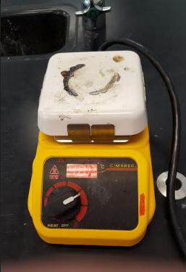
Preheat a hot plate to 400°C
Notes:
Walk students through this procedure, which matches their handouts

Slide 3
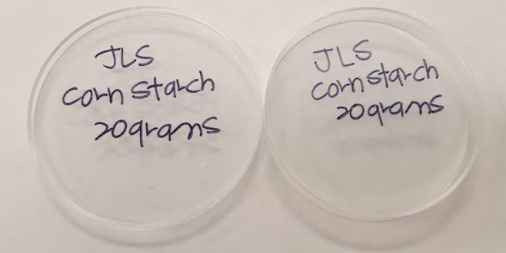
Label tops and bottoms of petri dishes with group initials, sample name and reactant concentration

Slide 4
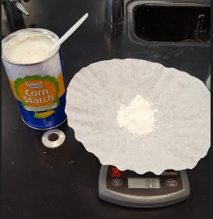
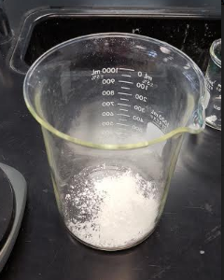
In 1,000-ml beaker, add 10 g of cornstarch

Slide 5
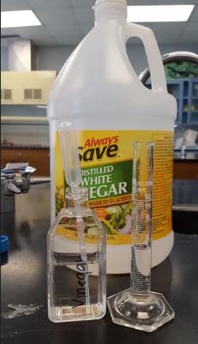
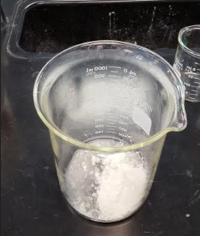
Using a 10-ml graduated cylinder, add 5 ml of vinegar to the same beaker

Slide 6
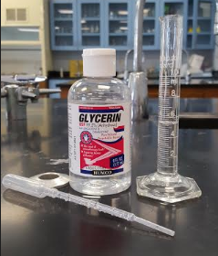
Using a 10-ml graduated cylinder, add 5 ml of glycerin to the same beaker

Slide 7
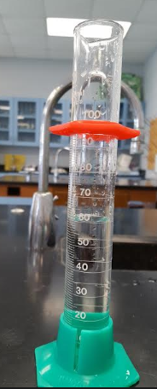
Using a 100-ml graduated cylinder, add 60 ml of water to the same beaker

Slide 8
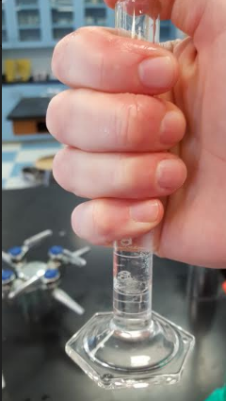
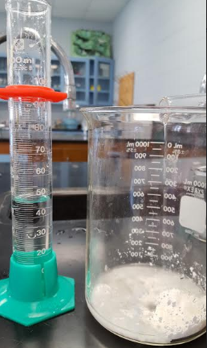
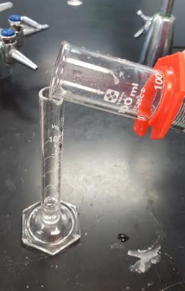
Use your measured water to get the glycerin residue from the graduated cylinder in the previous step

Slide 9
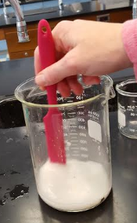
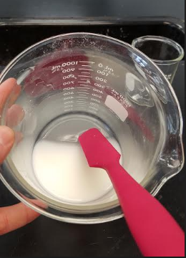
Using a silicone spatula, stir until all material is completely dissolved

Slide 10
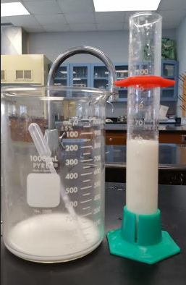
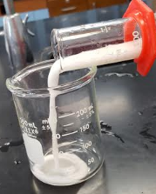
Using a 100-ml graduated cylinder, measure out 60 ml of the mixture, and put into a clean 250-ml beaker

Slide 11
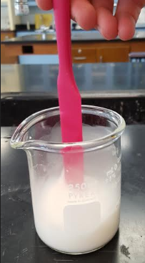
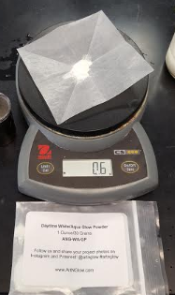
Add 0.6 grams of phosphorescent powder to the 60-ml mixture in the 250-ml beaker—and stir

Slide 12
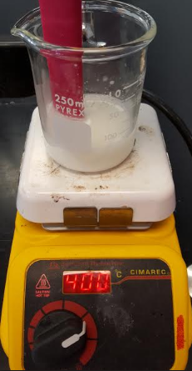
On the preheated hot plate, heat the mixture in the 250-ml beaker
400 °C ➔

Slide 13
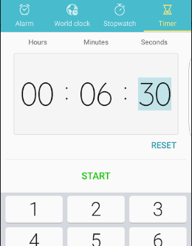
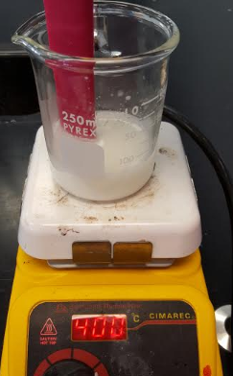
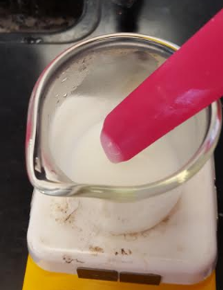
Continuously stir while heating the mixture for 6 mins and 30 secs
Notes:
** BE CONSISTANT WITH TIME FOR ALL YOUR SAMPLES **

Slide 14
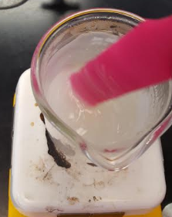
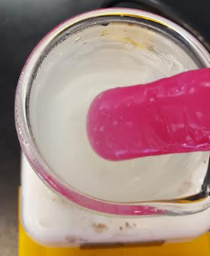
After 6 mins and 30 secs, the mixture becomes clear and/or a viscous solid
Notes:
** BE CONSISTANT WITH TIME FOR ALL YOUR SAMPLES **

Slide 15
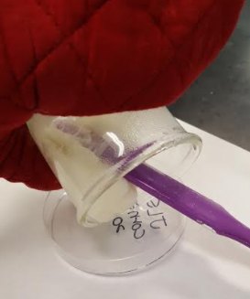
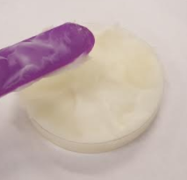
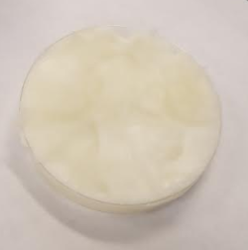
Using the silicone spatula, transfer the heated mixture to a prepared petri dish
Let the phosphorescence bioplastic dry overnight
Notes:
Using the silicone spatula, transfer the heated mixture into a small petri dish that is lined with aluminum foil and labeled with the sample name.

