Slide 1
Sample Preparation
Notes:
Sample Preparation Presentation, Lab Research to Engineer a Phosphorescent Bioplastic activity, TeachEngineering.org
///
All images: 2016 Jamie Sorrell, RET Program, School of Polymers and High Performance Materials, University of Southern Mississippi (author)

Slide 2
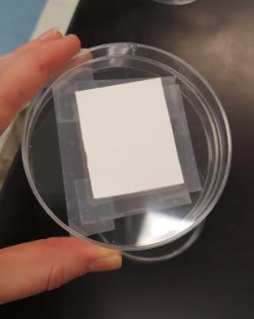
Tape a sample paper template on the outside bottom of a petri dish Use this as one of your petri dishes AND as a template to prepare all the rest of your petri dishes to receive bioplastic samples
Notes:
Use on Day 3

Slide 3
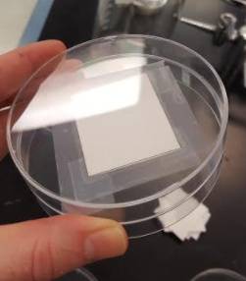
Place a blank petri dish on top of the petri dish template

Slide 4
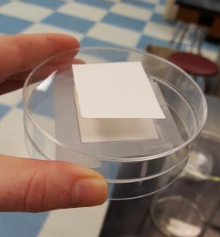
Place the sample paper template on top of the blank petri dish using your first petri dish as a guide

Slide 5
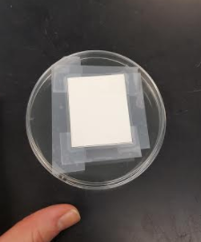
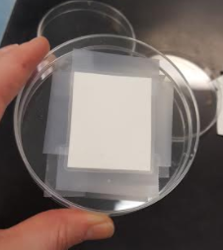
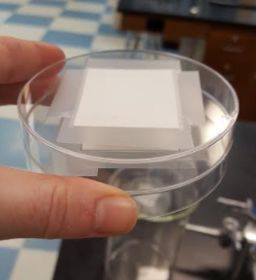
Tape down the sample paper template on the blank petri dish

Slide 6
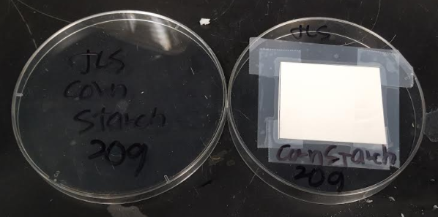
Label the lid and bottom of the petri dish template

Slide 7
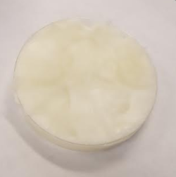
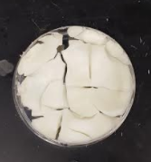
Sample may crack as it cures

Slide 8
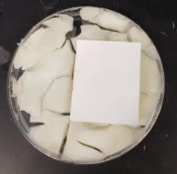
Place paper template over the most intact portion of the bioplastic Use a box cutter to cut around paper template

Slide 9
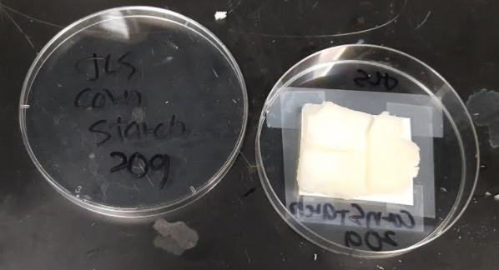
Place cut sample over the paper portion of the petri dish template

Slide 10
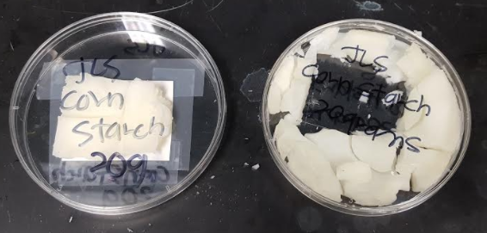
Keep the extra pieces for qualitative analysis

