Slide 1
Control Lab Procedures

Slide 2
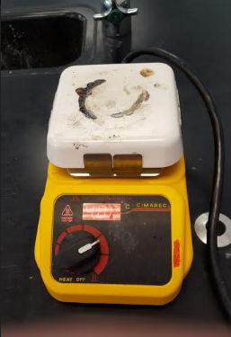
Preheat hot plate to 400°C

Slide 3
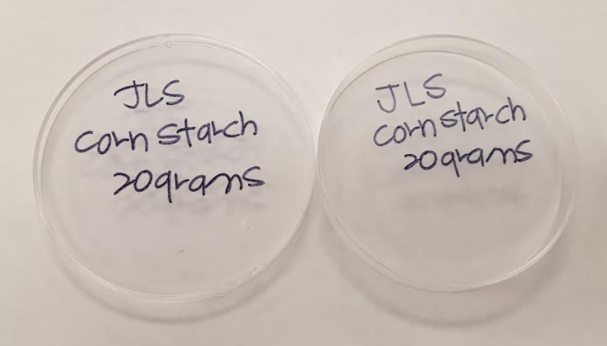
Label petri dishes (top and bottom) with sample name

Slide 4
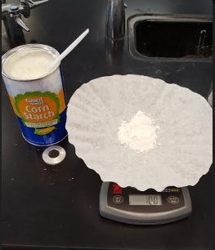
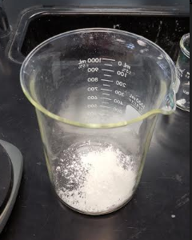
Add 10 g of cornstarch to a 1000 ml beaker

Slide 5
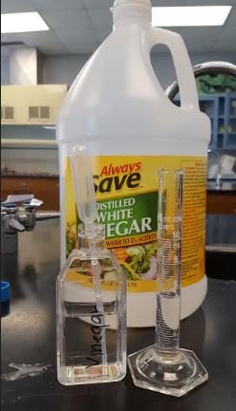
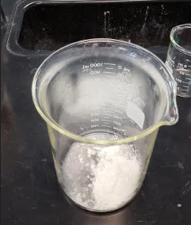
Add 5 ml of vinegar to the same beaker (using a 10 ml graduated cylinder)

Slide 6
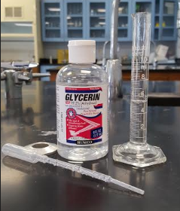
Add 5 ml of glycerin to the same beaker (using a 10 ml graduated cylinder)

Slide 7
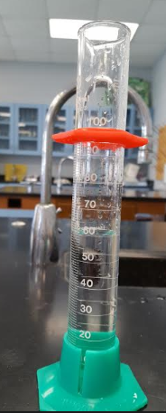
Add 60 ml of water (using a 100 ml graduated cylinder)

Slide 8
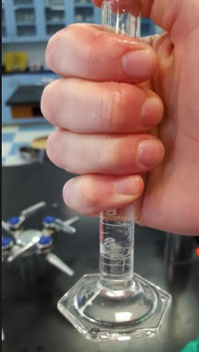
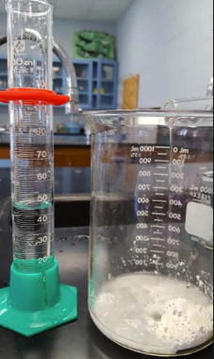
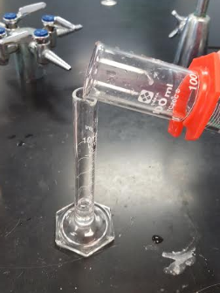
Use your measured water to get the glycerin residue from the graduated cylinder (in Step 3)

Slide 9
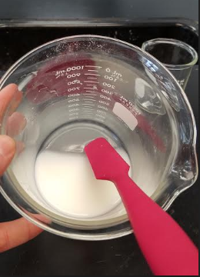
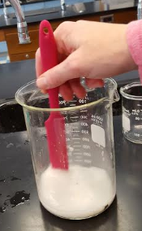
Stir using a silicon spatula until the material is completely dissolved and the solution is uniform

Slide 10
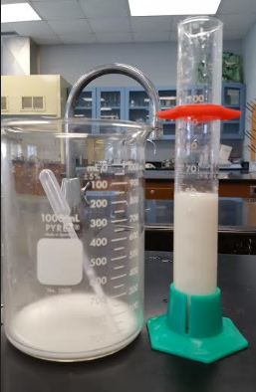
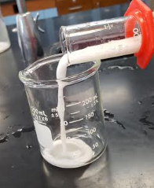
Measure out 60 ml of the mixture, using a 100 ml graduated cylinder into a 250 ml beaker

Slide 11
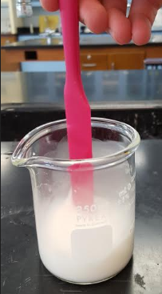
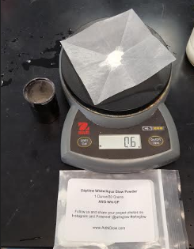
Add 0.6 grams of Phosphorescent Powder to the 60mL mixture and Stir

Slide 12
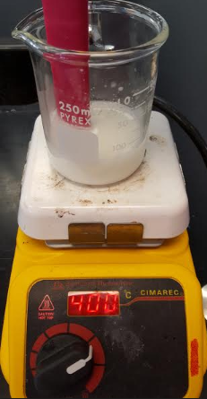
Heat the mixture in the 250mL Beaker using the preheated 400°C Hot Plate

Slide 13
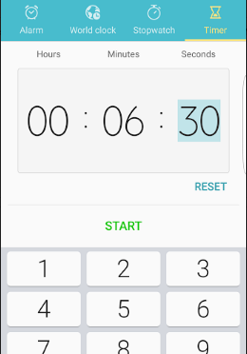
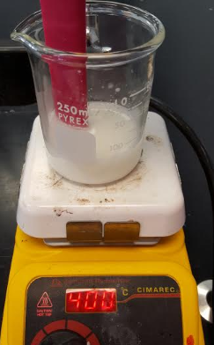
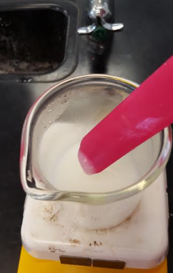
Continuously stir while heating the mixture for 6 minutes and 30 seconds

Slide 14
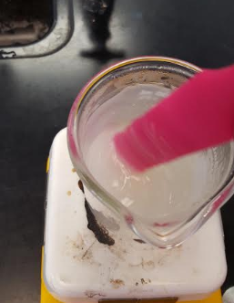
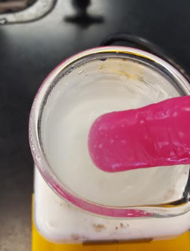
After 6 minutes and 30 seconds, the mixture will become a clear and/or a viscous solid

Slide 15
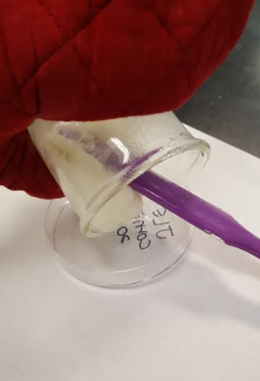
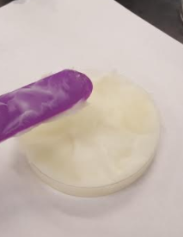
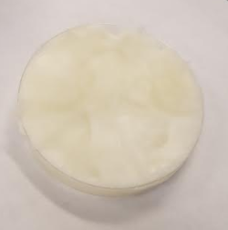
Transfer the heated mixture to a prepared petri dish using the spatula; let sit and dry overnight

