Slide 1
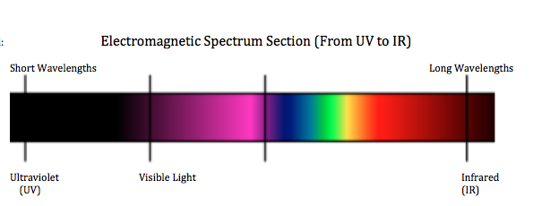
Light is an example of an electromagnetic wave (electrons in an atom oscillating back and forth).
This diagram shows the range of
electromagnetic waves.

Slide 2
Intro Question: What happens to use if we are overexposed to sunlight?

Slide 3
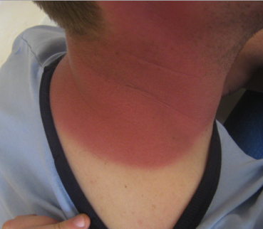
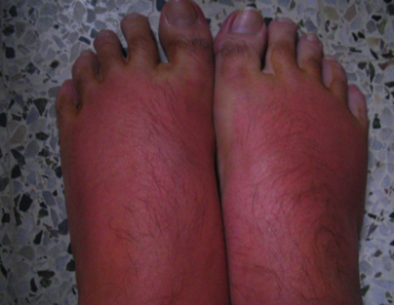
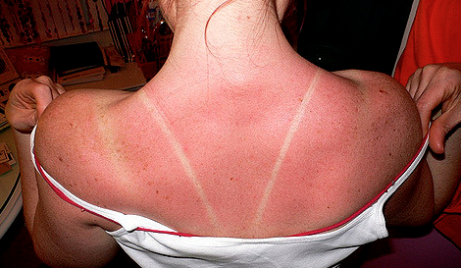
What happens to use if we are overexposed to sunlight?

Slide 4
Which of the following light waves from the sun cause sunburn?

Slide 5
Which of the following light waves from the sun cause sunburn?
Helps synthesize vitamin D, can cause sunburn
Waves we can see
in the form of visible light
Waves that
give off heat

Slide 6
How do we protect ourselves from ultraviolet (UV) light?

Slide 7
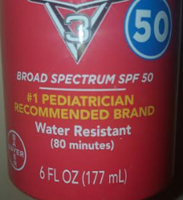
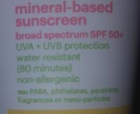
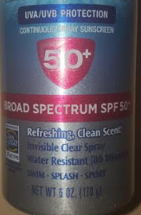
How do we protect ourselves from ultraviolet light?

Slide 8
Let’s test your sunscreen and see if it really does provide UV protection.
To test our sunscreen types, we need to create a testing material that will change when we expose it to UV light.
In this activity, we’ll create a material that is phosphorescent.

