Slide 1
Integumentary Systems
If an animal in the wild is exposed to ultraviolet (UV) rays, how do they protect themselves from UV exposure?

Slide 2
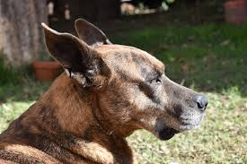
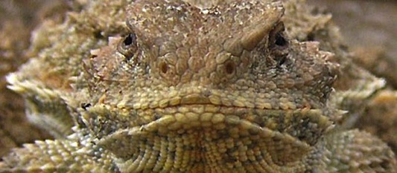
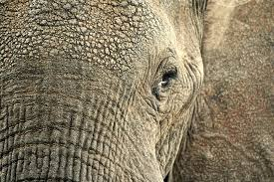
Integument and UV Rays

Slide 3
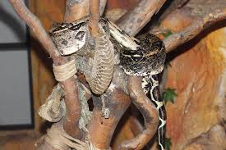
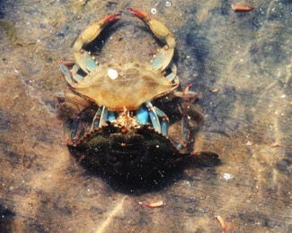
Integumentary System
A external system that protects the internal organs and structures of animals

Slide 4
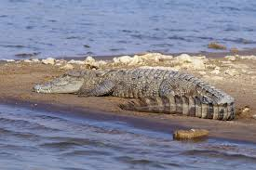
The Importance of the Integument
Protection from
Abrasion
Puncture
Invasive bacteria
desiccation
water saturation
UV rays

Slide 5
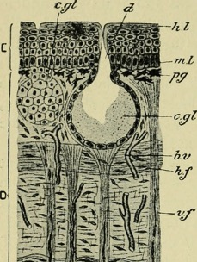
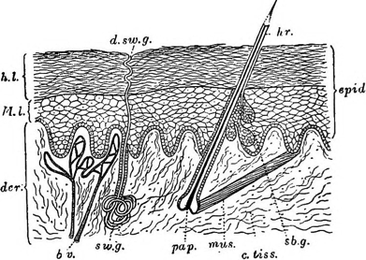
Key organ of the human integumentary system:
The skin; made up of:
epidermis: a single- layered outermost tissue
dermis- the inner layer that contains follicles, sweat glands, muscles, nerves, and blood vessels

Slide 6
The integumentary system may also provide additional protection in the form of:
Exoskeleton (found in arthropods)
Hair or fur
Feathers
Scales (in reptiles and fish)
Pigments
Structural Coloration

Slide 7
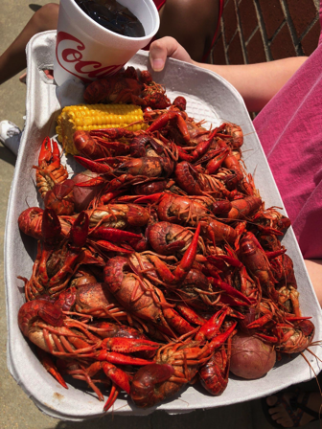
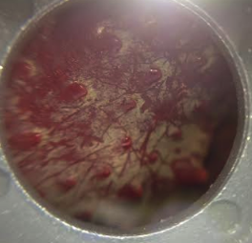
Exoskeleton
Found in arthropods such as insects and crustaceans
A two-layered complex cuticle
A non-cellular material secreted by the epidermis

Slide 8
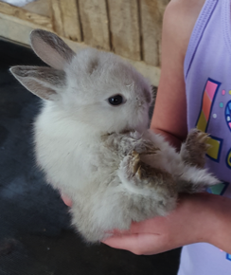
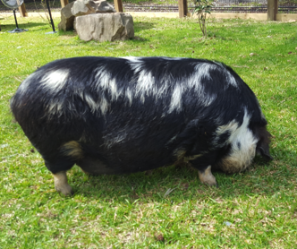
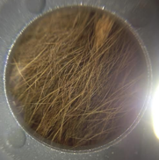
Hair or fur
Found in mammals
Originates from the epidermis
A thread-like protein composed of keratin
Found in a range of earth-tone colors (brown, black, red, or yellow)

Slide 9
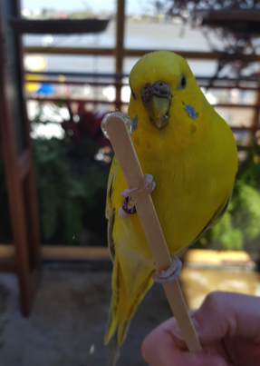
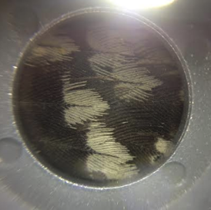
Feathers
Found in birds
Originates from the epidermis
A highly branched structure composed of keratin
One of the most complex integumentary systems in the biological world

Slide 10
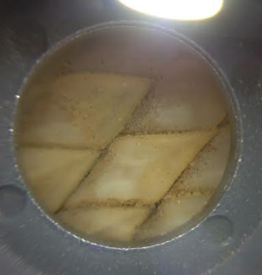
Scales
Found in reptiles, fish, butterflies and moths wings, the feet of birds
Originates from the epidermis
Small rigid plates of protein composed of keratin
Found in a range of sizes and colors

Slide 11
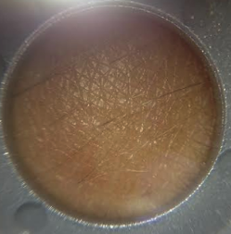
Pigment
Large molecules that reflect light
The most common melanin is a group of black or brown colors
Melanin can range from yellow and to red in color
Produced by special cells in the epidermis

Slide 12
Structural Coloration
Found in butterflies, certain beetles, and a few fish
They can reflect light
They give off iridescent and metallic hues
Found in the cuticle or scale
Composed of several stacks of plate-like structures

Slide 13
Why is UV protection important?
Sunlight plays a key role in synthesizing vitamin D in the human body; however, overexposure to UV rays over time can:
Age the skin prematurely
Cause the skin to become dry and leathery
In high doses, it can cause genetic mutations
Cause skin cancer
1 million new cases of skin cancer occur in humans each year

