Slide 1
Testing Apparatus Construction

Slide 2
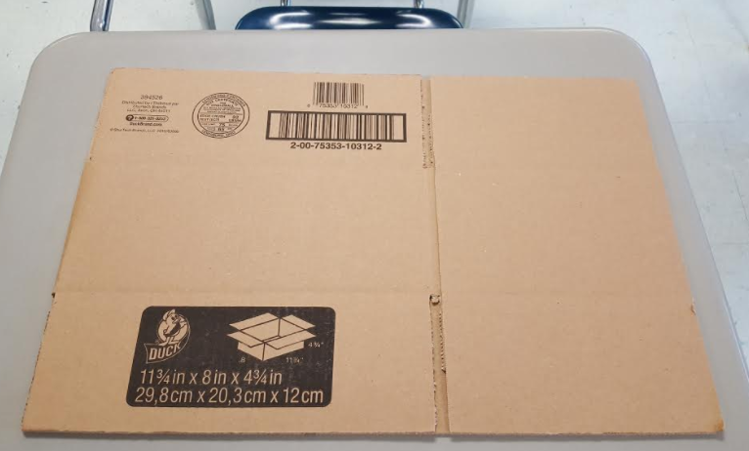
Assemble a box measuring approximately 29.8 cm x 20.3 cm x 12 cm

Slide 3
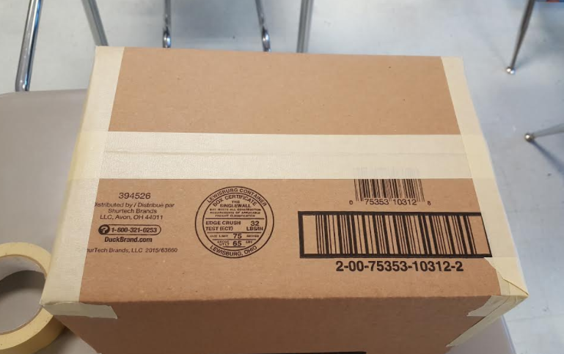
Tape the bottom and sides of the box

Slide 4
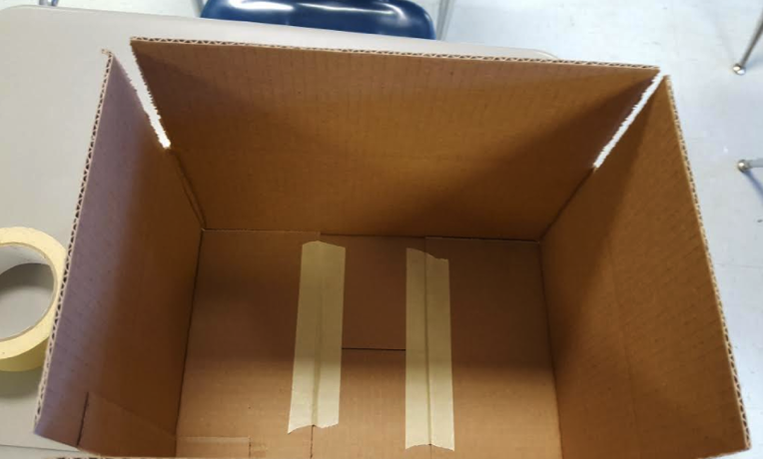
Tape down the bottom flaps on the inside of the box

Slide 5
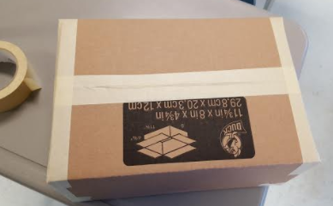
Tape the top and sides of the box

Slide 6
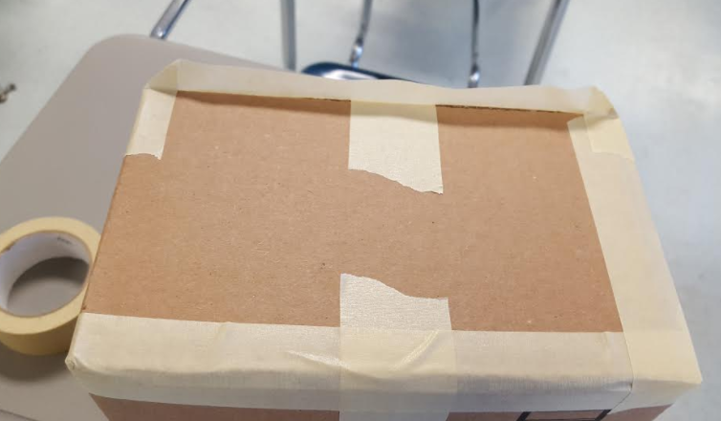
Make sure all the sides are covered with tape to keep out ambient light

Slide 7
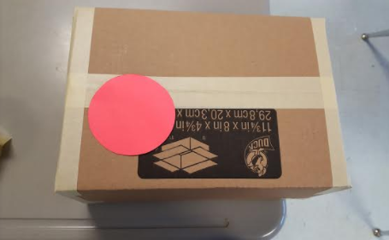
Cut a circle the size of petri dish; place this template on the top of the box

Slide 8
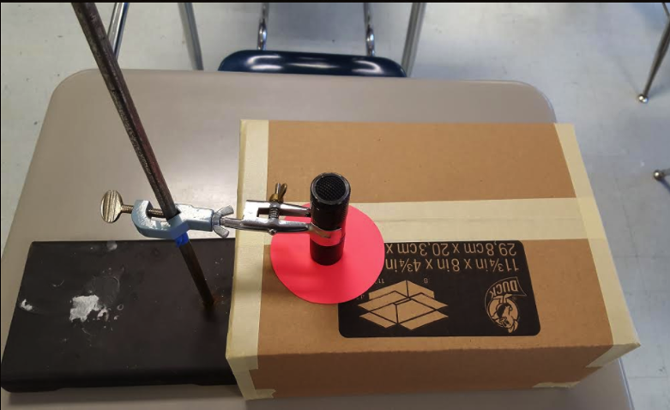
Secure the UV flashlight using a clamp and ring stand in the center of the template

Slide 9
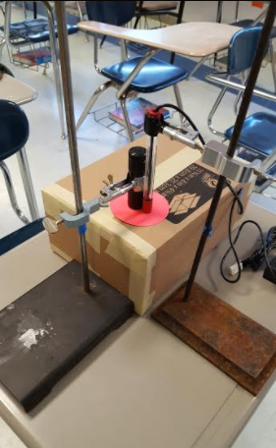
Secure the light sensor probe using the other clamp and ring stand next the UV flashlight and on the template

Slide 10
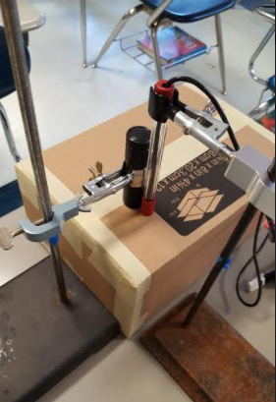
Remove the template and trace around the ends of the UV flashlight and light probe on the top of the box

Slide 11
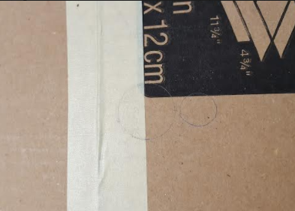
Your tracing should look like this:

Slide 12
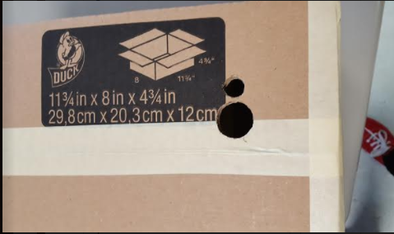
Cut out the circles using a box cutter

Slide 13
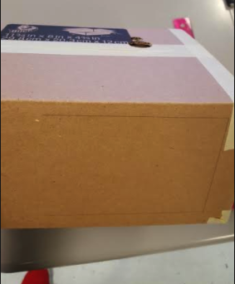
Trace a door on the side of the box away from the cut holes

Slide 14
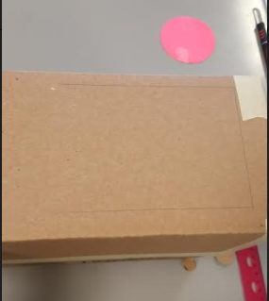
Cut out the door starting 1 cm from the top; the top and bottom sides of the door are 14 cm and the door is 10 cm wide; the bottom of the door is 2 cm from the bottom of the box

Slide 15
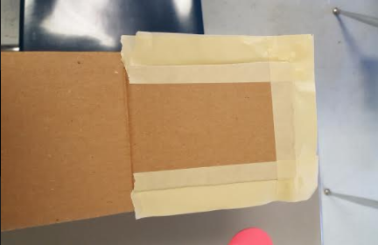
Tape the edges of the door so when the door is closed it will keep out ambient light; it will also be easier to open between samples

Slide 16
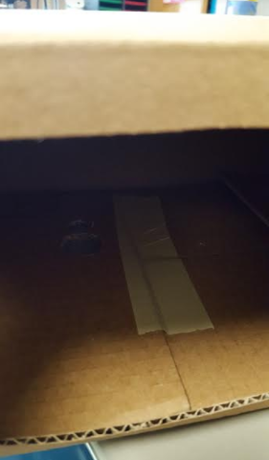
Open the door and tape down the top flaps on the inside of the box

Slide 17
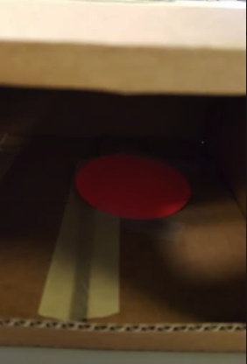
Under the UV flashlight and light probe holes, tape down the petri dish template for sample placement.

Slide 18
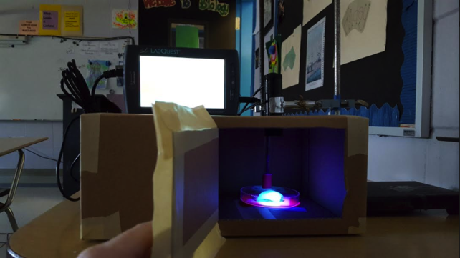
Put the UV flashlight and light sensor probe into place using the ring stand and clamps; the light probe needs to be close to the sample but far away so that samples can be switched without disturbing the probe

Slide 19
Directions for Quantitative Analysis
Make sure the LabQuest and light probe are turned on
Set a timer for 2 minutes
Put a test sample into place
Close door; record initial data reading
Turn on UV Flashlight
After 2 minutes, turn the UV flashlight off and record the first 5 readings of the LabQuest.
Average the 5 numbers for 1 quantitative reading; subtract the average from initial data reading to get a final quantitative data point

Slide 20
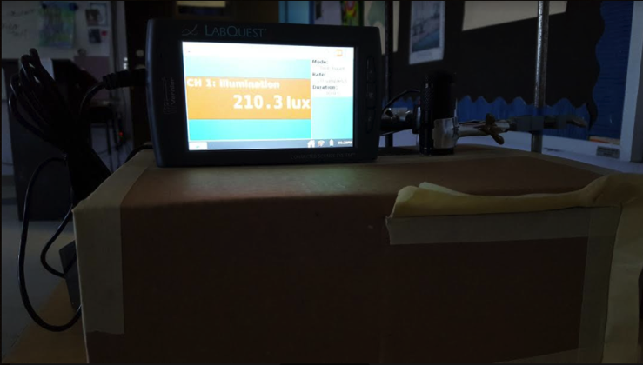
LabQuest Reading of UV Flashlight

Slide 21
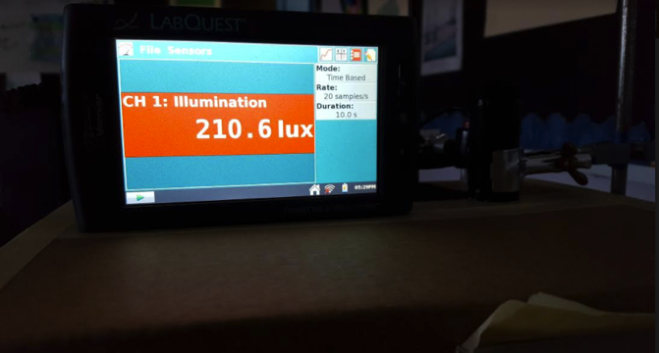
LabQuest Reading of UV Flashlight

Slide 22
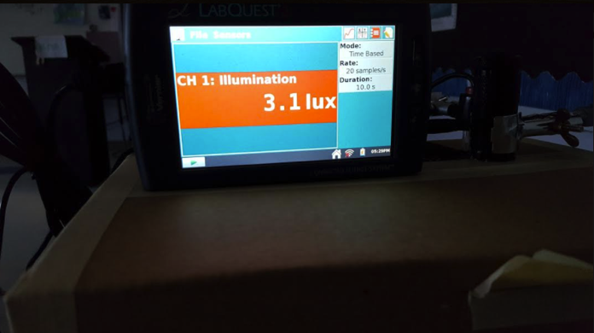
LabQuest reading after the UV flashlight is turned off; the light sensor is picking up a reading from the glow of the sample

Slide 23
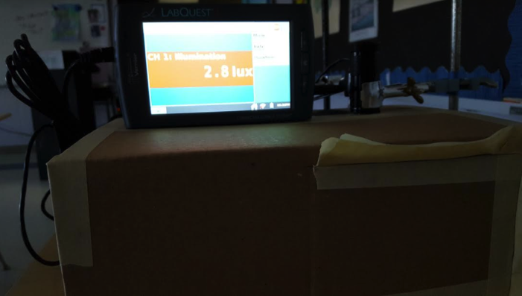
Door is still closed

