Slide 1
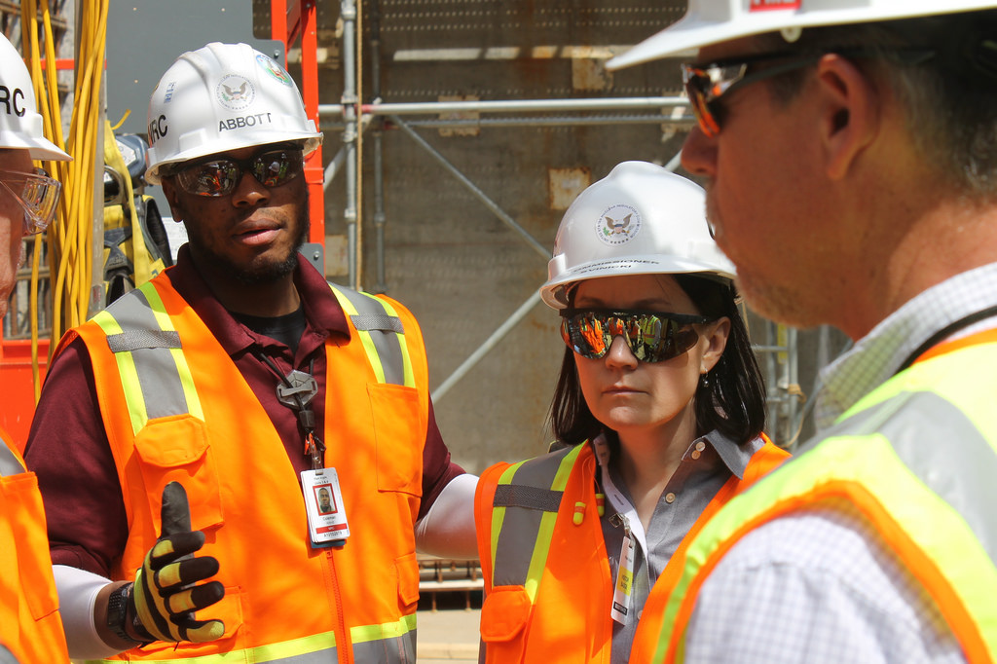
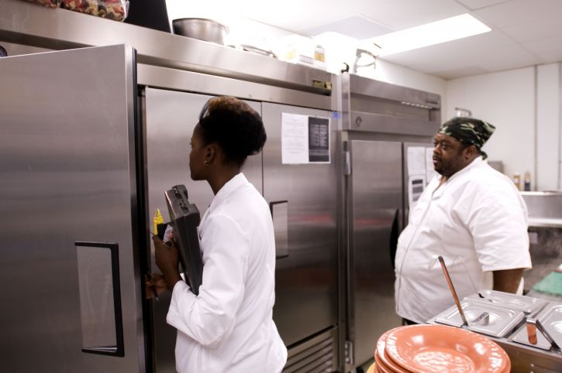
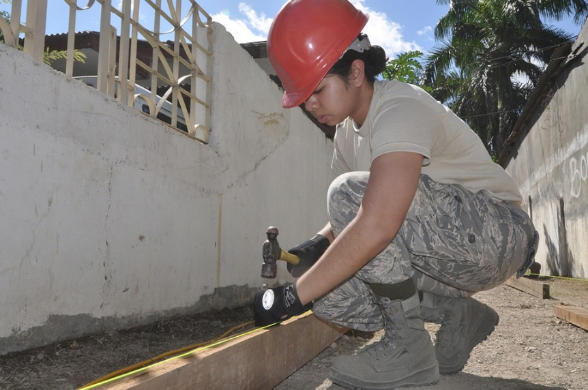
Safety Engineers
Career Spotlight: Health and Safety Engineers
Designing Procedures and Systems That Keep People Safe
Notes:
Safety Engineers Presentation, Engineering Safety Activity, TeachEngineering.org
In kitchens, on construction sites, using building tools and in all sorts of other situations—safety is a concern for health and safety engineers. This presentation will teach you about what safety engineers do, and prepare you to act as one in order to make your classroom a safer place to work.
~
Image sources:
(left; 2 adults in kitchen): Amanda Mills, USCDCP, Public Domain Images (CC0 public domain) http://www.public-domain-image.com/free-images/people/kitchens-staff-was-on-hand-for-the-inspection-and-feedback-provided-by-the-inspector
(middle; four adults in orange vests and hard hats): 2014 Nuclear Regulatory Commission, Flickr (CC BY 2.0) https://www.flickr.com/photos/nrcgov/13609195514 and https://creativecommons.org/licenses/by/2.0/
(right; woman in red hard hat hammering): skeeze, Pixabay (CC0 Public Domain) https://pixabay.com/en/construction-worker-hardhat-hammer-659898/

Slide 2
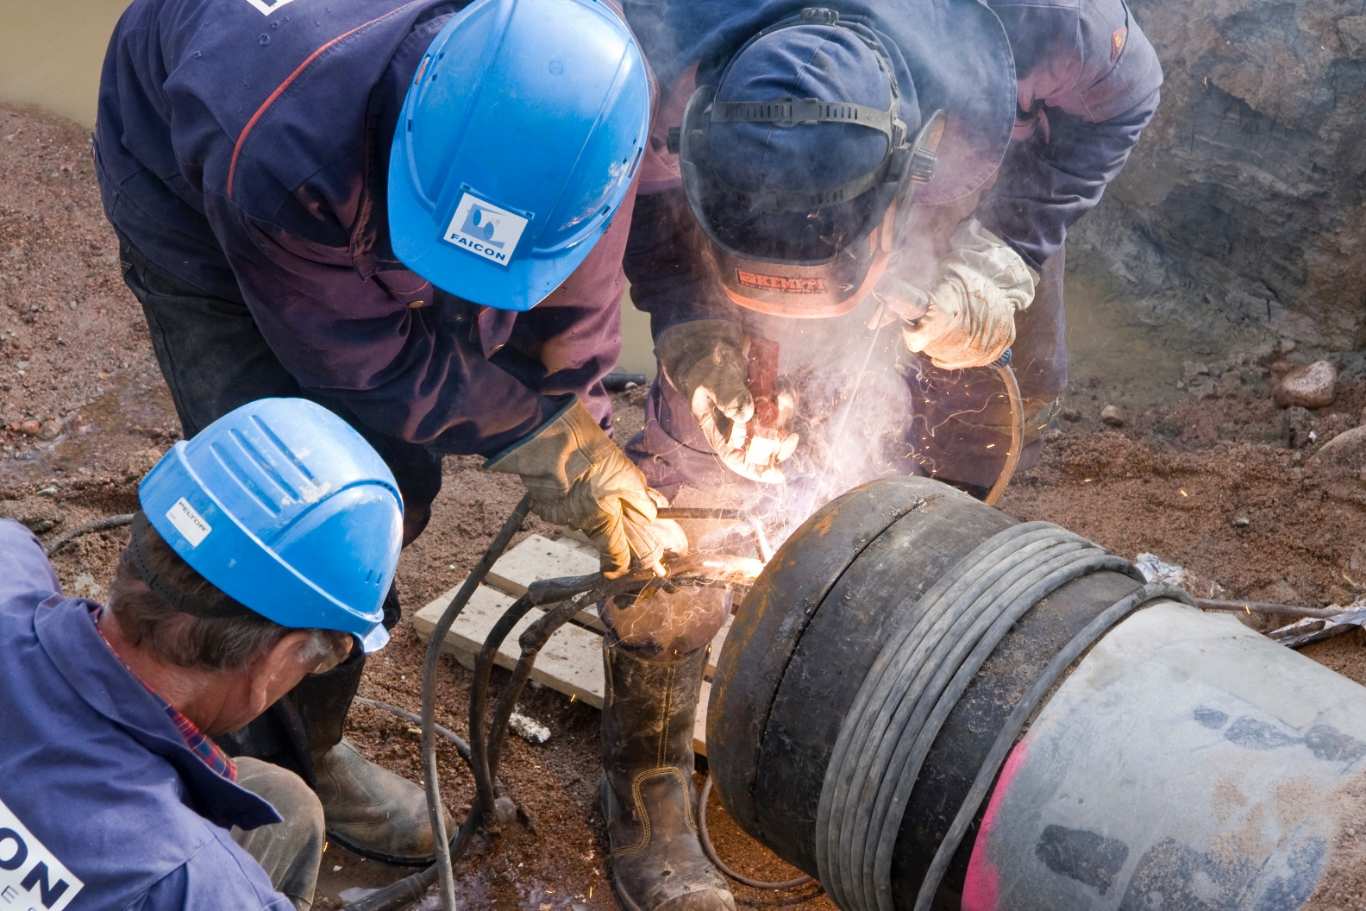
Safety engineers make lists of rules and/or procedures for workers to follow to keep them safe.
For example:
Wear safety glasses to cover your eyes
Wear thick clothes to keep sparks from burning your clothes
Before welding, throw a spark into the pipe to make sure no live gas is in the pipe
Notes:
Image source:
(3 men welding a natural gas pipe): 2011 Jukka Isokoski, Wikimedia Commons https://commons.wikimedia.org/wiki/File:Constructing_natural_gas_pipe,_Finland.jpg

Slide 3
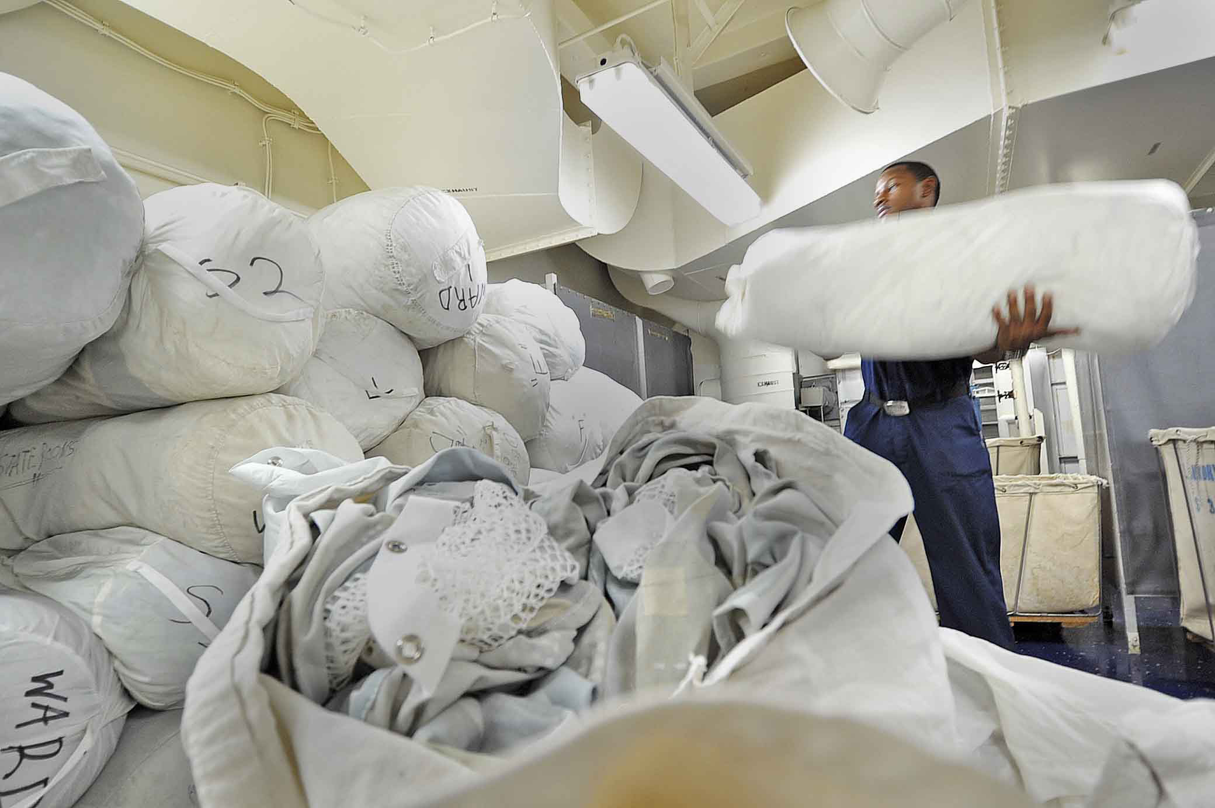
Safety engineers make lists of rules and/or procedures for workers to follow to keep them safe.
For example:
Wear gloves when handling dirty laundry at a hospital
Wear an apron so your clothes do not touch the dirty laundry
Remove the apron when leaving the workplace to avoid spreading bacteria and viruses that spread by touching dirty clothes
Notes:
Image source:
(man lifts bag of laundry on navy ship): 2012 Roadell Hickman, USNS, Department of Defense, Wikimedia Commons https://commons.wikimedia.org/wiki/File:U.S._Navy_Ship%27s_Serviceman_2nd_Class_Jaquan_Hartford_stacks_bags_of_clean_clothing_in_the_laundry_room_aboard_the_hospital_ship_USNS_Mercy_(T-AH_19)_Aug._28,_2012,_while_under_way_in_the_Pacific_Ocean_120828-N-KW566-003.jpg

Slide 4
Your Turn to Be a Safety Engineer
As you can see from these examples, safety engineers often take a close look at workplaces and identify ways to make them safer.
Your engineering challenge:
Imagine that you are a safety engineer
Analyze the photos of a classroom lab in your packet
Circle anything that you think might be unsafe, dangerous or potentially lead to injuries
Notes:
Show this slide while looking at the Health and Safety Engineering Handout.

Slide 5

Your Turn to Be a Safety Engineer
After you have analyzed the photos, write two rules for the students in your class to follow.
These two rules should keep the students safe in the lab.
Image source: Compliance and Safety
Notes:
Image source:
(safety equipment: gloves, goggles, hard hat): 2012 Compliance and Safety LLC via Wikimedia Commons https://commons.wikimedia.org/wiki/File:Occupational_Safety_Equipment.jpg AND http://www.atlantictraining.com/blog/free-occupational-safety-stock-phot/

Slide 6

Example
Workplace
Safety Poster
Notes:
Image source:
(Example OSHA workplace safety poster titled: Protect Yourself: Cleaning Chemicals and Your Health) Occupational Safety and Health Administration (OSHA), U.S. Department of Labor https://www.osha.gov/pls/publications/publication.AthruZ?pType=Types&pID=5

Slide 7
Create a workplace safety poster
Your safety engineering challenge:
Create a workplace safety poster that demonstrates how workers might prevent a hazard or injury
Include images and graphics
Include rules, steps, procedures
Make your poster easy to read
Communicate important information in a concise way
Your safety poster will be evaluated using this rubric ➔
 | Images | Concise Writing
Full Credit | The poster includes one or more images that relate to the assigned hazard. These images clearly illustrate the consequences of the hazard or how to prevent the hazard. | The poster includes at least two rules, steps or procedures that workers or their employers can follow in order to minimize the likelihood that they will be involved in the hazard. The poster is written in concise language so that workers can quickly read and understand it.
Partial Credit | The poster includes one image, but it may be hard to determine how this image relates to the assigned hazard. | The poster includes one rule, step or procedure that workers or their employers can follow in order to minimize the likelihood that they will be involved in the hazard. The poster may include difficult vocabulary, unclear or unnecessary language, or confusing sentences that make the poster difficult to understand when workers first look at it.
No Credit | The poster includes no images. | The poster include no rules, steps or procedures for minimizing the assigned hazard.

