Slide 1
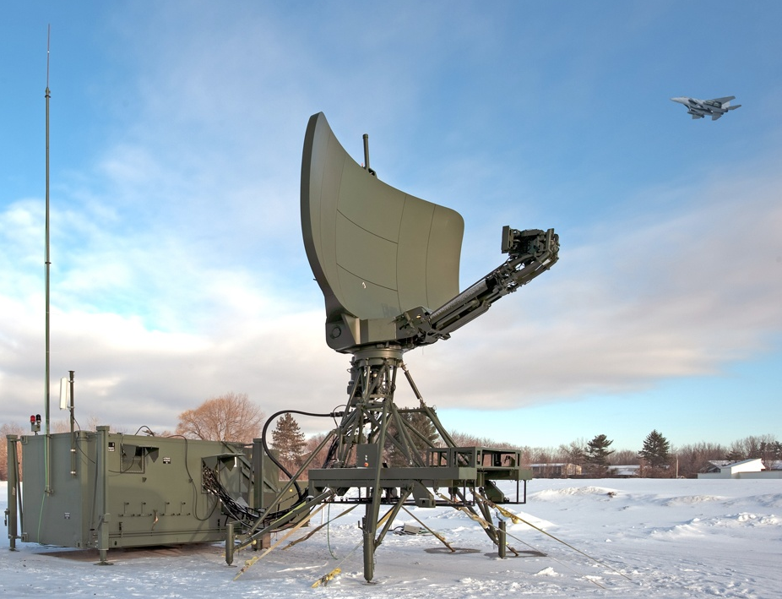
The Invisible Radar Triangle
Image source: US Air Force, http://www.af.mil/photos/media_search.asp?q=isar
Notes:
2012 © The Invisible Radar Triangle activity, TeachEngineering.org

Slide 2
What is radar imaging?
Radar imaging is used to detect objects that are far away.
Many different types of radar imaging have been created, but in this activity, we will look at inverse synthetic aperture radar (ISAR).
ISAR creates images of objects (targets) that are constantly moving (such as airplanes, cars, planets, etc.).
Notes:
Radar imaging is used to create images of various objects to detect, classify and identify their sizes and directions of movement. For example, to conduct military surveillance, monitor weather and take images of the Earth and other planets. While many different types of radar systems are in use, this activity looks at the inverse synthetic aperture radar (ISAR). ISAR is widely used for military surveillance because of its ability to work in all weather conditions.
ISAR is a technique used to create radar images of targets that continually move, such as airplanes, cars and planets. A stationary antenna sends radio waves to a moving target. The radio waves are reflected back to the antenna, stored and processed to form a two-dimensional image (picture) of the target. (Wolff, 2012)

Slide 3
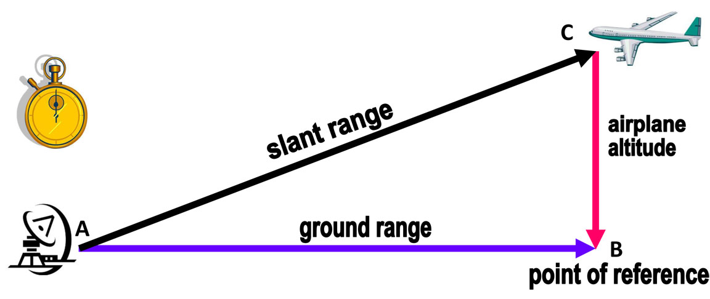
What about the triangle?
This drawing illustrates a radar imaging scenario. 
The distance from the radar to the target is the slant range.
The horizontal distance from the radar to a point of reference on the ground under the target is the ground range.
The slant range, ground range and airplane’s altitude form an invisible right triangle. Do you see it?
Notes:
If the target, radar and point of reference are connected by imaginary lines, they form a right triangle.

Slide 4
Engineers use this invisible triangle and different equations to calculate the distance, direction and elevation angle of the target.

Slide 5
Why do we need radar imaging?
ISAR radar imaging is mainly used by government agencies for surveillance.
Engineers have designed many radar systems for many different uses.
For example, NASA uses different kinds of radars to study the Earth, other planets and space.
Radars are also used to monitor weather.

Slide 6
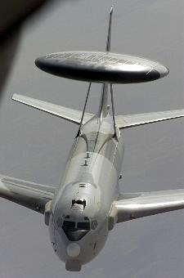
Radar imaging simulations
To continually improve existing radar imaging techniques, engineers have developed radar imaging simulators.
A radar imaging simulator uses a three-dimensional model of the target being studied to generate radar images and adjust parameters until the desired image quality is achieved.
Similarity and scaling are used to create three-dimensional scale models of targets.
Image source: US Air Force, model of E-3, http://www.af.mil/photos/media_search.asp?q=radar imaging simulation&page=36

Slide 7
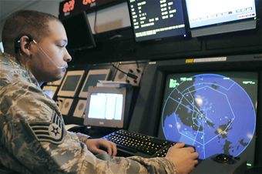
Imagine…
Imagine you are an army soldier who monitors radar systems at a military base. You are asked to make a presentation to a group of people describing how radar imagining is done. Your audience is not familiar with radar imaging.
You decide to use a model to help your audience better understand your presentation. Your model must be similar to the one shown in the presentation.
Image source: US Air Force, http://www.af.mil/photos/media_search.asp?q=isar
How can a model help you present this concept?
Notes:
Use this slide to present the activity challenge.

Slide 8
37°
90°
You know the angle formed by the ground range and the airplane’s altitude is 90 degrees.
You want to use an elevation angle of 37 degrees (formed by the ground range and slant range).
How can you determine the third angle in the triangle?
How can you make a realistic model of the scenario?
How can the concept of similar figures help you construct a proportional model to make it more realistic?
Notes:
Example to show students (see Procedure section of the activity write-up).

Slide 9
Let’s Plan
First, design your model on paper.
When you are done, show it to me.

Slide 10
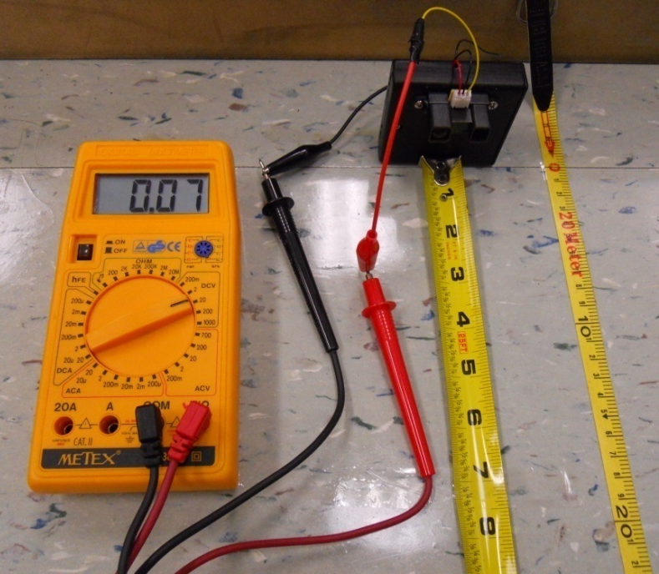
Infrared range sensor
Radars send radio waves to a target, the waves reflect back and are stored and processed to produce an image.
Engineers use equations to calculate the distance between the radar and the airplane.
In our activity, we will use an infrared range sensor and a multimeter to calculate the distance between the radar and the airplane.
You will work in your groups
to make and calibrate your
sensors.
Image source: 2012 RET-ENET Program, The University of Texas-Pan American

Slide 11
References
Wolff, Christian. “Synthetic Aperture Radar.” Accessed July 6, 2012. (inspiration for triangle diagram) http://www.radartutorial.eu/20.airborne/ab07.en.html#this
“Video Gallery.” NASA. Accessed July 6, 2012. http://www.nasa.gov/multimedia/videogallery/index.html

