Slide 1
SENSORS AND SCATTERPLOTS
Introduction

Slide 2
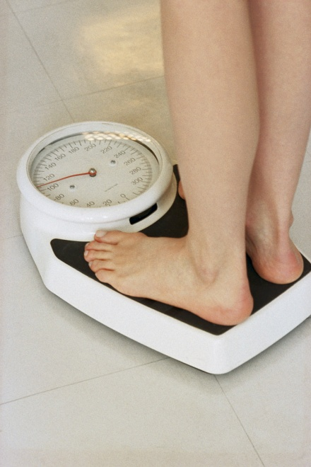
Body mass index (bmi)
BMI is a number calculated from your weight and height.
BMI = (weight, kg)
(height, m)²
The number is used by medical professionals to screen for health problems.
Source: http://www.cdc.gov/healthyweight/assessing/bmi/childrens_bmi/about_childrens_bmi.html Image source: Copyright © 2004 Microsoft Corporation, One Microsoft Way, Redmond, WA 98052-6399 USA. All rights reserved.

Slide 3
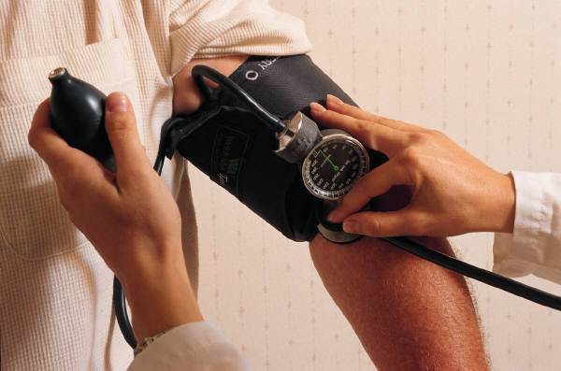
Blood pressure (BP)
Each time your heart beats, it pumps blood into your arteries.
Blood pressure is the force of blood pushing against the walls of the arteries as your heart pumps blood.
Written as a ratio: systolic pressure (when your heart beats)
diastolic pressure (when your heart rests)
110/70 mmHg is read 110 over 70 millimeters of mercury.
BP used to screen for health problems.
Source: http://www.heart.org/HEARTORG/Conditions/HighBloodPressure/AboutHighBloodPressure/Understanding-Blood-Pressure-Readings_UCM_301764_Article.jspI
Image source: Copyright © 2004 Microsoft Corporation, One Microsoft Way, Redmond, WA 98052-6399 USA. All rights reserved.

Slide 4
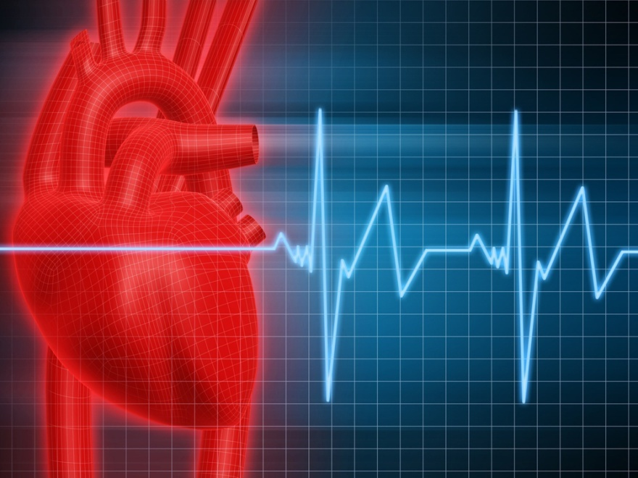
Pulse rate
Your pulse rate is the number of times your heart beats per minute.
As with BMI and BP, your pulse rate is used to screen for health problems.
Image source: Copyright © 2004 Microsoft Corporation, One Microsoft Way, Redmond, WA 98052-6399 USA. All rights reserved.

Slide 5
Scatterplot relationships
Positive trend/correlation
Negative trend/correlation

Slide 6
Scatterplot relationships (cont’d)
No trend/correlation
Line of best fit

Slide 7
Let’s consider some relationships
Do you think that there is a relationship between:
BP and BMI?
Pulse rate and BP?
BMI and pulse?
Do you think there is a difference in the relationships between the male and female data?

