Slide 1
An Introduction to 3D Bioprinting
Notes:
Presentation, An Introduction to 3D Bioprinting Lesson, TeachEngineering.org

Slide 2
Lesson goals
Introduce engineering problem (“Bill”)
Define and analyze different types of 3D bioprinters
Define the basics of tissue engineering
Identify current applications and limitations of 3D bioprinting
Start figuring out how to help Bill!
Notes:
These are the topics we intend to cover during this lesson.

Slide 3
Why do we care about 3D bioprinting?
Watch this video
Notes:
A student, Bill, got into a terrible accident. With 3D bioprinting, we may be able to help him!
We managed to get footage of what he went through, so you’ll better understand the situation.
Show the 51-second YouTube video (Bill.mp4) at https://www.youtube.com/watch?v=AAoFE-rq67Y

Slide 4
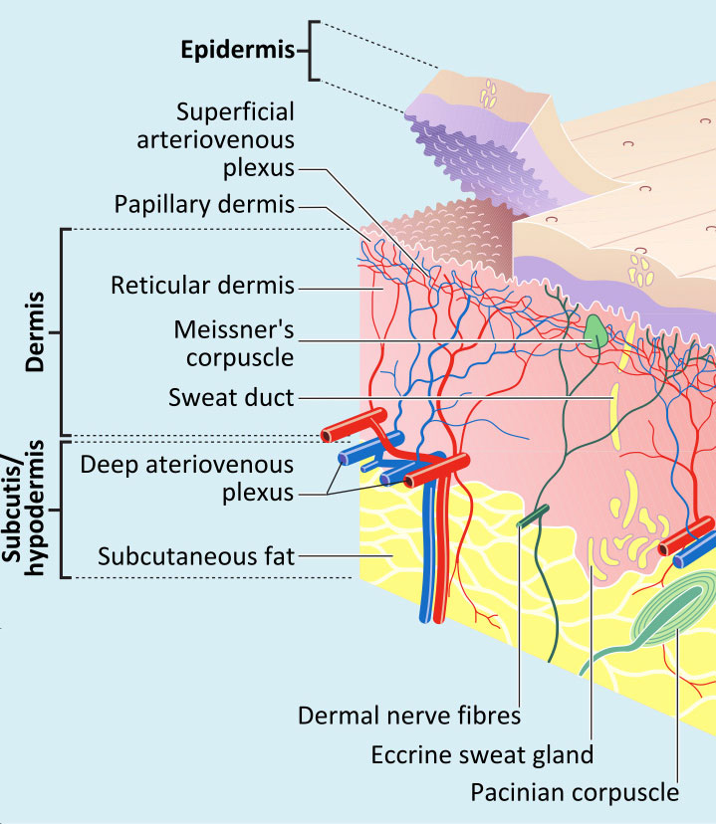
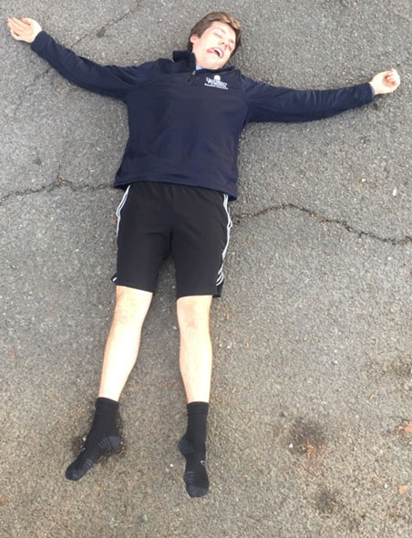
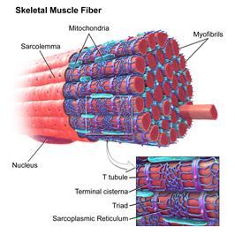
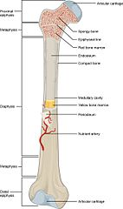
Bill’s Injuries
Image 1
Image 2
Missing skin on the left arm
Image 3
Ripped rectus femoral muscle
Severely broken femoral shaft
Notes:
So – Bill was pretty hurt from that car crash. He was rushed to the ER immediately.
He sustained 3 injuries: a ripped muscle in his right leg, a broken bone in his left leg, and major skin loss on his left arm.

Slide 5
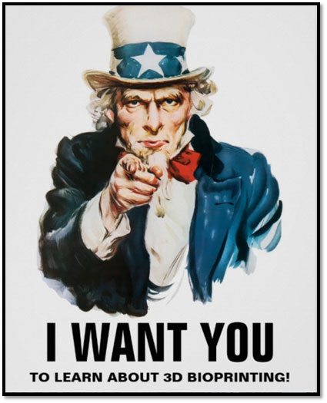
We need your help!
Image 4
Notes:
By using 3D bioprinting, we may be able to help Bill!
We’ll teach you everything you need to know about 3D bioprinting, so that later in class (in the Help Bill! Bioprinting Skin, Muscle and Bone associated activity), you will print the 3 tissues Bill has lost using mock-3D bioprinters.

Slide 6
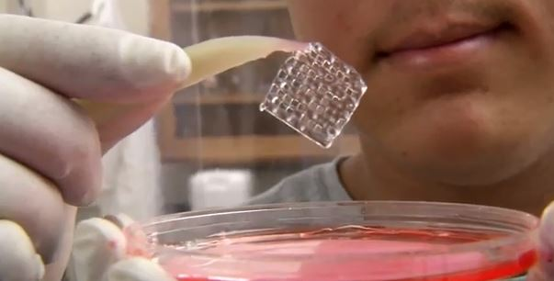
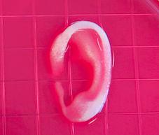
What is 3D bioprinting?
Image 5
Image 6
Image 7
Notes:
Ask: Who has heard of 3D bioprinting? If so: Where did you hear of it? For what was it being used?
Ask: Has anyone heard of 3D printing? If so: Where did you hear of it? For what was it being used?
Give definition: 3D bioprinting is a way of printing tissues, layer by layer. This printed tissue contains two parts: the cells and the unique mixture of fibers that makes up the structure and shape of the printed tissue.
These structures may vary in size and shape, like the simple, symmetrical grid in the top right photograph, or the more complex, as seen in the bottom right image.

Slide 7
We need to learn about the different types of bioprinters!
Will be used in the activity
inkjet
laser
extrusion
Image 8
Image 9
Image 10
Inkjet Bioprinting
B
Notes:
Three different types of bioprinters are inkjet, laser and extrusion. Each has its own strengths and weaknesses. (Activity connection: knowing which one to use will help us better treat Bill.)
We will go over the different types in the next couple of slides. On each slide, we will discuss an analogy, limitations and the best application for each bioprinter type.

Slide 8
Types of bioprinters: Inkjet
Image 8
Analogy: inkjet printer
Limitations
Low viscosity
Bio-ink must solidify
Cell densities
Best application = quickly creating skin grafts
Inkjet Bioprinting
Notes:
An inkjet bioprinter works similar to the inkjet printers that you may be familiar with; maybe you have one at home. With different types of cells, inkjet bioprinters release layer cells and support material in order to build up a designed structure.
The limitations of this type of bioprinter are…
The best application for this type of bioprinter is creating skin grafts.

Slide 9
Types of bioprinters: Inkjet
Watch this video
Notes:
Skin damage can occur during surgery or from an injury.
In this video, note how different types of cells are dispersed by the printer to accommodate different cell layers in the skin.
Show the 1:14-minute YouTube video (InkJet printing of cells) at https://www.youtube.com/watch?v=HwuWSg95_7M
Clinical applications include reducing trauma after surgery and wound healing.
One company is researching the potential for inkjet bioprinters to treat wounded soldiers directly on the battlefield.

Slide 10
Types of bioprinters: Laser Assisted
Analogy: placing polka dots on a dress to create a pattern
Limitations
Low printing speed
Cannot print multiple layers easily
Wasteful
Best application = placing cells precisely into solid structures
Image 9
Notes:
A laser bioprinter works similar to placing polka dots on a dress: Laser assisted bioprinters use a system of lasers and mirrors to place cells precisely onto desired locations.
The limitations of this type of bioprinter are… (see details below)
The best application for this type of bioprinter is placing cells precisely into solid structures.
Teaching Goal
Explain how a laser assisted bioprinter works
Explain the main limitation
Explain the main application
---------------------- details below ----------------------
This is the newest and most sophisticated type of bioprinter:
traces the desired anatomical pattern onto photosensitive material using polymers
droplets created based on energy and duration of the pulse
remove aqueous material
Analogy
Imagine creating a dress. After the initial design, you decide you want to put small dots on the design. To do this, you use a precise technique to either “paint” or sew the dots onto the dress.
Laser-assisted bioprinters are similar. Imagine a surface on which you want to place cells. You want to put the cells at precise locations so the design is exactly as you intend.
In order to place these cells very precisely, you focus a laser onto an energy-absorbing layer. When the energy-absorbing layer receives the laser pulse, the cells are “knocked off” the energy absorbing layer. Cells fall down onto the bioprinting surface.
Using the laser to hit different points on the energy-absorbing layer “knocks off” cells at different locations.
As the cells fall onto the printing surface, a pattern is created.
Limitations
The printing speed is slow since you are essentially creating the design cell by cell. Since cells are so small, it takes a long time to get enough cells to cover a surface area.
Multiple layer printing is difficult: After a cell is “knocked off” the energy-absorbing layer, no more cells exist in that location. To print multiple layers, an entirely new energy-absorbing layer must be replaced with a fresh layer of new cells.
Wasteful: Any cells not “knocked off” by the laser are removed and discarded.
Best application: precise cell placement
It is used to precisely place cells in scaffolds, gels or tissues
Different cell densities can also be established easily
Emphasize that all types of printers can do many different types of tissue generation.
Source of information: “Laser assisted cell printing” by L. Koch et al. at https://www.ncbi.nlm.nih.gov/pubmed/23570054

Slide 11
Types of bioprinters: Laser Assisted
Watch this video
Notes:
In this video, note how the laser pulses bounce off a mirror and are focused through a lens.
Show the 35-second YouTube video (Laser-Assisted Bioprinting: how does it work) at https://www.youtube.com/watch?v=QG5hz_60V3w
A layer absorbs the light energy and transfers the energy to a cell layer.
The cells are “knocked off” at precise locations, creating precise patterns on the printing surface.

Slide 12
Types of bioprinters: Extrusion
Will be used in the activity
Analogy: squeezing ketchup out of a bottle
Limitations
Lower cellular viability
Low resolution
Slow print speed
Best application = creating large 3D structures
Image 10
Notes:
An extrusion bioprinter works similar to squeezing ketchup out of a bottle: By applying pressure, biological material is pushed out the end of a tip. By making multiple passes, layers accumulate, resulting in a 3D biological structure.
The limitations of this type of bioprinter are…
The best application for this type of bioprinter is creating large 3D structures.

Slide 13
Types of bioprinters: Extrusion
Watch this video
Notes:
Show the 1:22-minute YouTube video (Extrusion-based Bioprinting) at https://www.youtube.com/watch?v=adbCa1sxinU&t=1s
The first scene is a pneumatic extrusion bioprinter laying down the base layer of a 3D structure.
The second scene is a close-up of the printing process.
The third scene is a bioprinter extruding two materials at the same time. Researchers use this technique to create more complicated 3D biological structures.

Slide 14
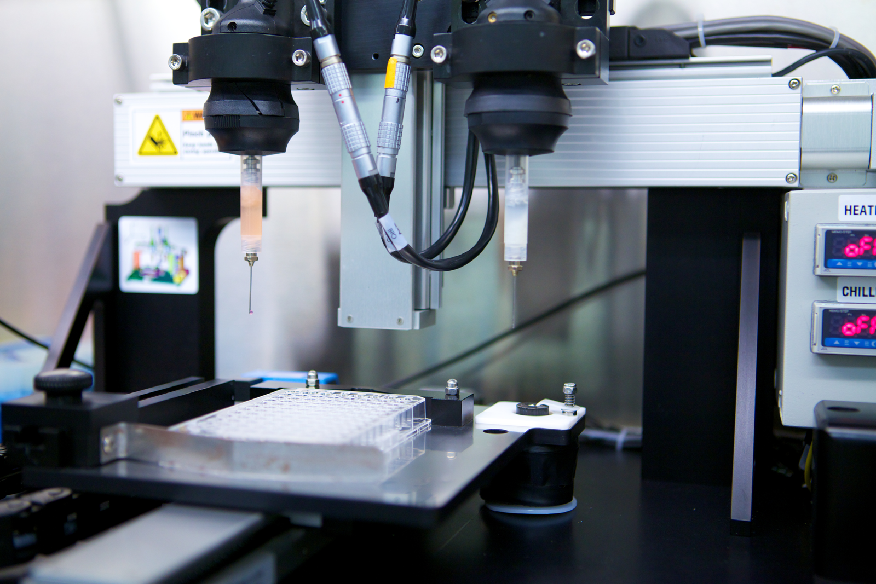
Parts of an extrusion bioprinter
Reservoir 2
Image 11
Reservoir 1
Printing stage
Image 11
+ Control system
Notes:
The printing “stage” is the platform where the materials are printed onto.
The reservoirs are loaded with two different types of biomaterials.
The control system has two components: the positioning controller and the dispensing controller:
For the positioning controller > the computer uses MRI/CT/CAD scans to control printer movement in the x, y and z directions
For the dispensing controller > the computer controls what cartridge is actively dispensing its material and at what rate

Slide 15
Types of bioprinters: Summary
inkjet
laser
extrusion
Inkjet Bioprinting
Notes:
Ask: Which type of bioprinter would be the best to use for each of Bill’s injuries: Bill’s skin? Bill’s muscle? Bill’s femur (bone)?
Require students to justify why they choose a particular printer type for each injury repair.
Emphasize that different printers can be used to create the same structures; some are just more efficient and effective than others. While there is no “wrong answer,” sometimes one printer makes more sense than the others for certain objectives/situations.
However, if you could only pick one printer to print all 3 replacement tissues, extrusion bioprinter would be the best choice.

Slide 16
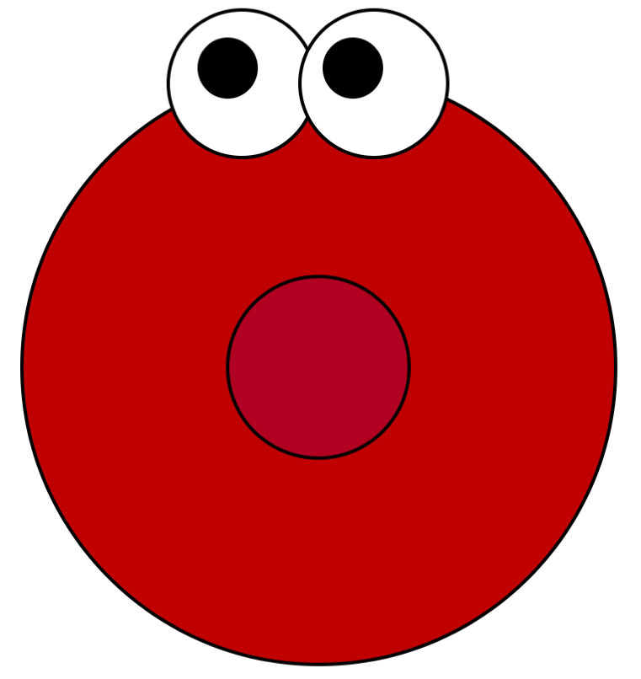
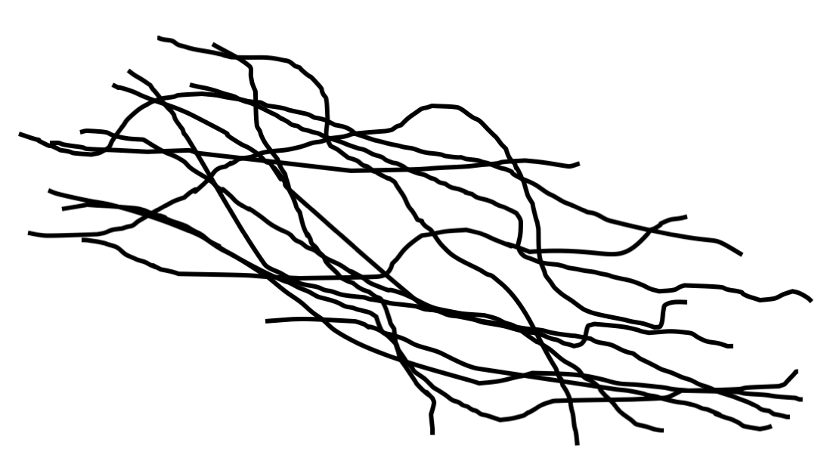
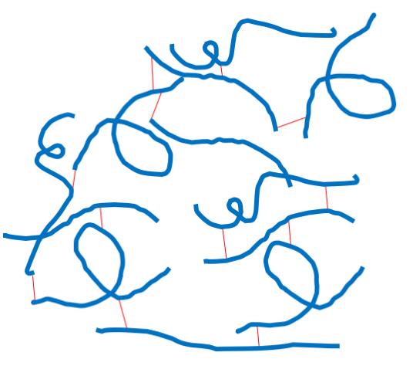
Basics of tissue engineering design: 5 Steps
Identify function being replaced
Determine cell types
Determine biomaterial types
Determine construction method
Construction!
Notes:
Now that you know about the different types of bioprinters, let’s talk about how to use them.
Bioprinting is a type of tissue engineering: A field of engineering seeking to improve or replace biological tissues.
There are 5 main steps of tissue engineering that we will use to design and then print tissues using a bioprinter.
List the 5 steps, which will be explained in more detail in the next few slides.

Slide 17
Determine cell types
Choose cell type for its function!
Constraints:
Strength of cells
Rejection and immune responses
Notes:
It is important that we choose the right type of cells! After all, cells are what give specific tissues their specific functions. It seems obvious, but it is very important that we choose the right cells.
For example, if we bioprint a bone for Bill, it is important to include osetocytes, which are naturally found bone cells. Doing this ensures that the bioprinted bone functions the same as natural bone.
Other things to think about:
Cell strength: Certain cells are unable to withstand the intense pressures of bioprinting. So, we need to make sure the cells we choose can survive the process or else we’ll end up having a useless tissue (All the cells will be dead!)
Rejection is negative feedback mechanism of the body that is facilitated by the immune system. Immune cells sense an implanted substance as foreign and invade it, attempting to remove it from the body. In short, if we print a tissue for Bill with someone else’s cells, there’s a chance when we transplant it that Bill’s immune system might attack it!

Slide 18
Determine biomaterial types
Natural biomaterials:
Collagen
Elastin
Synthetic biomaterials:
“Polys”
Notes:
Who has heard of the extracellar matrix (ECM) in the body? It is the noncellular matrix of fibrous biomaterials. This matrix gives body tissues support and their various mechanical properties. In short, it is what makes up your body’s tissues, except the cells!
When using a bioprinter, we must print our own ECM or else the cells have nothing to “be” in.
We have two choices of biomaterials that we can use in printing:
Natural biomaterials: Two examples are collagen and elastin, both of which are found in the body. They are very different from each other! Collagen is abundantly found in muscle and is typically “stiffer.” Elastin is found in skin and gives skin its “stretchy” properties.
Synthetic biomaterials are not found in the body, but mimic natural biomaterials. An example is polylactic acid or PLA.

Slide 19
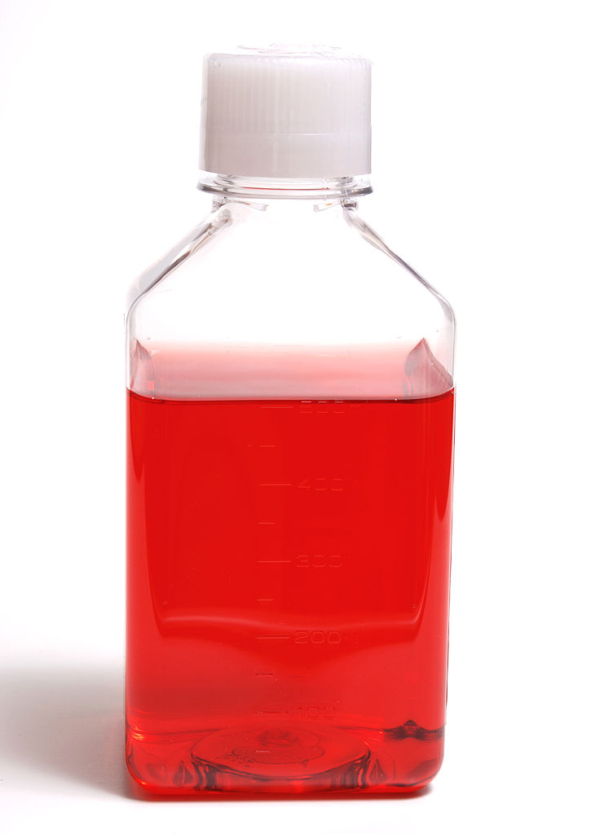
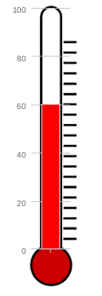
Cell survival during printing
Image 13
Image 14
Image 12
O₂
oxygen
nutrients
temperature
Notes:
While printing, we must take into account some environmental considerations so that we end up with functional tissues:
Oxygen: Cells need the correct mix of gases to survive! This includes oxygen. If they are exposed to too much of something, like CO2, it may kill them.
Nutrients: We typically “feed” cells with cell culture media, which is basically just sugar water.
Temperature: If the temperature is too hot or too cold, it may kill the cells we are printing with.

Slide 20
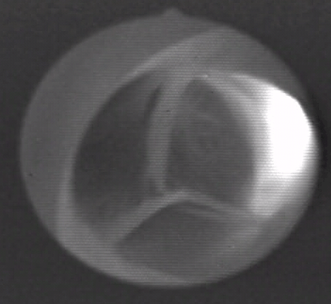
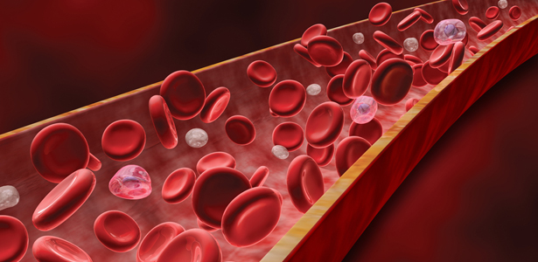
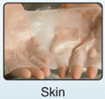
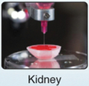
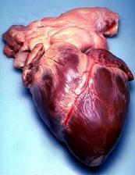
Applications of 3D bioprinting
Image 15
Current
Tissue mimics for drug testing and screening
Non-transplantable tissues and vessels
Near future (~15 years)
Transplantable tissues
Far future (~20+ years)
Organs
Image 16
Image 17
aortic heart valve
blood vessels
Image 18
Image 19
Image 20
Image 21
cartilage
skin
kidney
heart
Notes:
Emphasize current applications:
Tissue mimics for drug testing and screening: We can create representative bodily tissue to test drug effects. We can create these tissues without 3D bioprinters, however using 3D bioprinters is a way to speed up and automate the process in order to expedite the drug testing process.
Non-transplantable tissues: Researchers can 3D printer heart valves and blood vessels in the lab. At this point, they are used only for research purposes and are not ready to be implanted in people. The black and white round image is a still image pulled from a video clip of a living, beating pig heart—an aortic valve—that was bioprinted in a lab. The heart was arrested, connected to the perfusion system and restarted. The working fluid was oxygenated balanced saline solution.
Near future applications (~15 years):
Transplantable tissues: We can create different types of tissue such as skin, kidney, liver, muscle, cartilage and bone. However, we have not developed a safe and consistent way of getting these tissues into people. This process requires more testing, Federal Drug Administration approval, and getting 3D bioprinters into hospitals.
Distant future applications (~20+ years):
Organ creation and transplantation: Many people who are on organ waitlists die because they do not receive an organ replacement in time. In the far future, we hope to be able to print organs with a person’s own cells. Ideally, we would take cells from the patient and put them in a lab. Then we would induce them to replicate. After we have enough cells from a particular organ, we could use these cells to 3D bioprint a new organ.

Slide 21
Applications
Watch this video
Notes:
This bioprinter is in the Peirce-Cottler Lab at the University of Virginia. It is printing the beginning of a 3D biological structure.
Show the 13-second YouTube video (shayns) at https://www.youtube.com/watch?v=2Bdc2AOGhWI

Slide 22
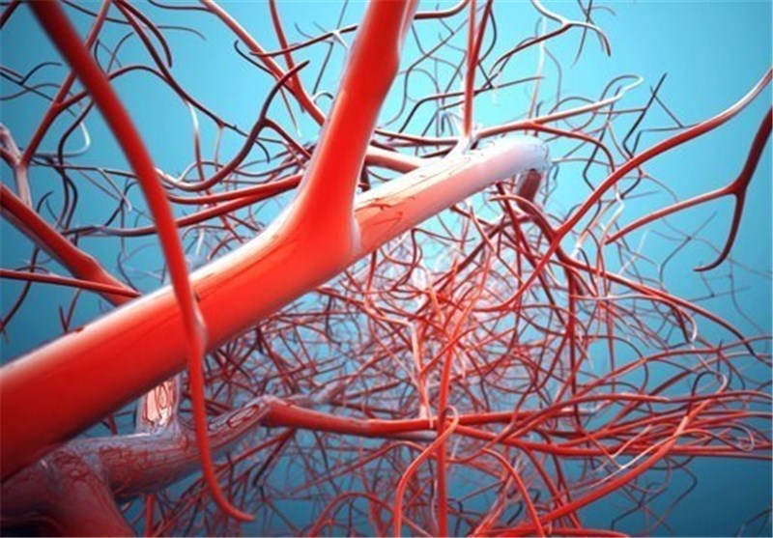
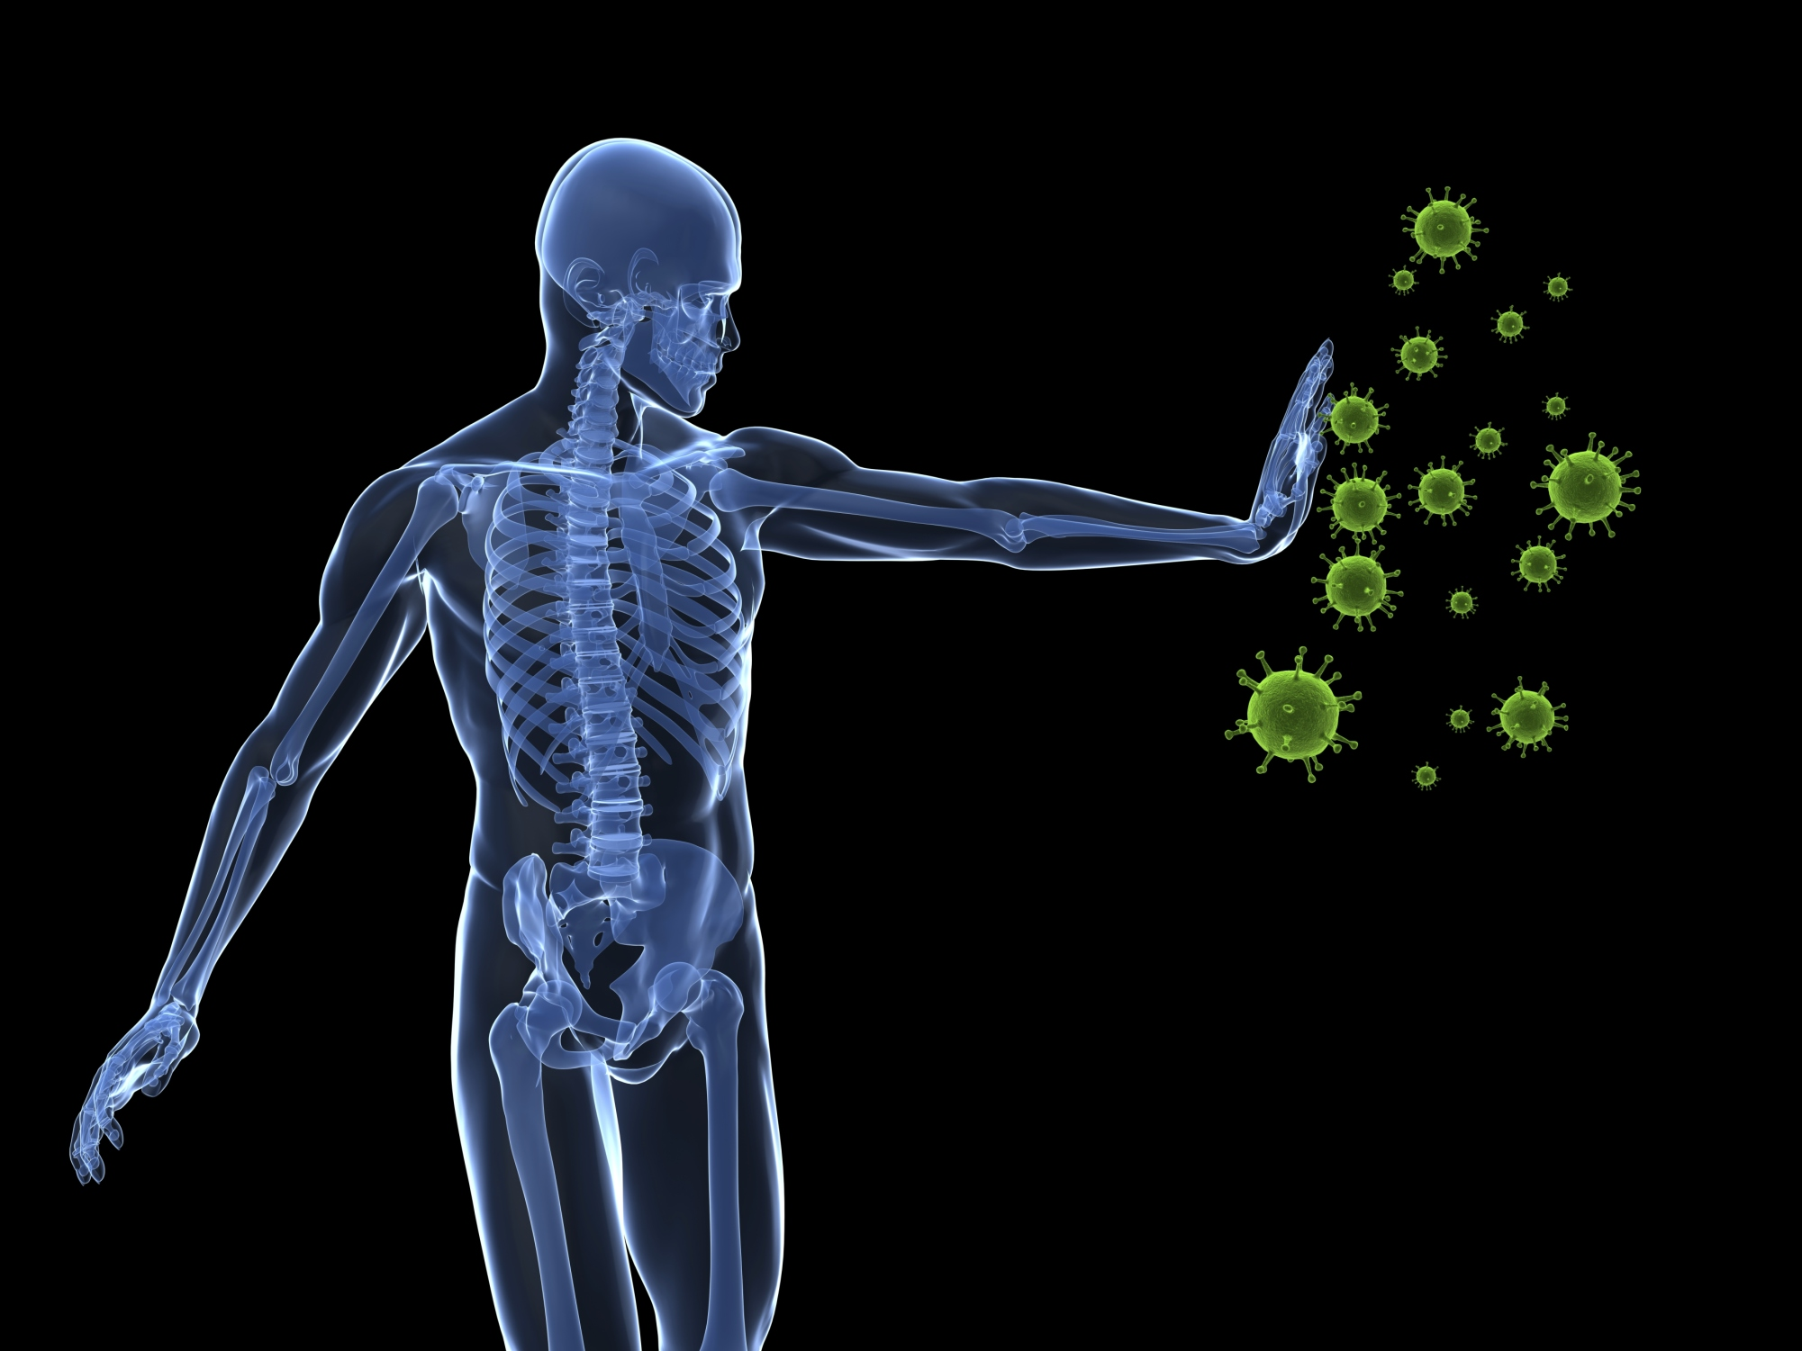
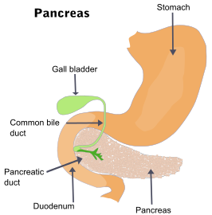
Limitations
Image 22
Vascularization
Immune rejection
Biocompatibility
Image 23
Image 24
Notes:
Vascularization:
All body tissues have blood vessels that run through them. These blood vessels are essential for the tissue to survive. Blood vessels deliver nutrients and oxygen, and take away cell waste. Outside of the body, tissues can survive without blood vessels IF you supply the needed nutrients and oxygen. However, the effort needed to maintain this can only be conducted in a laboratory setting. For tissues and organs to survive in people, they need to have blood vessel built into the structure and be able to connect to the person’s blood vessel system (the person’s vasculature)
Currently, we are able to print preliminary blood vessels, but we are unable to incorporate blood vessels into tissues or organ structures.
Immune rejection:
When foreign materials (bacteria, viruses, etc.) enter our bodies, our immune systems attack them. This is critical to our survival. A transplanted tissue or organ can be identified as foreign and attacked by our immune system. We need to create tissues that are not attacked and rejected by our immune systems.
The chance of immune rejection decreases when using host cells. (not foreign!)
The chance of immune rejection decreases when using tolerance induction strategies.
A difficulty arises if the patient is already too ill and cannot undergo a surgical procedure to harvest host cells from tissue.
Biocompatability:
Some non-organic polymers degrade into products that are toxic to the body.
If we use non-organic (synthetic) materials (and we do :) ), then we need to make sure that they do not harm patients.
3D bioprinted parts must maintain their structural properties (hardness, viscosity) while within the body.
We do not want the organ or tissue to literally fall apart within the person.
Extra material:
Anatomy: Material must maintain its structural and mechanical properties. We need to carefully select materials for diverse tissue types. We need to avoid foreign body responses or toxic degradation products. Nanoscale characteristics can affect cell adhesion, orientation, motility, surface antigen display, cytoskeletal condensation and modulation of intracellular signaling pathways.
A challenge for some synthetic polymers = poor biocompatibility, toxic degradation of products, loss of mechanical properties during degradation. Others are relatively biocompatible and degrade purposefully (e.g., PSLDMA).
Now it’s up to you to fix it! :)

Slide 23
Lesson Goals: Summary
Introduce engineering problem (“Bill”)
Define and analyze different types of 3D bioprinters
Define the basics of tissue engineering
Identify current applications and limitations of 3D bioprinting
Start figuring out how to help Bill!
Notes:
Read over the 5 bullet points and explain how we have covered them through this presentation
(If not proceeding directly to conduct the associated activity, edit as necessary.)

Slide 24
Activity Instructions
Review your assignments (~5 min)
Learn to use your mock bioprinter (~2 min)
Engineering sketch of your plan > get approval (~10 min)
Get biomaterials and print! (~20 min)
Present your design and limitations (~2 min for each group)
Notes:
Briefly review the overall activity (the instructions on this slide).
Then go to the next slide to show a video about how to use the mock bioprinter.
(If not proceeding directly to conduct the associated activity, no need for this slide.)

Slide 25
Mock 3D Bioprinter Instructions for Use
Show this video
Notes:
Let’s familiarize ourselves with how to use the mock 3D bioprinter we have at our disposal.
Show the 50-second YouTube video (Bioprinter_Operation.mp4) at https://www.youtube.com/watch?v=4fpHjysScNM
(If not proceeding directly to conduct the associated activity, no need for this slide.)

Slide 26
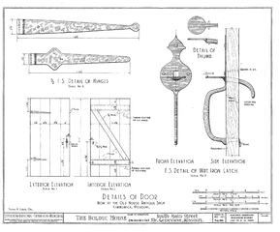
Engineering Sketch
Image 25
Diagram with labels
Measurements and scale
Axes, for reference
Notes:
Emphasize the importance of an engineering sketch if students do not know how to do one.
Engineering sketches include measurements, scales, dimensions and multiple views of the same design at different angles. Details are important!
(If not proceeding directly to conduct the associated activity, no need for this slide.)

Slide 27
Bill’s Injuries
Image 1
Image 2
Missing skin on the left arm
Image 3
Ripped rectus femoral muscle
Severely broken femoral shaft
Notes:
So – Bill was pretty hurt from that car crash. He was rushed to the ER immediately.
He sustained 3 injuries: a ripped muscle in his right leg, a broken bone in his left leg, and major skin loss on his left arm.

Slide 28
Image Source/Rights
Image 1: Skin anatomy diagram | File name: skin1.jpg
Source/Rights: 2013 Anatomy Box, Creative Commons Attribution Share License http://www.anatomybox.com/chapters/skin/
Caption: An example of a skin tissue. Bill has injured skin.
Image 2: Muscle anatomy diagram | File name: muscle.jpg
Source/Rights: WikiJournal of Medicine Gallery of Blausen Medical, 2014. CC Licensure 3.0. http://teachmeanatomy.info/the-basics/ultrastructure/histology-muscle/
Caption: An example of a muscle. Bill has a ripped femoral muscle.
Image 3: Anatomy of a long bone | Image file name: bone.jpg
Source/Rights: 2016 Carl Fredrick, Wikimedia Commons CC BY-SA 4.0 https://commons.wikimedia.org/wiki/File:603_Anatomy_of_a_Long_Bone.jpg
Caption: An example of a bone and underlying tissue. Bill has a broken femoral shaft.
Image 4: Uncle Sam saying “I want you to learn about 3D bioprinting.” | Image file name: unclesam.jpg
Source/Rights: 2011 Library of Congress (public domain) https://www.loc.gov/exhibits/treasures/trm015.html AND https://www.loc.gov/item/93509735/
Caption: Some U.S. scientific research funding is going towards 3D bioprinting research.
Image 5: A photograph shows a 3D bioprinter with 4 extrusion heads | Image file name: regenhu.jpg
Source/Rights: 2016 RegenHu. All rights reserved. Used with Permission. http://www.aniwaa.com/product/3d-printers/regenhu-3ddiscovery/
Image 6: A photograph shows a 3D bioprinted tissue being taken out of growing media. | Image file name: tissue.jpg
Source/Rights: 2016 Anderson, Ojada, Nguyen. Governor’s School of Architecture. All rights reserved. Used with permission. https://govschoolagriculture.com/tag/3d-bioprinting/
Caption: A 3D bioprinted tissue that is kept in media to allow cells to grow.
Image 7: A photograph shows of 3D bioprinted structure in the shape of an ear. | Image file name: ear.jpg
Source/Rights: Wake Forest Institute for Regenerative Medicine. Non-published. Used with permission. http://www.wakehealth.edu/WFIRM/
Caption: 3D bioprinters can build structures that are in the shape of an ear.
Image 8: Diagram shows a model of an inkjet bioprinter. | Image file name: inkjet.jpg
Source/Rights: 2016 Arslan-Yildiz, Assal, Chen, Guven, Inci, Demirci. Used with permission. http://iopscience.iop.org/article/10.1088/1758-5090/8/1/014103
Caption: Inkjet bioprinters disperse cells over a surface covering much area quickly.

Slide 29
Image Source/Rights
Image 9: A diagram of a laser-assisted 3D bioprinter. | Image file name: laser.jpg
Source/Rights: 2016 Arslan-Yildiz, Assal, Chen, Guven, Inci, Demirci. Used with permission. http://iopscience.iop.org/article/10.1088/1758-5090/8/1/014103
Caption: A laser-assisted bioprinter use lasers to force cells onto specific locations of the printing surface.
Image 10: A diagram of an extrusion 3D bioprinter. | Image file name: extrusion.jpg
Source/Rights: 2016 Arslan-Yildiz, Assal, Chen, Guven, Inci, Demirci. Used with permission. http://iopscience.iop.org/article/10.1088/1758-5090/8/1/014103
Caption: Extrusion bioprinters extrude cells within a filament. The filament/cell mixture forms the structure we see.
Image 11: A photograph of a 3D bioprinter with 2 extrusion heads printing onto a cell culture plate called a 96-well plate. | Image file name: organovo.jpg
Source/Rights: 2016 Organovo. Used with Permission http://www.csmonitor.com/Technology/2015/0519/3D-printing-human-skin-The-end-of-animal-testing
Caption: Extrusion 3D bioprinters have multiple heads to print from. They can also print on different surface. A computer system controls the rate of extrusion, the location, and which material is extruded.
Image 12: A graphic of a cell having oxygen delivered to it. | Image file name: oxygen.jpg
Source/Rights: 2017 Nick Asby (author), UVa Department of Biomedical Engineering. Caption: Cells need proper oxygen concentrations to survive.
Image 13: A picture of bottle of cell media | Image file name: media.jpg
Source/Rights: 2011 Lillly_M, Max Planck Institute for Molecular Cell Biology and Genetics in Dresden, Wikimedia Commons CC BY-SA 3.0 https://commons.wikimedia.org/wiki/File:Glasgow_MEM_cell_culture_medium.jpg
Caption: Cells are kept in cell media while they grow. Media provides nutrients, proper pH, water, and other compounds need to make cells grow.
Image 14: A graphic of a thermometer | Image file name: temperature.jpg
Source/Rights: 2004 Microsoft Corporation, One Microsoft Way, Redmond, WA 98052-6399 USA. All rights reserved
Caption: Cells need to be kept at proper temperatures to replicate and survive.
Image 15: A picture of 3D bioprinter printing into a cell culture container. The one in this picture is called a 96-well plate. | Image file name: drugTest.jpg
Source/Rights: 2016 Organovo. Used with permission. http://www.csmonitor.com/Technology/2015/0519/3D-printing-human-skin-The-end-of-animal-testing
Caption: 3D bioprinters are utilized by companies and researchers to create testing tissue for pharmaceutical research.
Image 16: A still image taken from an animation/video of beating bioprinted aortic valve. | Image file name: valve.gif
Source/Rights: 1989 Valveguru, Wikimedia Commons CC BY-SA 3.0 https://commons.wikimedia.org/wiki/File:Aortic_valve.gif
Caption: Researchers use 3D bioprinters to create valves. These are used for research purposes and cannot be placed in humans yet.
Original caption: This is still image pulled from a video clip of a living, beating pig heart—an aortic valve—that was bioprinted in a lab. The heart was arrested, connected to the perfusion system and restarted. The working fluid was oxygenated balanced saline solution.

Slide 30
Image Source/Rights
Image 17: A picture of cells laid down to create a blood vessel. | Image file name: vessel.jpg
Source/Rights: 2004 Microsoft Corporation, One Microsoft Way, Redmond, WA 98052-6399 USA. All rights reserved
Caption: Scientists have methods of creating blood vessels with 3D bioprinting methods.
Image 18: A picture of bioprinted cartilage in the shape of an ear. | Image file name: cartilage.jpg
Source/Rights: Wake Forest Institute for Regenerative Medicine. Non-published. Used with permission. http://www.wakehealth.edu/WFIRM/
Caption: Scientists can bioprint cartilage in the shape of an ear for research purposes. However, it is not safe to use these ears on humans.
Image 19: A picture of bioprinted skin being held. | Image file name: skin2.jpg
Source/Rights: Wake Forest Institute for Regenerative Medicine. Non-published. Used with permission. http://www.wakehealth.edu/WFIRM/
Caption: Scientists can print human skin for drug testing purposes. The skin does not have the exact structure of human skin, but it is a close replicate.
Image 20: A photo of a kidney being printed. | Image file name: kidney.jpg Source/Rights: Wake Forest Institute for Regenerative Medicine. All rights reserved. Non-published. Used with permission. https://govschoolagriculture.com/tag/3d-bioprinting/
Image 21: A picture of a human heart in vitro (outside the body) | Image file name: heart.jpg
Source/Rights: 2007 alexanderpiavas134, Wikimedia Commons (public domain) https://commons.wikimedia.org/wiki/File:Humhrt2.jpg
Caption: Scientists are working towards bioprinting hearts.
Image 22: A picture of a complex blood vessel system. | Image file name: vasculature.jpg
Source/Rights: 2004 Microsoft Corporation, One Microsoft Way, Redmond, WA 98052-6399 USA. All rights reserved
Caption: Incorporating blood vessel structure into tissues and organs requires complicated computer algorithms.
Image 23: A picture of a body rejecting pathogens. | Image file name: immune.jpg
Source/Rights: 2004 Microsoft Corporation, One Microsoft Way, Redmond, WA 98052-6399 USA. All rights reserved
Caption: Scientists are working to reduce of immune rejection when implanting a bioprinted tissue or organ into the body.
Image 24: A picture of pancreas attached to the gall bladder and bile duct. | Image file name: pancreas.jpg
Source/Rights: 2004 Microsoft Corporation, One Microsoft Way, Redmond, WA 98052-6399 USA. All rights reserved
Caption: Biocompatible bioprinted organs have the functionality, longevity, and mechanical properties that the original organ possessed.
Image 25: A multi-view engineering drawing | Image file name: engineeringSketch.png
Source/Rights: 1938 Frank R. Leslie, Historic American Engineering Record, National Park Service; Record MO-1105, Library of Congress, Prints & Photographs Division, MO-1105 (public domain) https://commons.wikimedia.org/w/index.php?curid=3715658
Caption: Engineering sketches include measurements, scales, dimensions and multiple views of the same design at different angles.

