Slide 1
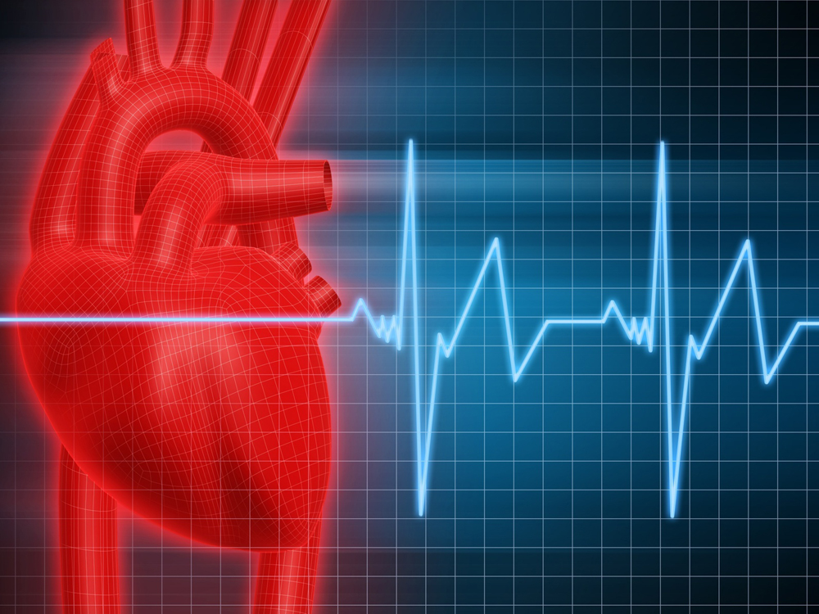
The Human Heart and Blood Flow

Slide 2
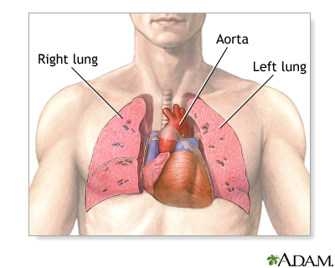
The Human Heart
Located in the Thoracic Cavity, between the two lungs and slightly to the left
About the size of a clenched fist.
Weighs around a ½ pound
http://www.nlm.nih.gov/medlineplus/ency/presentations/100147_1.htm

Slide 3
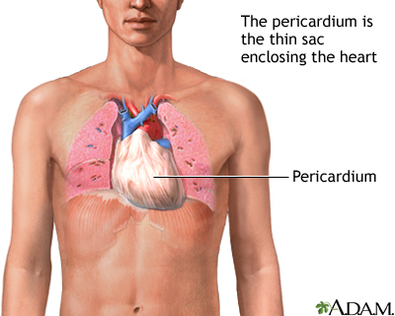
Pericardium: Protecting the Heart
Pericardium – protective membrane around the heart
Made up of 3 layers:
Epicardium – outermost layer, reduces friction
Myocardium – thick layer, contains cardiac muscle
Endocardium – innermost layer, contact with blood
http://www.nlm.nih.gov/medlineplus/ency/imagepages/18081.htm

Slide 4
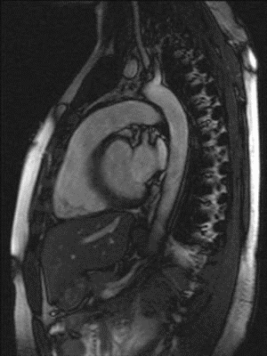
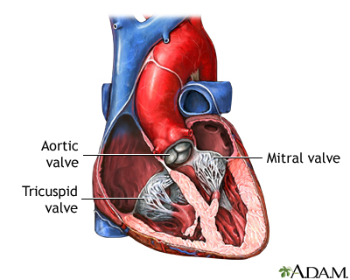
Heart Pumping
Heart pumps blood through the body through contraction. What do valves do for our heart?
MRI of a Human Heart
MRI at Charite Mitte, Berlin http://commons.wikimedia.org/wiki/ File:Cardiac_mri_ani_sagittal_bionerd.gif
http://www.ncbi.nlm.nih.gov/pubmedhealth/PMH0004820/

Slide 5
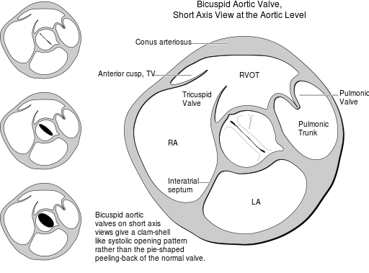
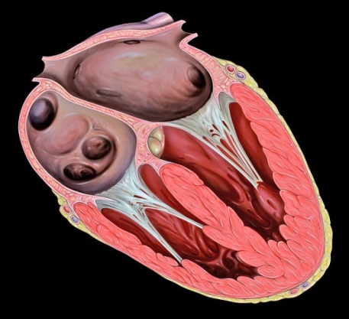
Heart Valves
One-way valves are vital to move blood in the correct direction
Cross section of the heart, focusing on the Aortic Valve
Tricuspid Valve
2006 Patrick J. Lynch, medical illustrator http://commons.wikimedia.org/wiki/File:Heart_tee_tricuspid_valve.jpg
2006 Patrick J. Lynch, medical illustrator http://commons.wikimedia.org/wiki/File:Heart_bicuspid_aortic_valve.svg

Slide 6
The Heart and the Path of Blood
Exterior View of the Heart
http://www.nhlbi.nih.gov/health//dci/Diseases/hhw/hhw_all.html

Slide 7
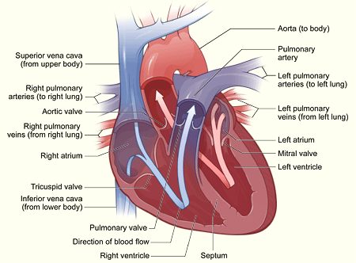
The Heart and the Path of Blood
Interior View of the Heart,
with the path of the blood
http://www.nhlbi.nih.gov/health//dci/Diseases/hhw/hhw_all.html

