Slide 1
Augmented Reality Mirror (ar_mirror) Demo Tutorial and Lesson Plan Guide

Slide 2
Guide Objectives
Provide teachers a general guide how to navigate the ar_mirror physiology demos and to provide students with project ideas.

Slide 3
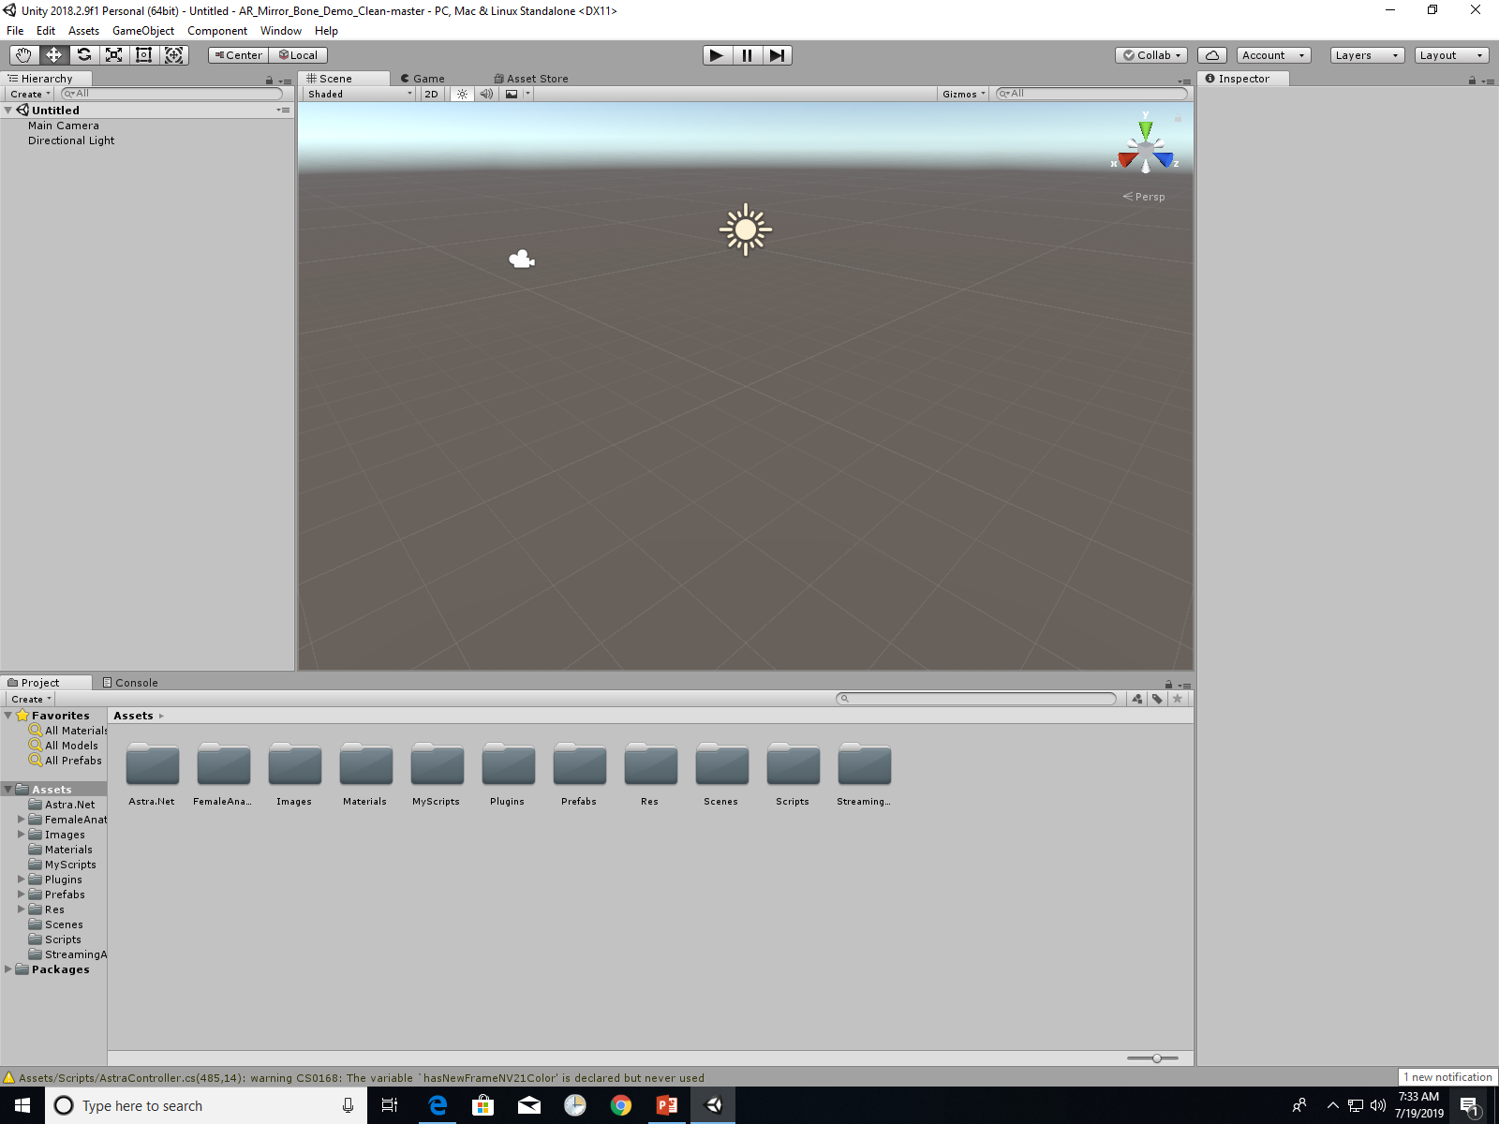
Open AR_Mirror_Bone_Demo in Unity
The main screen should look something like this…

Slide 4
You’ll notice many assets folders available. Unity allows for multiple scenes to be created.
The demo’s only have one scene, so we will open it and check it out.

Slide 5
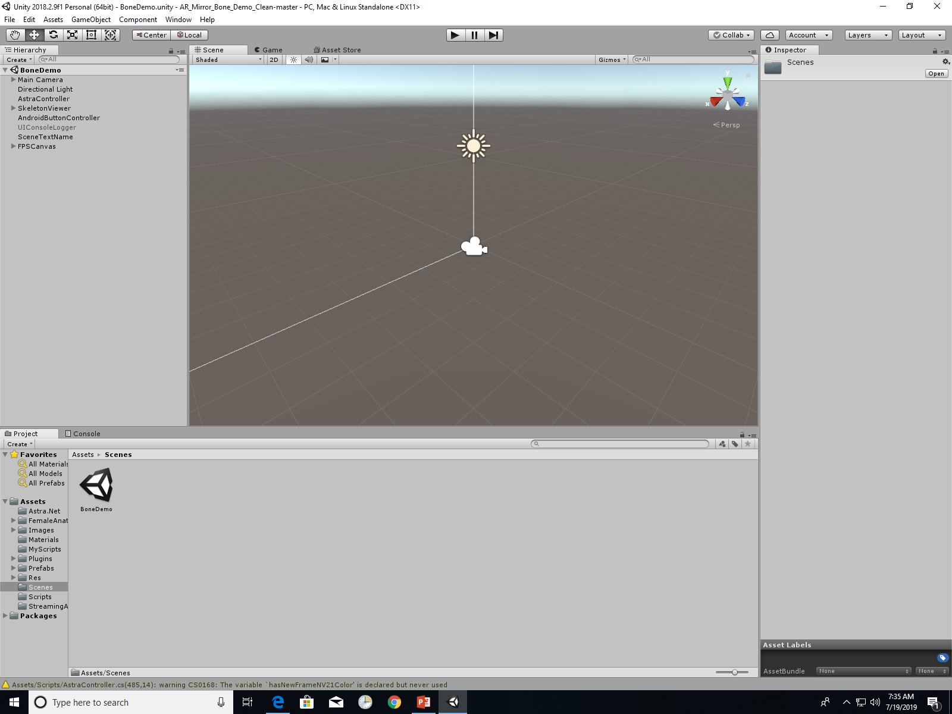
Open the BoneDemo scene

Slide 6
Changing Bone Overlays

Slide 7
Open the SkeletonViewer

Slide 8
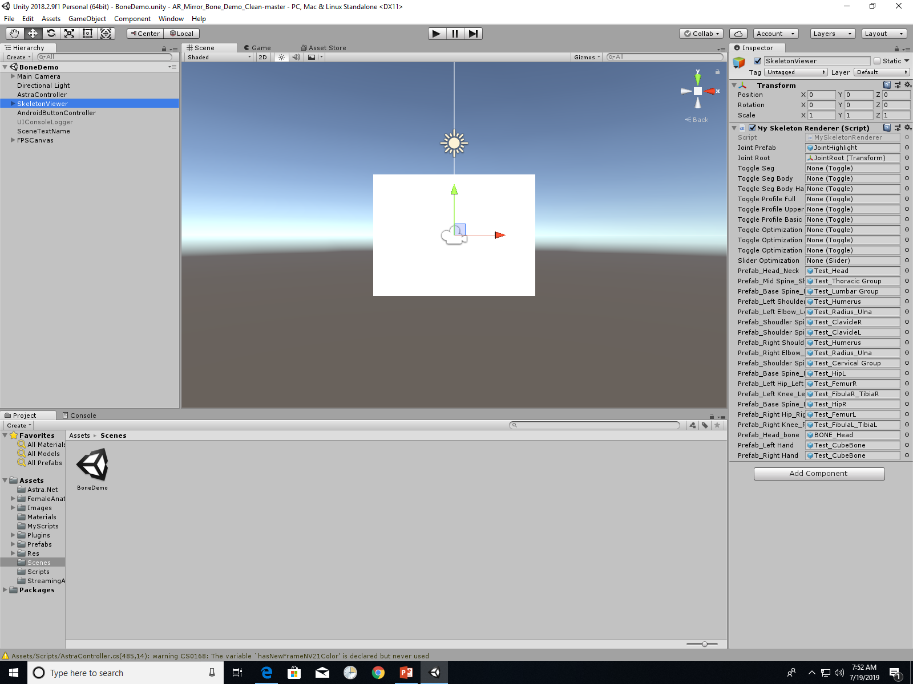
This provides you access to where the specific bone images are linked to each respective joint. You can change these to whatever images you have.

Slide 9
Note: The Orbbec camera recognizes each of the labelled joints. Technically, you can associate a 3D image between any of these respective joints.
You could have the students overlay images in any combination.

Slide 10
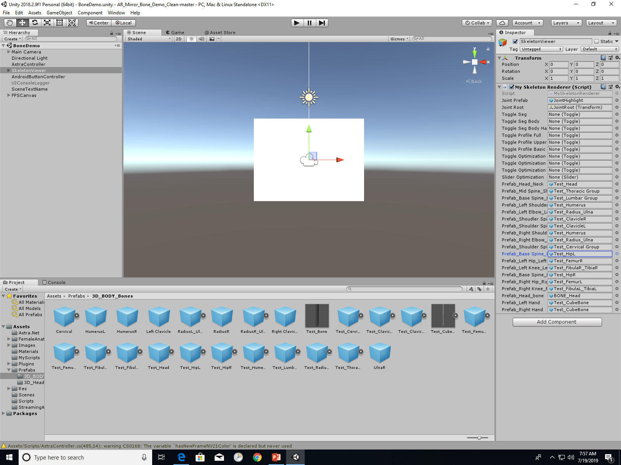
The images are saved in the “Prefabs” folder, and you can add more images here to allow you to plug and play.

Slide 11
If you press the play button, you can see how your changes affect the program.

Slide 12
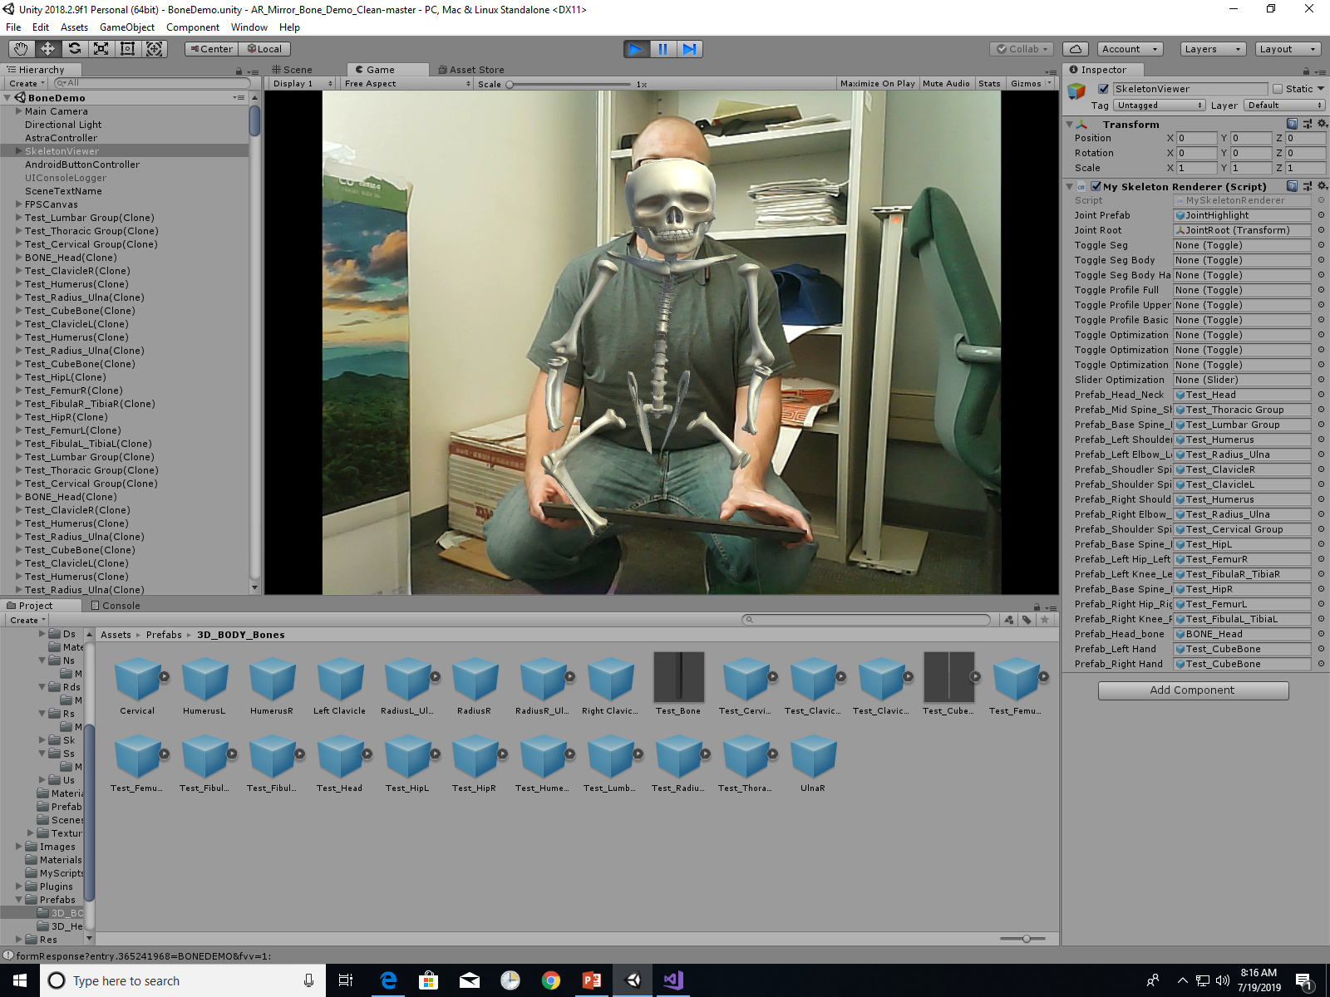
What you see in the main screen is what you’ll see when your demo is running.
When you’re finished checking, press the play button again to stop the demo

Slide 13
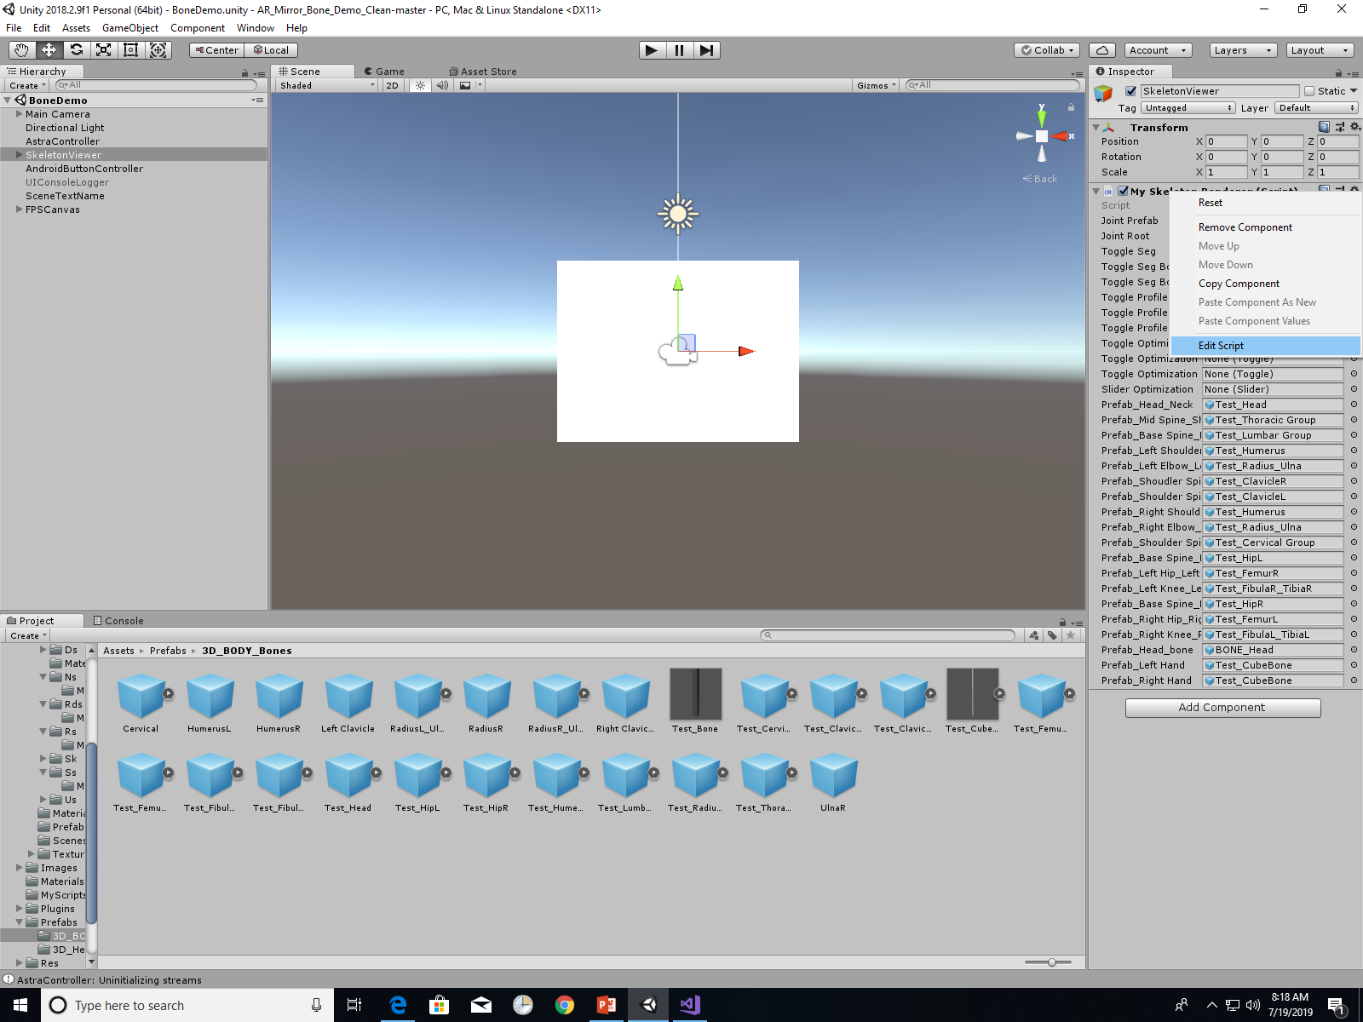
You can also manipulate the code by right clicking in box and selecting “Edit Script”
This opens Visual Studio to view your C# script.

Slide 14
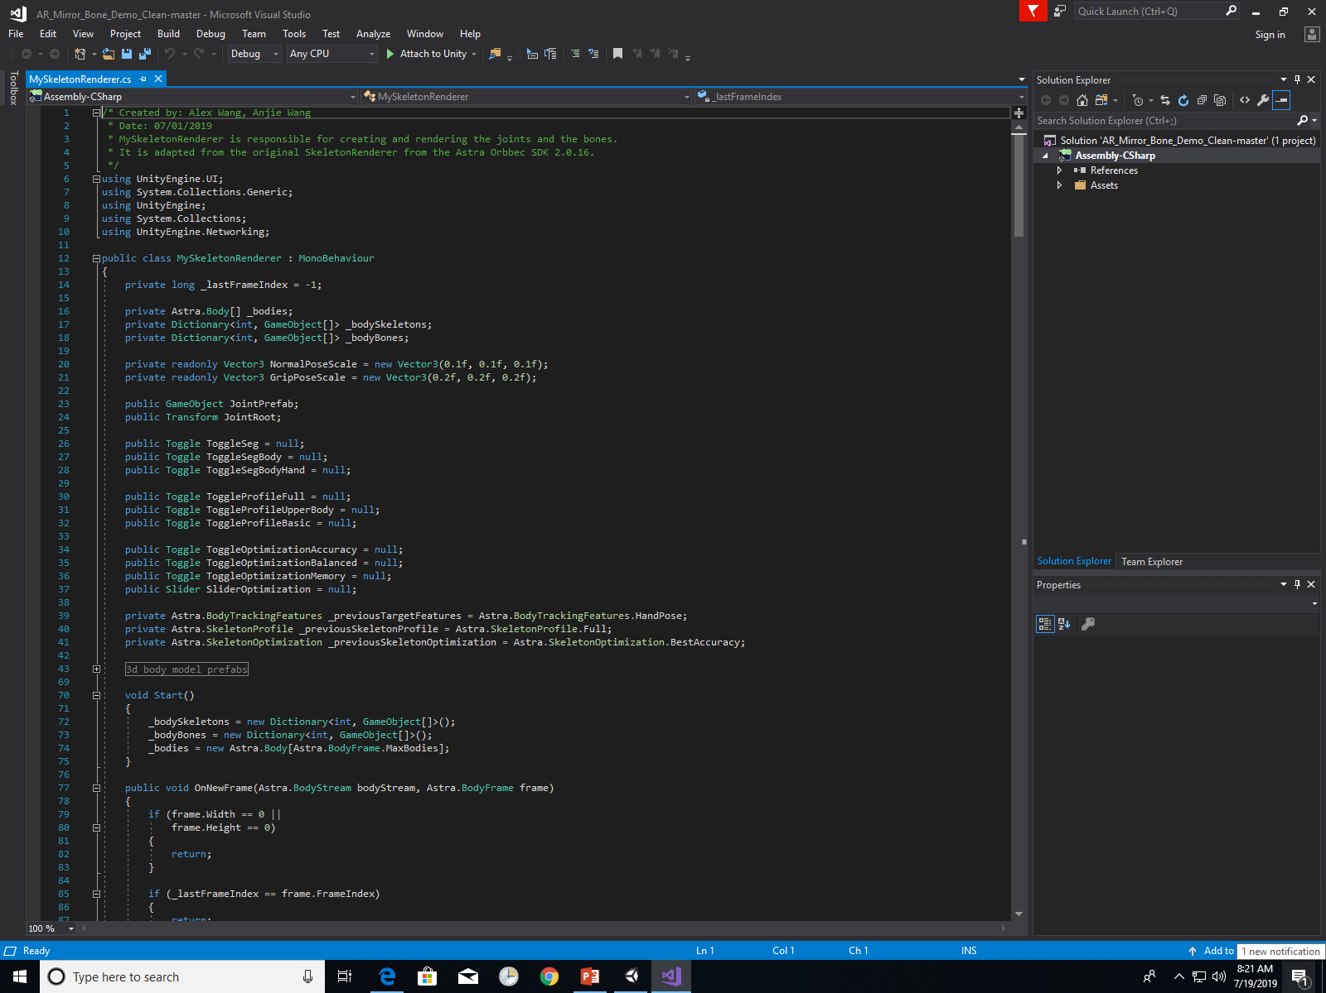
This allows you to check out the script responsible for rendering the bone overlay in the program.
Some suggestions are to have the you annotate the code or see what happens if they modify the code.

Slide 15
Example: Adding a bone between the hand joints

Slide 16
Step 1.
Define a new GameObject.

Slide 17
Step 2.
Define a new bone. This allows you to select an image for this in Unity

Slide 18
Step 3.
Define the connecting points.
In this case, the bone you defined previously will now be connected between these two joints.

Slide 19
Step 4.
Attach your changes to Unity. This will allow you to now update the images to attach, including the option to attach an image between the hand joints.
Note: If any syntax errors occurred, Visual Studio will flag it and prompt you to make any necessary corrections/changes.

Slide 20
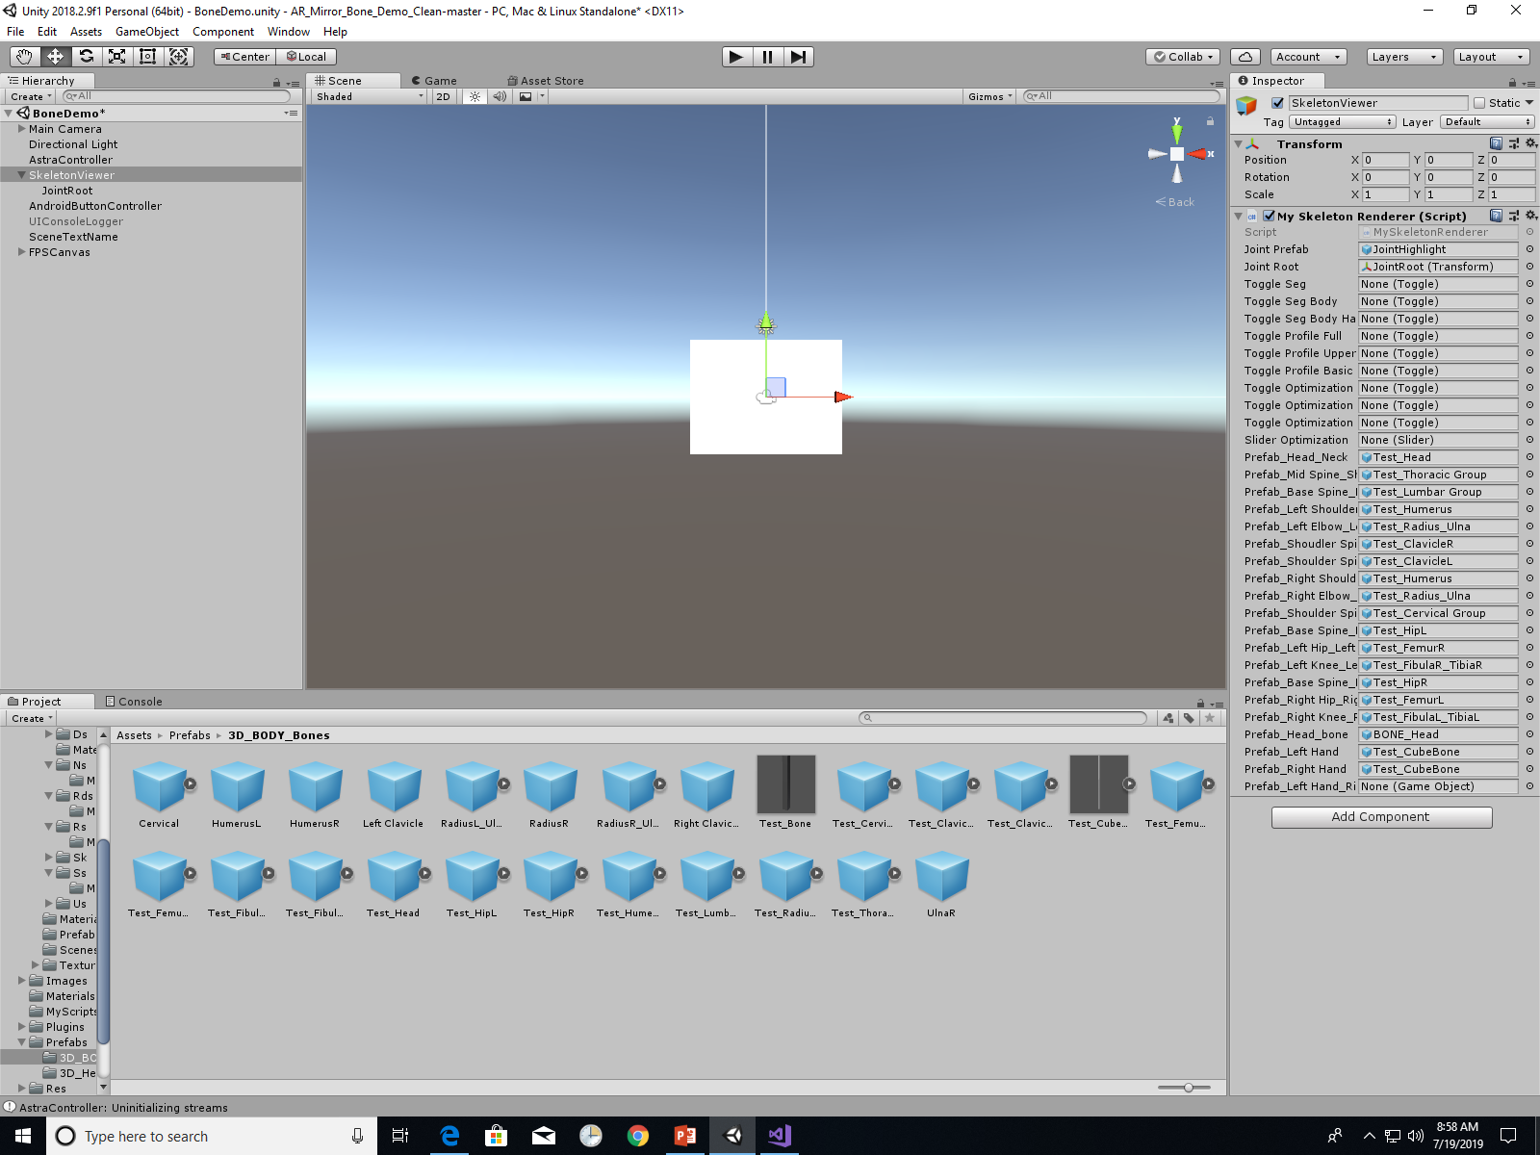
Back in Unity, the renderer has been updated, and a new option to add an image is available.
When you click on it, it opens the image folder and allows you to select an image.

Slide 21
Back in Unity, the renderer has been updated, and a new option to add an image is available.
When you click on it, it opens the image folder and allows you to select an image.

Slide 22
Back in Unity, the renderer has been updated, and a new option to add an image is available.
When you click on it, it opens the image folder and allows you to select an image.

Slide 23
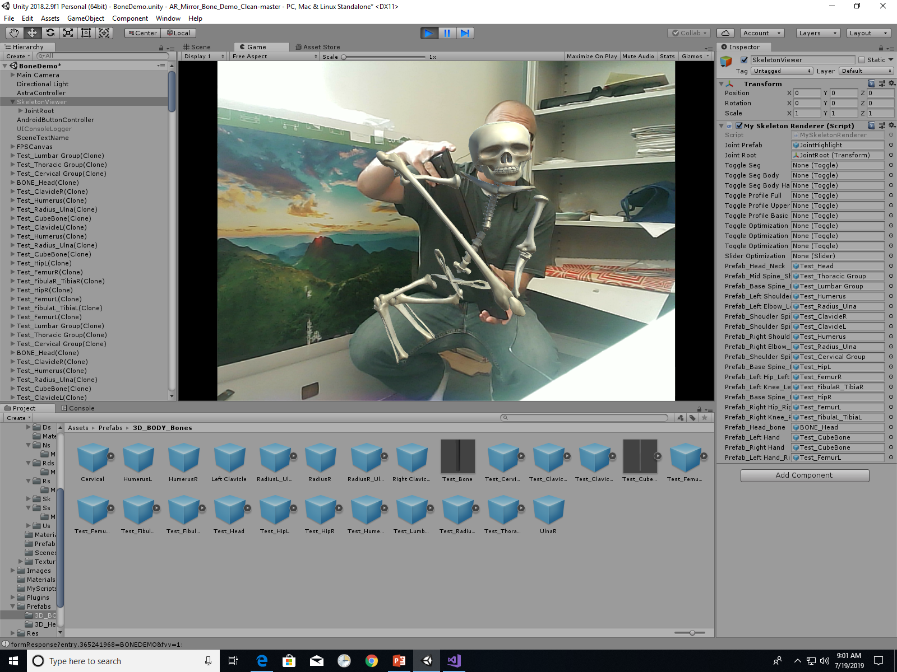
Femur is attached!
Note: Since the model is not upright, the rendering can be a bit off. It works best when the user is upright.

