Slide 1
Delineating the Watershed

Slide 2
Why?
When it rains, where does all the water go?
Civil engineers design infrastructures and water systems to manage this influx of water so we can prevent flooding of our homes and streets.
Notes:
Image credit: https://easton-pa.com/pwstormwater.html

Slide 3
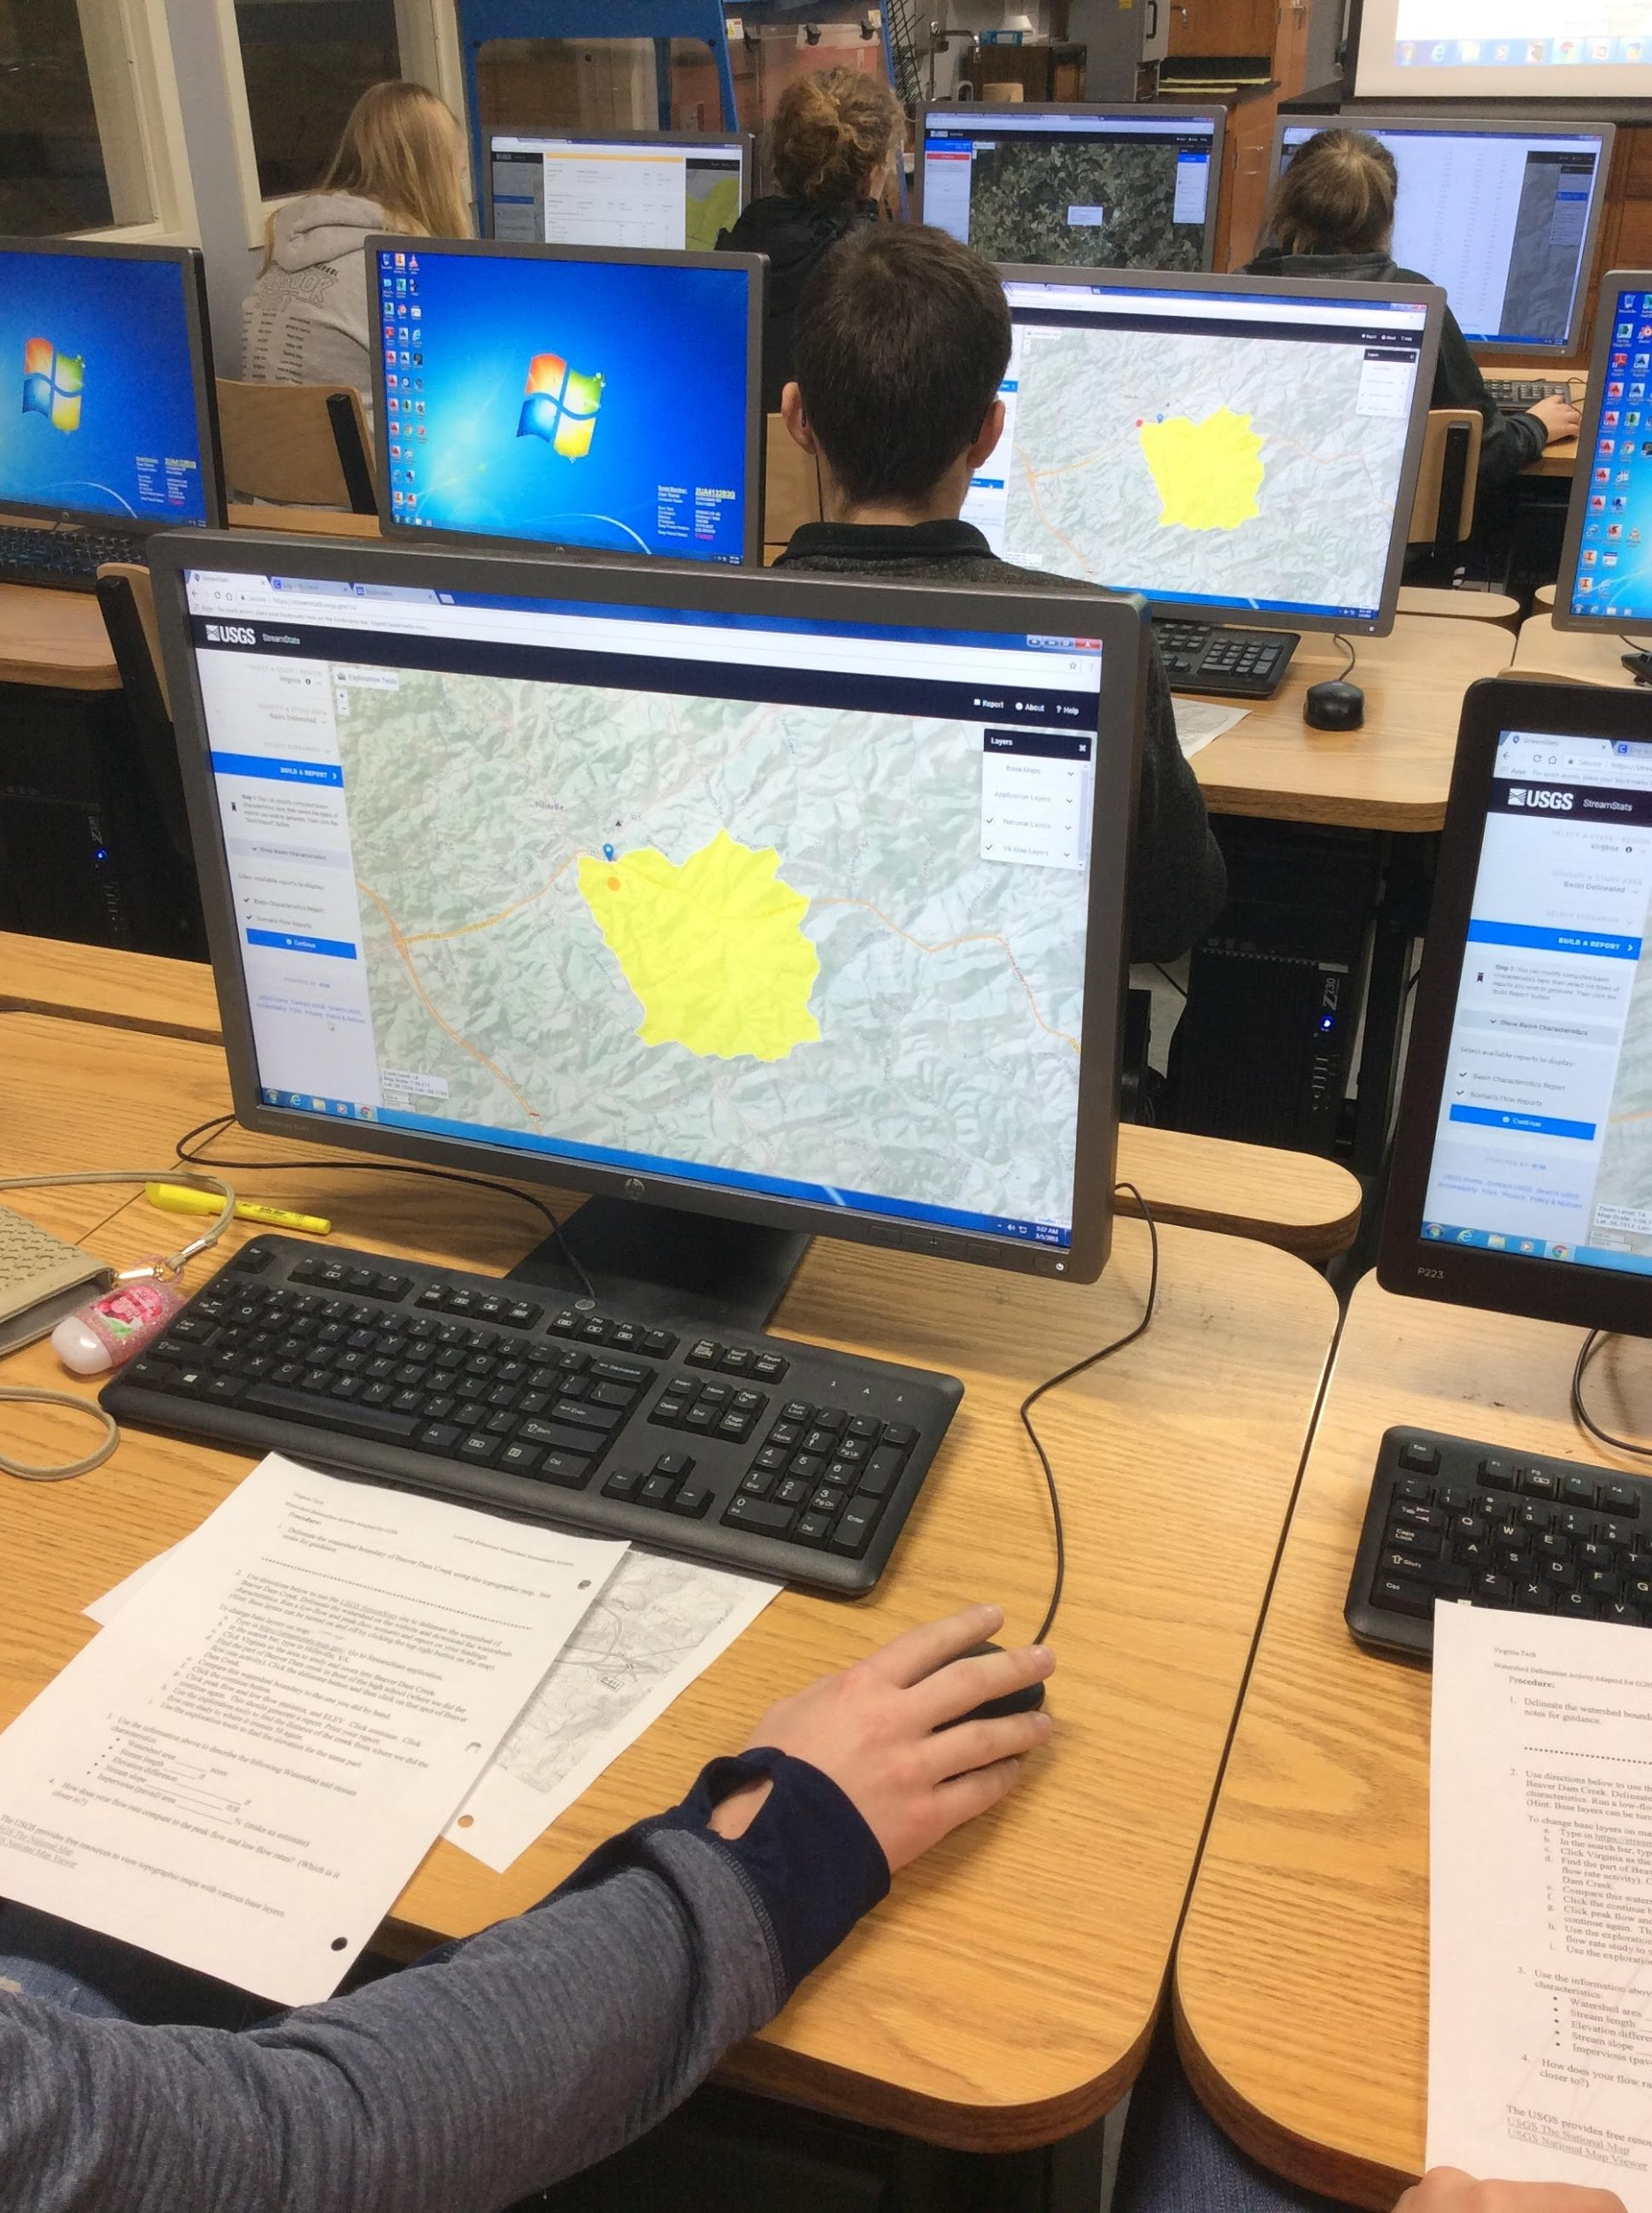
How?
To do this, engineers calculate how much water flows through that area.
The first step is to define the area.
In this activity, we will be defining that area by outlining the watershed or in engineering terms “delineating the watershed.”
Notes:
Image credit: Rachelle Rasco

Slide 4
Delineating the Watershed
A watershed is a land area defined by high point and/or ridges that separate waters flowing to different rivers.
Watersheds are defined based on a point of interest downstream.
A watershed carries water “shed” from the land after rain falls and snow melts.
Drop by drop, water is channeled into soils, groundwaters, creeks, and streams, making its way to larger rivers and eventually the sea.
http://watershedatlas.org/fs_indexwater.html
Notes:
http://watershedatlas.org/fs_indexwater.html

Slide 5
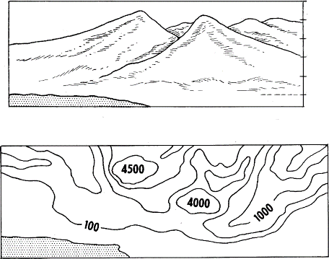
What is a Topographic Map?
Map showing natural and/or physical features of a landscape, including altitude contours.
Also called contour map.

Slide 6
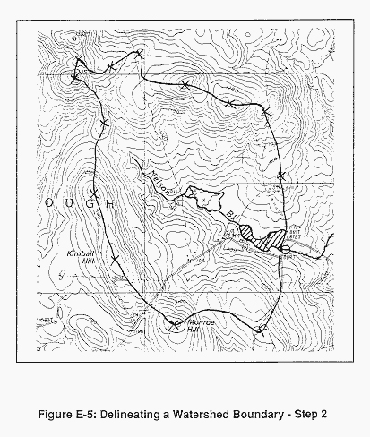
Delineating a Watershed
Delineation is a line defining the watershed.
To begin delineation, you start at the outlet and use the topography to see what drains to that point.

Slide 7
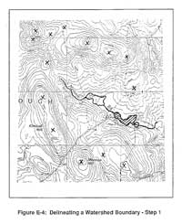
How to Delineate a Watershed
Draw a circle at the outlet or downstream point of the wetland in question (the wetland is the hatched area shown in Figure E-4 to the right)
Put small "X's" at the high points along both sides of the watercourse, working your way upstream towards the headwaters of the watershed.

Slide 8
How to Delineate a Watershed
Starting at the circle that was made in step one, draw a line connecting the "X's" along one side of the watercourse (Figure E-5, below left).
This line should always cross the contours at right angles (i.e. it should be perpendicular to each contour line it crosses).
Continue the line until it passes around the head of the watershed and down the opposite side of the watercourse. Eventually it will connect with the circle from which you started.
Notes:
These directions were adapted from the following USGS site: https://www.nrcs.usda.gov/wps/portal/nrcs/detail/nh/technical/?cid=nrcs144p2_015680. The lesson could be adapted by having the students use this site directly to outline their map.

Slide 9
Class Discussion
What types of land surfaces fall in the watershed?
What would affect the movement of water in the watershed?
Would any water be absorbed into the ground?
Would water levels rise faster?
Notes:
These directions were adapted from the following USGS site: https://www.nrcs.usda.gov/wps/portal/nrcs/detail/nh/technical/?cid=nrcs144p2_015680. The lesson could be adapted by having the students use this site directly to outline their map.

Slide 10
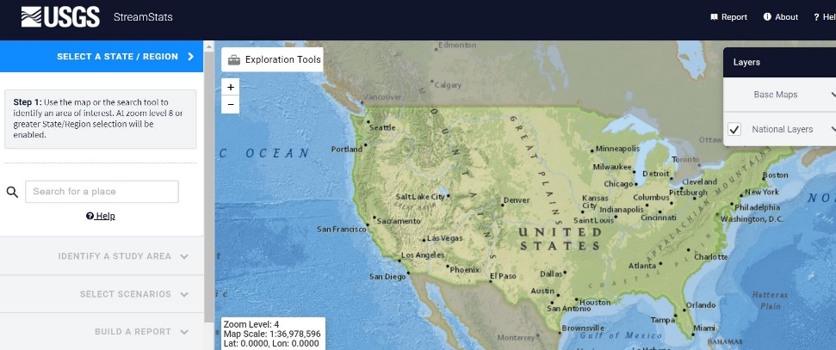
USGS StreamStats
Go to: https://streamstats.usgs.gov/ss/
In the search bar, type in your location (ex. Hillsville, VA.)
Click the area to state or regional area to study (ex. Virginia) and zoom into creek you are going to take water samples from later. (ex. Beaver Dam Creek.)

Slide 11
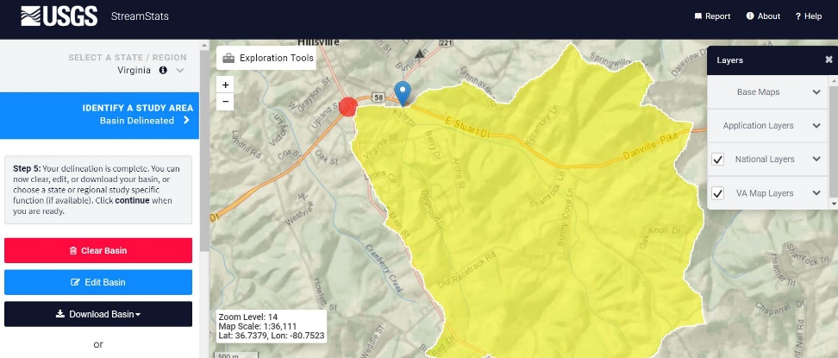
USGS StreamStats
Find the part of the creek you are using (ex. Beaver Dam creek in front of the high school. Click the delineate button and then click on that spot of the creek where you will be taking water samples later (creeks are designated with blue lines.
Compare this watershed boundary to the one you did by hand.
How useful do you think this application is to engineers and other scientists or public officials?

Slide 12
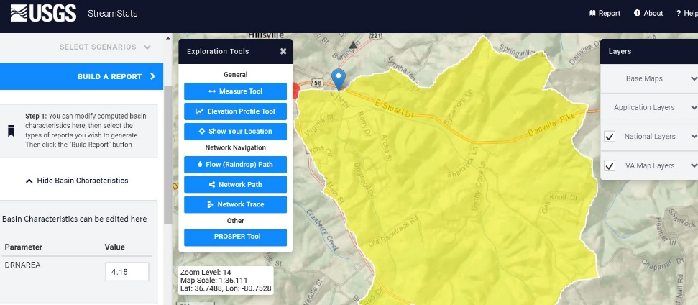
USGS StreamStats
Explore the exploration tools at the top left of the screen to find different characteristics.
Click the measure tool. Select two points on your stream to measure their distance. Click elevation profile tool. Select two points on your stream to see a profile of the different elevations.
In the left hand toolbar, choose the blue continue button. Choose basin characteristics.
Click DRNAREA (and any other characteristics you are interested in). Click continue then show basin characteristics. This is the size of the area of your watershed which is important in figuring out the drainage for that area.

Slide 13
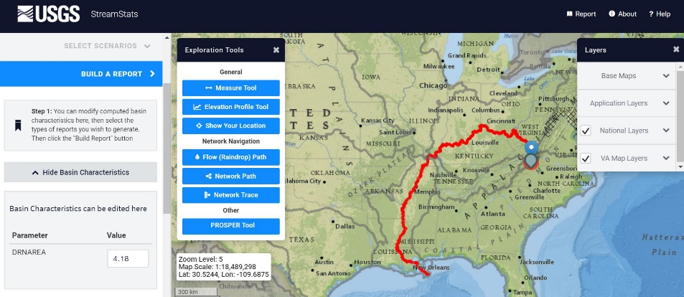
USGS StreamStats
Go back to the exploration tools. Try out the flow (raindrop) path button to see where where this water eventually goes.
Click the start point location. (Use pour point or click another spot on the map). Click go.
Water from streams and creeks head to rivers and eventually to the ocean. Where does your water end up?

