Slide 1
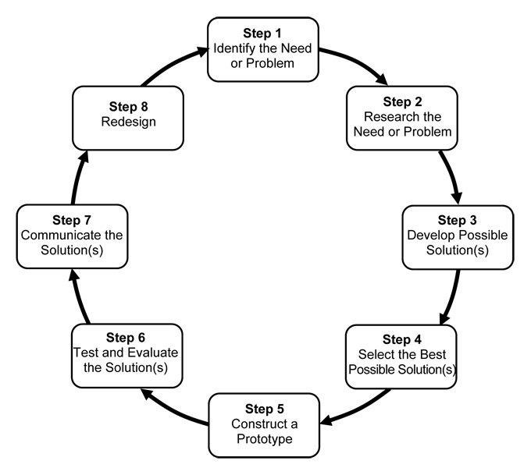
The steps of the
Engineering Design Process
Notes:
Assistive Artistic Device Project Slides, An Assistive Artistic Device activity, TeachEngineering.org
Image source: Massachusetts Department of Education http://www.doe.mass.edu/frameworks/scitech/2001/standards/strand4.html

Slide 2
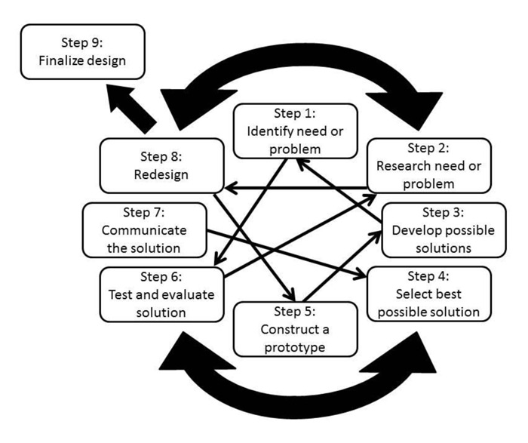
The steps of the
Engineering Design Process
Notes:
This modification of the Massachusetts EDP model emphasizes the nonlinear nature of engineering design—showing how it’s a little bit messier in the real world. This model indicates how designers may jump back and forth between some steps and possibly skip others entirely.
Image source: National Center for Engineering and Technology Education (NCETE) via LinkEngineering http://linkengineering.org/Discover/EngineeringDesign/5824.aspx

Slide 3
Assistive Artistic Device
Project Introduction
Problem Statement
Design an assistive device for a disabled person to hold a paintbrush, crayon, marker or colored pencil
Design Criteria: The device must:
Be safe
Be durable
Weigh less than 4 ounces
Cost less than $5 to make
Attach to a child’s hand or wrist
Be easy to put on and use
Hold a small paintbrush or drawing utensil

Slide 4
Assistive Artistic Device
Presentation Criteria
Create a one-slide presentation that includes:
Title, including the device name
List of the group member names
Brief description of the design task
Photo that shows the device being used
Labels and arrows to ID parts and materials
Total cost of the final device
Final teacher rating for the device

