Slide 1
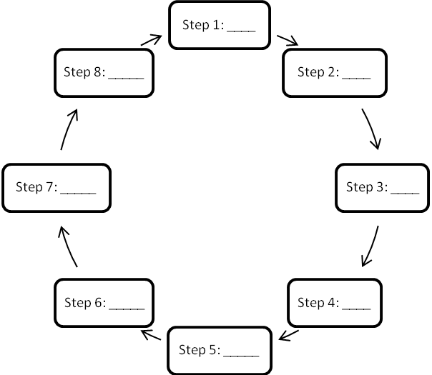
Engineering Design Process
The eight steps of the engineering design process are listed below, but they are NOT in the correct order.
Indicate the correct order by filling in the blanks of the circular diagram with the letter for each step.
A. Communicate the solution
B. Choose the best solution
C. Define the problem
D. Develop possible solutions
E. Redesign
F. Research the problem
G. Create a prototype
H. Test and evaluate
Notes:
EDP Pre/Post-Test for Design a Carrying Device for People Using Crutches activity > TeachEngineering.org

